Slide 1
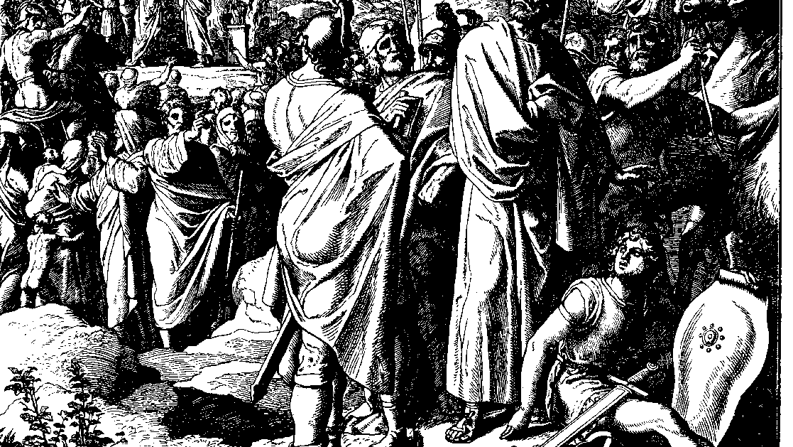
The Books of Chronicles
August H. Konkel
McMcaster Divinity College
October 2021

Slide 2
Punishment of Pride
session 20
august h. konkel

Slide 3
Succession of Joash (22:10–23:21)
Athalia’s attempt to end Judaean dynasty (22:10-12)
Coronation of Joash (23:1-11)
Execution of Athalia (23:12-15)
Covenant with priest, people and king (23:16-21)
Purification of worship
Joash installed as king

Slide 4
Reign of Joash (24:1-27)
Joash under high priest (24:1-16)
Purification of the temple
Funds raised through voluntary gifts
Joash under Judgment (24:17-27)
Compromise of temple for foreign influence
Killed Zechariah the son of the high priest
Hazael attacked to regain control of Transjordan
Joash killed in conspiracy

Slide 5
Reign of Amaziah (25:1–26:2)
Compromised faithfulness (vv. 2, 15-16)
Consolidation of Power (25:1-4)
War against Edom (25:5-16)
Alliance with Israel
Revenge of mercenary soldiers
Disastrous war against Israel (25:17-24)
End of Amaziah’s Reign (25:25–26:2)

