Slide 1
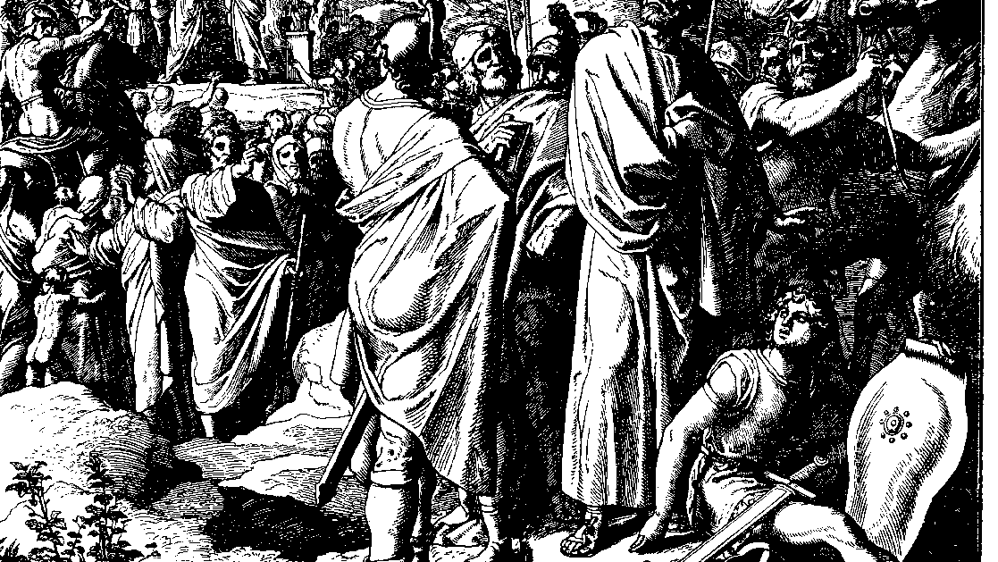
The Books of Chronicles
August H. Konkel
McMcaster Divinity College
October 2021

Slide 2
Israel in Chronicles
session 2
august h. konkel

Slide 3
Outline of Chronicles
Nation of Promise: 1 Chr 1-9:34
History of the Nation: 1 Chr 9:35-2Chr 36
Account of David: 1 Chr 9:35-29:30
Founding of the Kingdom: 1 Chr 9:35-20:8
Preparation for the Temple: 1 Chr 21:1-29:30

Slide 4
Outline of Chronicles (cont’d)
Account of Solomon: 2 Chr. 1-28
Reign of Solomon: 2 Chr 1:1-9:31
Israel until the Exile of the North: 10:1-28:27)
Hezekiah as a second Solomon: 2 Chr 29-36
Healing under Hezekiah: 29:1-32:23
Humiliation and Hope: 33:1-36:23

Slide 5
Nation of Promise (1 Chr 1:1-9:34)
Genealogies are a history of a people
Segmented genealogies describe a family (1 Chr 3:1-9 is the family of David)
Linear genealogies provide ancestry (1 Chr 3:10-14 covers 350 years of David’s sons)
Genealogies are fluid (relationships develop)

Slide 6
Israel among the nations (1 Chr 1:1-2:2)
Adam to Abraham (1:1-27); promise to Abram in v. 27
Adam to Noah (1-4)
Nations after the flood (5-23)
Semites (24-27)

Slide 7
Israel among the nations (1 Chr 1:1-2:2)
Abraham to Isaac (1:28-33)
Ishmael and Ketura
Ishmael descendants in western Arabia
Descendants of Ketura to far south and east Arabia

Slide 8
Sons of Isaac (34-2:2)
Esau (34-54)
Edom (35-37; cf. Gen 36:10-13)
Seir (38-42)
List of kings (43-51a)
List of chiefs (51b-54)

Slide 9
Sons of Isaac (34-2:2)
Sons of Israel (2:1-2)
Sons of Leah and Rachel
Sons of Bilhah and Zilpha

