Slide 1
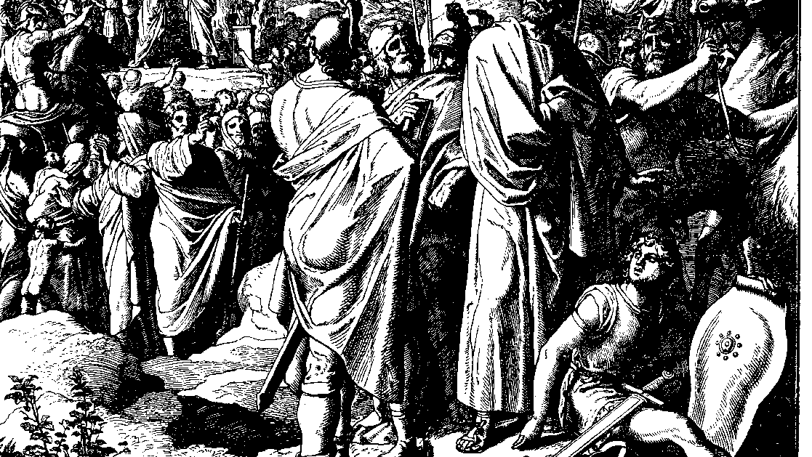
The Books of Chronicles
August H. Konkel
McMcaster Divinity College
October 2021

Slide 2
Preservation of the Promise
session 19
august h. konkel

Slide 3
Reign of Jehoram (21:1b–22:1)
Purge of the royal house (21:1b-7)
Subjugation of Edom (21:8-11)
Terrible Warning of Elijah (21:12-15)
Elijah translated during reign of Jehoshaphat (2 Kgs 2)
Jehoshaphat goes to war with Moab (2 Kgs 3
Raids of Philistines and Arabs (21:16–17)
Death of agonizing illness (21:18-22:1)

Slide 4
Reign of Ahaziah (22:2-9)
Son of Athalia, daughter of Jezebel
Reigned for one year
Alliance with Israel against Hazael
Killed in the purge of Jehu at Jezreel

