Slide 1
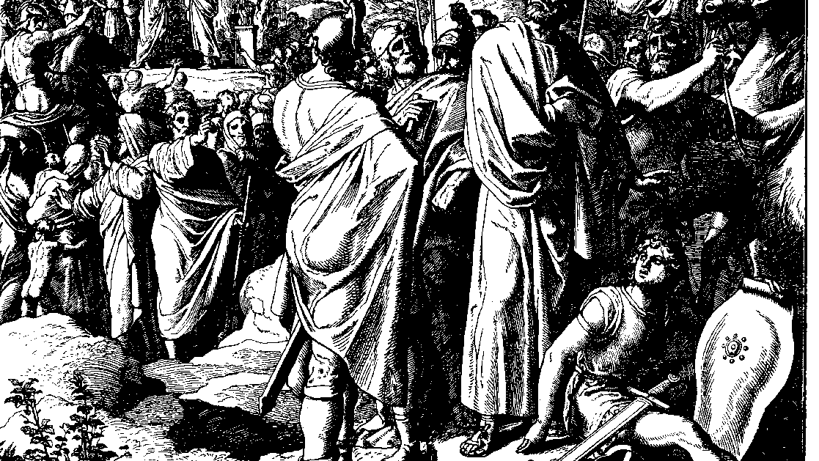
The Books of Chronicles
August H. Konkel
McMcaster Divinity College
October 2021

Slide 2
God Fights for Us (Holy War)
session 18
august h. konkel

Slide 3
Reforms of Jehoshaphat (17:1–19)
Instruction of the torah
Fortifications of cities
Collection of tribute

Slide 4
Jehoshaphat and Ahab (18:1–19:3)
Alliance to free Ramoth-gilead
Deception of Ahab
Death of Ahab
Warning of Jehu son of Hanani

Slide 5
Judicial Reform (19:4-11)
Judges appointed in fortified towns
Citizens had duties to the king and to God

Slide 6
Victory over Moab and Ammon (20:1-21:1a)
Lament of Jehoshaphat (seeks the Lord)
Assurance of Jahaziel (battle belongs to God)
Alliance is defeated by a Levitical choir
Conclusion of Jehoshaphat’s Reign (20:31–21:1a)

