Slide 1
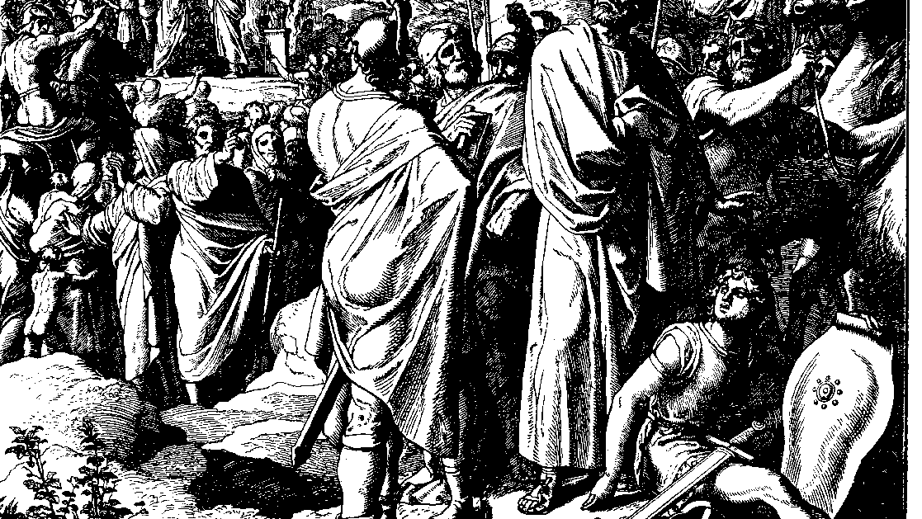
The Books of Chronicles
August H. Konkel
McMcaster Divinity College
October 2021

Slide 2
Compromised Faithfulness
session 17
august h. konkel

Slide 3
Righteous Reign of Asa (14:1b–15)
Reform and Security (14:1b-8)
Removal of places of foreign worship (Asherah)
Fortification of Judaean cities
Massive army
Victory over Zerah (14:9-15)
Nubian army under the command of Egypt in Philistine area
God wins the battle and Asa gains spoils

Slide 4
Revival under Asa (15:1-19)
Azariah’s Call to Revival (15:1-7)
Time frame of distresses is not given, possibly days of the judges
Must not be discouraged in challenging times
Covenant Renewal and Celebration (15:8-19)
Tribes of the north are included in revival
Ceremony during the feast of weeks (third month)
Removal of the queen mother

Slide 5
Disastrous End of Asa (16:1-14)
War with Baasha (16:1-6)
Chronological conundrum (cf. 1 Kgs 16:8) [35th year is long after Baasha]
Theology of the Chronicler
Hanani’s Sermon (16:7-10)
Fallacy of alliances
Exile of Hanani
Asa’s unending warfare

Slide 6
Disastrous End of Asa (16:1-14)
Death and Burial of Asa (16:11-14)
Asa dies of illness (judgment)
Buried with a “spice fire”

