Slide 1
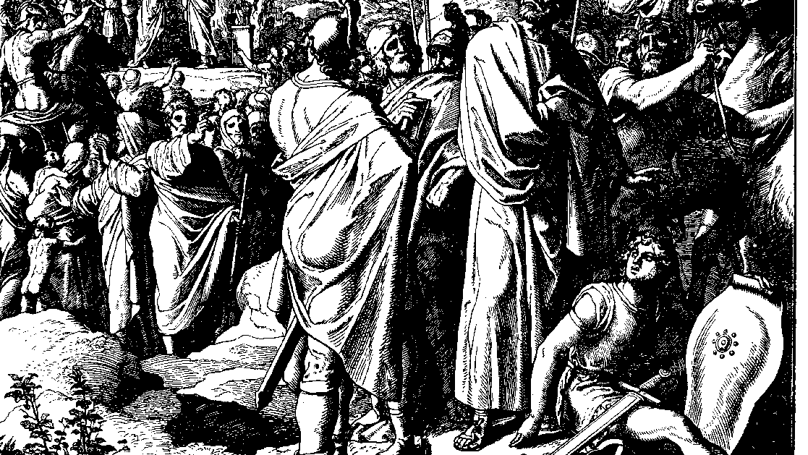
The Books of Chronicles
August H. Konkel
McMcaster Divinity College
October 2021

Slide 2
Conflicted Kingdom
session 16
august h. konkel

Slide 3
Outline of Chronicles
Nation of Promise: 1 Chr 1-9:34
Founding of the Kingdom: 1 Chr 9:35-20:8
Preparation for the Temple: 1 Chr 21:1-29:30
Reign of Solomon: 2 Chr 1:1-9:31
Israel until the Exile of the North: 10:1-28:27)
Healing under Hezekiah: 29:1-32:23
Humiliation and Hope: 33:1-36:23

Slide 4
Reign of Rehoboam (10:1–12:16)
Division of the Monarchy (10:1–11:4)
Return of Jeroboam
Reversal of the affirmation of David (v. 16)
Adoram was stoned when he attempted to enforce conscripted labor
Shemaiah the prophet averts war with Israel

Slide 5
Reign of Rehoboam (10:1–12:16)
Establishment of Rehoboam’s Rule (11:5-23)
Fortified cities of Judah
Blessing of a large household

Slide 6
Shishak’s Invasion (12:1-16)
Punishment for ‘abandoning the torah’
Repentance brought about through Shemaiah
Conclusion of Rehoboam’s Rule

Slide 7
Reign of Abijah (13:1–14:1a)
Preparations for War (13:1-3)
Speech of Abijah (13:4-12)
Rash scoundrels prevailed over inexperienced Rehoboam (v. 7)
Jeroboam is to blame for dividing ‘kingdom of Yahweh’ (v. 8)
Judgment of Jeroboam (13:13-20)
Abijah restores northern border cities (Bethel) to Judah
Jeroboam dies in divine judgment
Conclusion of Abijah’s Rule (13:21–14:1a)

