Slide 1
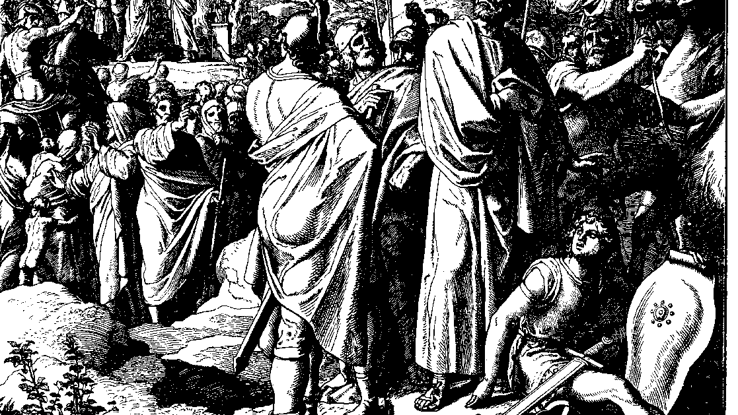
The Books of Chronicles
August H. Konkel
McMcaster Divinity College
October 2021

Slide 2
Kingdom of Solomon
session 15
august h. konkel

Slide 3
Military and Labor Provisions (8:1-16)
Economic and Military Activities with Lebanon and Syria (8:1-6)
Conscripted labor (mas) of non-Israelites (8:7-10)
Temple Worship at feast of Tabernacles (8:11-16)

Slide 4
Grandeur of Solomon’s Kingdom (8:17–9:31)
Maritime Activities at the Gulf of Aqaba (8:17-18)
Exchange with the Queen of Sheba (9:1-12)
Royal Pageantry (9:13-20)
Ceremonial Shields
Elevated throne of six steps and platform
Commercial and Military Trade (9:21-28)
Tarshish ships are a large cargo ship
Large cavalry and trade in horses with Egypt
Epitaph (9:29-31)

