Slide 1
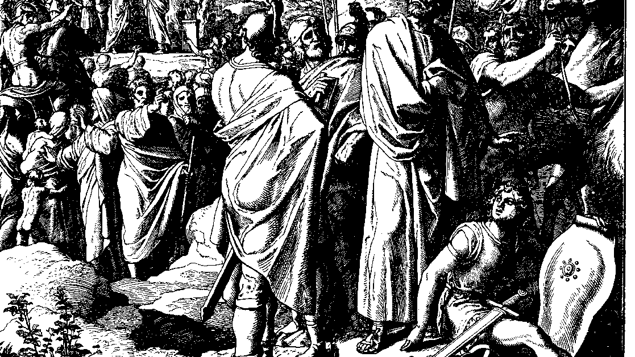
The Books of Chronicles
August H. Konkel
McMcaster Divinity College
October 2021

Slide 2
The Divine Presence
session 14
august h. konkel

Slide 3
Installation of the Ark (5:2–6:11)
Priests place the ark in the most holy place
Darkness symbolizes the holy
Placing the name indicated rule

Slide 4
Poem of God’s Dwelling
The Lord made manifest his sun in the heavens.
He has chosen to dwell in deep darkness,
Saying, “Build my house!”
A house fitting for you yourself,
That you may abide in a new way. (3 Reigns 8:53; cf. 1 Kings 8:12-13)

Slide 5
Temple as a Representation of Creation
They feast on the abundance of your house;
You give them drink from your river of delights.
For with you is the fountain of life;
In your light we see light. (Ps 36:8-9)

Slide 6
Function of the Temple in Worship
Lift up your hands in the sanctuary,
And bless Yahweh.
May Yahweh bless you from Zion,
Maker of heaven and earth. (Ps 134:2-3)

Slide 7
Dedication Prayer (6:12-40)
Confession of temple function
Temple is not God’s space (6:19)
Dwelling of God refers to the rule of God

Slide 8
Dedication Prayer (6:12-40)
Heaven is my throne,
and the earth is my footstool.
Where is the house you will build for me?
Where will my resting place be?
Has not my hand made all these things,
and so they came into being? (Isa 66:1-2)

Slide 9
Prayer for God’s Blessing (6:41-42)
Chronicler’s own conclusion of Solomon’s petitions
Prayer for the promises of God: Ps 132:8-10, Isa 54:3

Slide 10
Consecration and Vision (7:1-22)
Divine presence and dedicatory ceremony (7:1-10)
Vision of warning and exhortation (7:11-22; n.b. v. 14)

