Slide 1
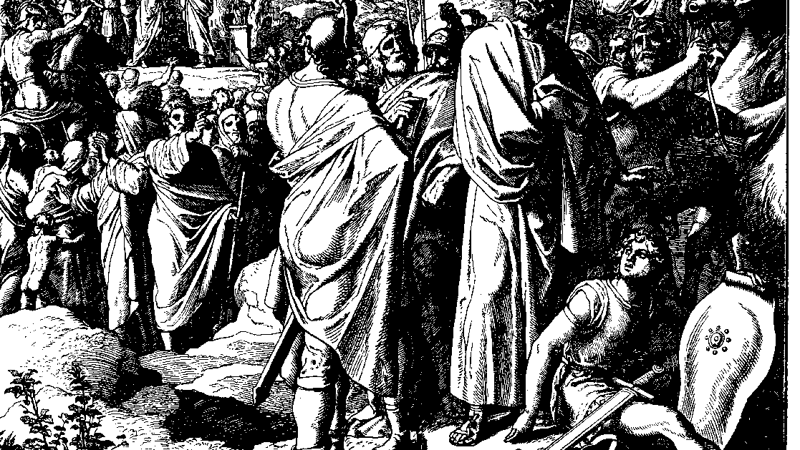
The Books of Chronicles
August H. Konkel
McMcaster Divinity College
October 2021

Slide 2
Solomon Becomes King
session 12
august h. konkel

Slide 3
Public Charge to Solomon (28:1–29:9)
Charge to the Assembly (28:1-10)
Solomon is chosen to rule on the throne of kingdom of God
Kingdom of God is established forever
Transfer of the Temple Plan (28:11-21)
Contributions for the Temple (29:1-9)

Slide 4
Solomon Made King (29:10-30)
Blessing of David (29:10-20)
Installation of Solomon (29:21-25)
Great festival for all Israel
Solomon is king on the throne of God
Conclusion of David’s Reign (29:26-30)

