Slide 1
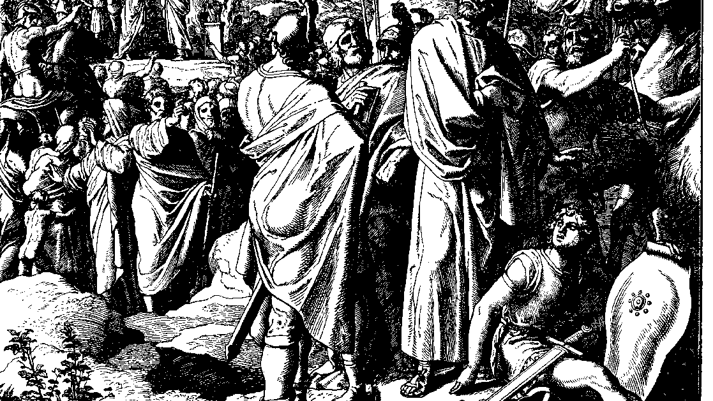
The Books of Chronicles
August H. Konkel
McMcaster Divinity College
October 2021

Slide 2
Leaders of Israel
session 11
august h. konkel

Slide 3
Organization of Levitical Officials (23:1–26:32)
Divisions of Levites (23:1-32)
Divisions of priests (24:1-31)
Musicians (25:1-31)
Gatekeepers (26:1-19)
Officers and Judges (26:20-32)

Slide 4
Divisions of Levites (23:1-23)
Heads of ancestral houses organized for service (1-5)
Service of the temple 24000
Judges and officers 6000
Gatekeepers 4000
Musicians 4000

Slide 5
Divisions of Levites (23:1-23)
Three traditional families enumerated (6-23)
Total of 24 families (Gershon 10, Kohath 9, Merari 5)
Daughters through their husbands retained their positions (Mahli, v. 22)

Slide 6
Levitical Duties (23:24-32)
Temple brings about change in the role of Levites
Levites serve alongside the priests in temple function (v. 28)
Care for storerooms, purity of sacred objects, sacred bread, music

Slide 7
Divisions of Priests and Levites (24:1-31)
Twenty-four rotations of priests, each served two weeks (1-19)
Update of the previous list of Levites (20-31; cf. 23:3-23)

Slide 8
Organization of National Officials (27:1-34)
Military Commanders (27:1-15)
Tribal Officers (27:16-24)
Civil Administrators (27:25-31)
Royal Council (27:32-34)

