Slide 1
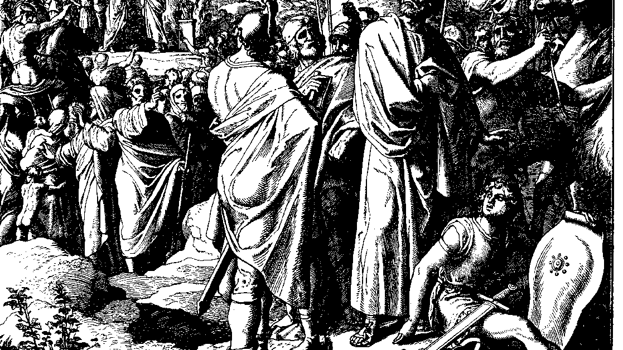
The Books of Chronicles
August H. Konkel
McMcaster Divinity College
October 2021

Slide 2
Temple Location
session 10
august h. konkel

Slide 3
Outline of Chronicles
Nation of Promise: 1 Chr 1-9:34
Founding of the Kingdom: 1 Chr 9:35-20:8
Preparation for the Temple: 1 Chr 21:1-29:30
Reign of Solomon: 2 Chr 1:1-9:31
Israel until the Exile of the North: 10:1-28:27)
Healing under Hezekiah: 29:1-32:23
Humiliation and Hope: 33:1-36:23

Slide 4
Designation of the Temple Site (21:1–22:1)
Census of David (21:1-7)
Who tests David? (cf. 2 Sam 24:1)
Who is Satan?
Judgment and Confession (21:8-17)

Slide 5
Designation of the Temple Site (21:1–22:1)
Purchase of Threshing Site (21:18-25)
Divine Response and Choice of Temple Site (21:26–22:1)
Signs of the dedication of the tabernacle in the wilderness
Tabernacle at that time was at Gibeon

Slide 6
Charge to Build the Temple (22:2-19)
Provision of Temple Materials (22:2-5)
Charge to Solomon (22:6-16)
Charge to Leaders of Israel (22:17-19)

