Slide 1
Hebrew Alphabet
Chapter 1

Slide 2
Introduction to Biblical Hebrew
Tanak
Semitic Languages: Akkadian, Ugaritic, later Aramaic
Canaanite Languages → Paleo-Hebew (1400-1000 BC) → Biblical Hebrew → Mishnaic Hebrew (ca. 200 AD) → Talmudic Hebrew(ca. 500 AD) Modern Hebrew revived and used by the state of Israel 1947/48.
Pointed (Niqqud) and unpointed
Masoretic Text (ca. 500-1000 AD) –Aramaic Square script

Slide 3
’Ālef אָ֫לֶף
א
Silent ’

Slide 4
Bêt בֵּית
ב
b as in boy b

Slide 5
Gîmēl גִּ֫ימֵל
ג
g as in girl g

Slide 6
Dālet דָּ֫לֶת
ד
d as in dog d

Slide 7
Hē (hay) הֵא
ה
h as in hay h

Slide 8
Vāv וָו
ו
v as in vote v

Slide 9
Zayin זַ֫יִן
ז
z as in zebra z

Slide 10
Ḥēt (hate) חֵית
ח
ch as in Bach ḥ

Slide 11
Ṭēt (tate) טֵית
ט
t as in tap ṭ

Slide 12
Yôd יוֹד
י
y as in yet y

Slide 13
Kaf כַּף
כ ך
k as in key k

Slide 14
Lāmed לָ֫מֶד
ל
l as in lamb l

Slide 15
Mēm (mame) מֵם
מ ם
m as in map m

Slide 16
Nûn נוּן
נ ן
n as in net n

Slide 17
Sāmek סָ֫מֶךְ
ס
s as in sit s

Slide 18
‘Ayin עַ֫יִן
ע
(silent) ‘

Slide 19
Pē (pay) פֵּא
פ ף
p as in put p

Slide 20
Ṣādê צָ֫דֵי
צ ץ
ts as in hats ṣ

Slide 21
Qôf קוֹף
ק
k as in key q

Slide 22
Rēsh רֵישׁ
ר
r as in red r

Slide 23
Śîn (seen) שִׂין
שׂ
s as in sit ś

Slide 24
Šîn (sheen) שִׁין
שׁ
sh as in shout š

Slide 25
Tāv תָּו
ת
t as in tap t

Slide 26
Whole Alphabet
א ב ג ד ה ו ז ח ט י כ ל מ נ ס ע פ צ ק ר שׂ שׁ ת

Slide 27
Acrostics: How do you translate this?
Prov 31 [→Ruth] (Lamentations, Pss. 25, 34, 37, 111, 112, 145)
אֵשֶׁת־חַיִל מִי יִמְצָ֑א וְרָחֹק מִפְּנִינִים מִכְרָהּ׃ ¹¹ בָּטַח בָּהּ לֵב בַּעְלָ֑הּ וְשָׁלָל לֹא יֶחְסָר׃
¹² גְּמָלַתְהוּ טֹב וְלֹא־רָ֑ע כֹּל יְמֵי חַיֶּיה׃ ¹³ דָּרְשָׁה צֶמֶר וּפִשְׁתִּ֑ים וַתַּעַשׂ בְּחֵפֶץ כַּפֶּיהָ׃ ¹⁴ הָיְתָה כָּאֳנִיּוֹת סוֹחֵ֑ר מִמֶּרְחָ֗ק תָּבִיא לַחְמָהּ׃
Psalm 119
Gematria: Matt 1 DVD = 14

Slide 28
Paleo-Hebew Alphabet (1400-1000 BC)

Slide 29
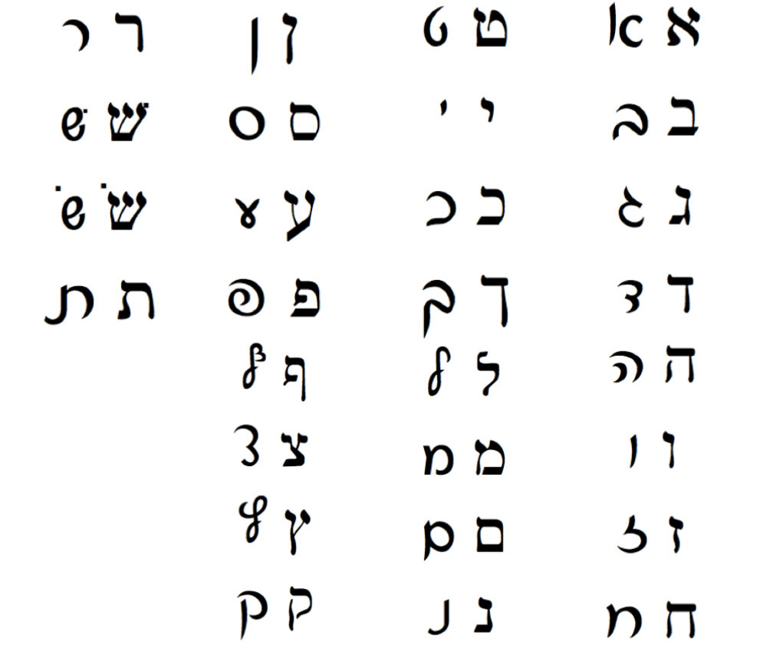
Modern Cursive Script

Slide 30
Easy to Confuse Letters
כ ב ך ן ז ו
נ ג ס ם מ
ר ד צ ע
ה ח ת שׂ שׁ

Slide 31
Five Final Letter Forms:
Regular form: כ מ נ פ צ
Final form: ך ם ן ף ץ
כְּךָ כ / ך
מֵם מ / ם
נוּן נ / ן
פֶּה / כַּף פ / ף
מִצְוָה / אֶ֫רֶץ צ / ץ

Slide 32
B^{e}gad k^{e}fat Letters (בגד כפת )
ב= b, בּ=b ג =g, גּ =g, ד=d, דּ=d,
כ =k, כּּּּּ=k, פ=p, פּ=p, ת=t, תּ=t.
3 Pronunciation shifts:
בּ = b as in boy ב = v as in vote
כּ = k as in key כ = ch as in Bach
פּ = p as in put פ = f as in fit or ph in phone

Slide 33
Gutturals:
ע ח ה א and sometimes ר

Slide 34
Tricky Transliterations:
ע = ‘ א= ’
ח=ḥ ה=h
ת=t ט=ṭ
שׁ=š שׂ=ś צ=ṣ ס=s
ב= b, בּ=b etc.

Slide 35
Speaking/hearing Hebrew
Shalom (שָׁלוֹם) = peace, hello/good-bye

