Slide 1
1 Kings: Solomon
United Monarchy: Saul, David, Solomon 1000BC

Slide 2
Transition of power
Adonijah’s bid for throne
David’s failure as a father (I Kgs. 1:6)
Nathan & Bathsheba plot (1:11ff)
Bathsheba’s son: Solomon (1:31, 33)
Solomon’s absence from the narrative: others speak for and about him 1:19, 26, 32, 38, he only seems to speak in “official” contexts

Slide 3
Solomon’s beginnings
David’s advice: law of Moses, Davidic covenantal “if” 2:2ff
David’s hit list (1 Kgs 2)
Joab (2:5, 28ff),
Shimei (2:5, 37ff),
Adonijah [Abishag] (2:17ff)
Solomon already wise before dream (2:6, 9)

Slide 4
Solomon at Gibeon
Dream at Gibeon: 3:4f
Solomon’s humility—child? (3:7)—how old is Solomon?—already has a 1 year old son by an Ammonitess (contra 11:1f)
Wealth -- why?—ironic reading, Marxist reading and difficulty with wealth, destruction of the heroic/achievement
Long life – why? (3:14)
Solomon’s wisdom victory: 2 women & a baby (3:24)

Slide 5
Solomon’s wisdom
Proverbs man -- (4:30ff) comparison cross cultures?
Pharaoh’s daughter 3:1; 7:8; 9:24; 11:1; Prov. wisdom=woman, no temple, Proverbs 22 –Amenemope, wisdom builds her house (9:1ff)
Temple construction: (ch. 5-6) –Hiram’s help—floating cedars of Lebanon, ships
Solomon’s dedication prayer (8:27)
on great achievements ( pride or worship)
Solomon’s fame: queen of Sheba (10:1, 6)

Slide 6
Solomon’s folly
Solomon’s folly: Pharaoh’s daughter (3:1) + wives/concubines (11:1) –married before king to Ammonitess???-Rehoboam 41 (1 Kgs 14:21).
Is it possible to turn away? (11:4, 9), Is Eccles. The answer—he turns back?
On wisdom and folly: reading Solomon narrative 1 Cor. 1:27; 8:1 knowledge puffs up
Kingdom torn: 11:11f—but for David’s sake
North: Jeroboam—ten tribes (Israel/Ephraim)
South: Rehoboam—Judah

Slide 7
Kings: the Divided Monarchy
Israel/Ephraim: 931-722 BC → Assyria [Nineveh]
Judah: 931- 586 BC → [Babylon]

Slide 8
The Split--1 Kgs 12
Rehoboam’s mistake: young versus old
On advice receiving & learning to listen (12:6ff); Adoniram 12:18
Northern Kingdom = Israel
All bad kings
Southern Kingdom = Judah—David’s descendants: 2 winners: Hezekiah, Josiah

Slide 9
Jeroboam (931-910 BC) 1 Kgs 12-14
Golden calves: Dan & Bethel

Slide 10
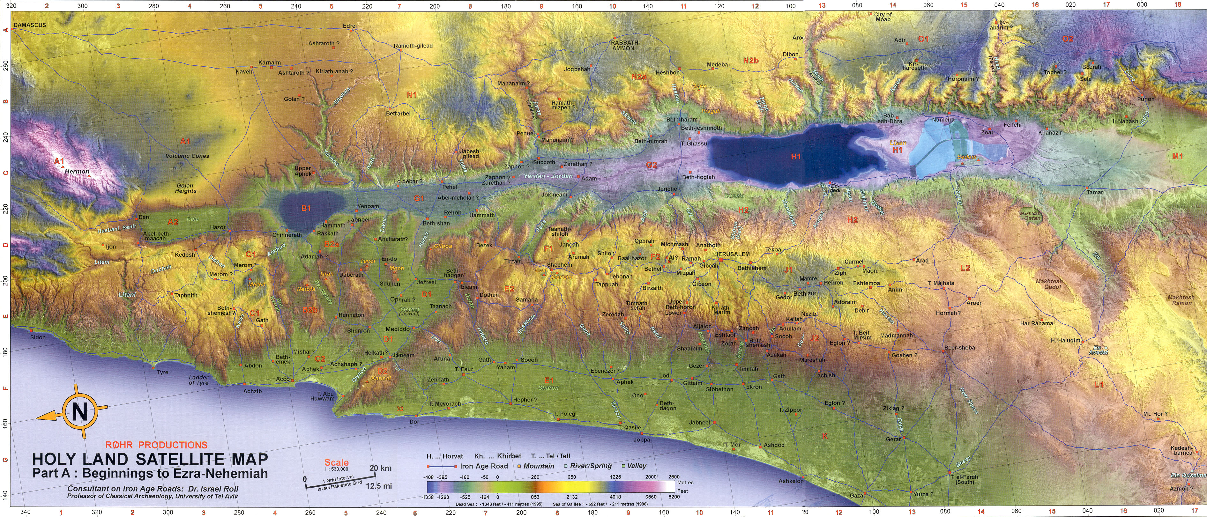
Israel-whole

Slide 11
Jeroboam (931-910 BC) 1 Kgs 12-14
Golden calves: Dan & Bethel 12:27ff
Epithet: taught Israel to sin
Spectacular prophecy: 1 Kgs. 13:2 Josiah
Critical response: Prophecy post eventu
Short range confirmation (altar split)
Short range verifying long range prophecy
Son dies 14:12 fulfilling short prophecy guarantees long—line will end

Slide 12
Ahab (874-853 BC) I Kgs 16:29ff
Omri (Ahab’s father) moved capital to Samaria, Mesha & Moabite stone (830 BC) mentions him as do Tiglath-pileser’s annals in Assyria (732 BC) “house of Omri”
Son, Ahab marries Jezebel and Baal worship grows in Israel
Elijah the troubler of Israel (I Kgs 18:17f)
Projection: my problem projected onto others
Battle on Mount Carmel: Elijah versus Prophets of Baal

Slide 13
Israel-whole

Slide 14
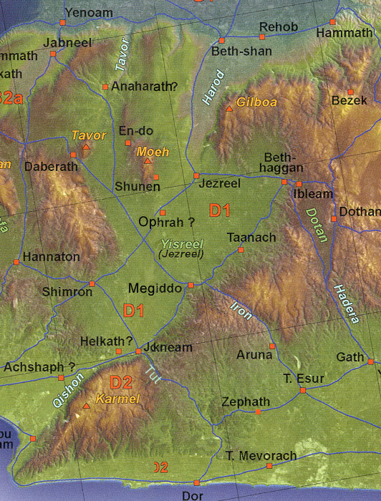
Jezreel Valley

Slide 15
Elijah Prophets of Baal
On Mt. Carmel--storms
Elijah’s call for a decision (18:21)
Baal: rain god (Ugarit)
Is sarcasm ever appropriate?
18:27 yes
Why did they cut themselves?
Greatest victory of his life

Slide 16
Jezebel’s power over Elijah
Her threat 19:2
His (Elijah’s) flight I Kgs 19:3
On a godly man (19:5)
Depression? On highs and lows
Wishing for death?
Existential aloneness 19:10f
Elijah’s 3 anointings to do: Hazael, Jehu, Elisha

Slide 17
Naboth’s vineyard (I Kgs 21:1-16)
Do good guys always win? -story line
Religious evil (21:10, 24-25)
God’s judgment (21:19)
Ahab repents (1 Kgs 21:27-29)
Grace notes

Slide 18
Dates to know
Abraham: 2000 BC
David 1000 BC
Israel Deported/scattered to Assyria 722 BC
Judah Deported to Babylon 586 BC
Return and End of OT (Ezra/Nehemiah/Malachi) 400 BC

Slide 19
Elisha stories (2 Kgs 6-7)
Translation of Elijah (2 Kgs 2)
Not twice as much -- on mentors 2:9
Chariots of fire –translation of Elijah 2:11
“Children” at Bethel (2 Kgs 2:23f)
2 Women each according to her need
Multiplying oil (4:1-7) used what she had
son given, woman’s pleading & boy raised 4:18-37

Slide 20
Elisha Stories (cont.)
Healing of Naaman the Syrian of Leprosy in the Jordan River
Gehazi’s greed (2 Kgs 5)

Slide 21
Founding of the Samaritans
10 Tribes scattered; poor left in land, foreigners hauled in to intermarry = Samaritans. “Fear of God” in 2 Kgs. 17

Slide 22
Prophets:
800’s: Elijah, Elisha
700’s: Isa, Micah, Amos, Joel, Jonah, Obadiah
600’s: Nahum (Nineveh), Jeremiah
500’s: Jer.; Daniel. Ezek. (Babylon)
400’s Post-exilic: Zecharaiah, Haggai, Malachi

Slide 23
Major OT lessons
God is awesome (dynamic, moving history, entering people’s lives)
People have a choice on how they respond to good & evil
Choices have consequences
God’s grace is incredible
Immanuel – God with us -- big theme

Slide 24
Messianic OT
Gen. 3:15 proto-evangelium: Woman’s seed crush the head of serpent
Gen. 12:3: all nations blessed through our father Abraham
2 Sam. 7:14 Messiah to be a son of David and an everlasting kingdom—God will build him a house

Slide 25
Messiah as fulfillment of prophecy
Malachi 4:5 Elijah coming again
Micah 5:2 born in Bethlehem
Isa. 9:6f unto us a child is born
Isa. 7:14 virgin with child, Immanuel
Zech 9:9 entering Jerusalem on a donkey
Psalmic foreshadowing: Ps. 22 My God, My God, why

Slide 26
Messiah as fulfillment of prophecy
Suffering Servant: Isa. 53:3 despised and rejected suffering servant
Pierced and beaten Isa 53:5f
Isa. 53:7 silence
Isa. 53:9 criminalize with wicked (pl.) yet rich (sing.) in death
Hope beyond the grave –resurrection 53:10-12
Immanuel has come→ hope beyond the grave, living life in God’s presence and for his glory (chief end of man)

Slide 27
Joy to the World
Joy to the world, the Lord is come!
Let earth receive her King;
Let every heart prepare Him room,
And Heaven and nature sing,
And Heaven and nature sing,
And Heaven, and Heaven, and nature sing

