Slide 1
Judges
In those days there is no king in Israel everyone did that which was right in his own eyes, Judges 21:25

Slide 2
Meet the Judge
Deut 16:18-20 establish justice / no bribes
Military deliverers leading Israel to war
Judges 2:16
Tribal or regional Chieftan: ruled for 40 years

Slide 3
Participation of each Generation
Joshua took the all the land (Jos 21:43-45)
Tension with Judges:--not really (Jud 1:20f)
Conditionality of the covenant (Jud 2:20-22), some left to test Israel
Cross generational communication (Jud 2:10f)—teach each generation warfare (3:1f)

Slide 4
Main Themes
Need for a king (Judg 17:6)—Judah pushed (northern tribes negative)
Main theme: everyone did what was right in his own eyes (Judg 21:25)

Slide 5
Judges cycle: ROC DR
Rebellion: people did evil in eyes…
Oppression: sold into the hands of ...
Cry: people cry to the LORD
Deliverance: God raises up a judge
Rest: judge ruled for x years

Slide 6
Ehud: mini cycle
Rebellion 3:12 “once again Israel did evil in eyes of Lord”
Retribution 3:12b-14 sold into hands of Eglon fat king of Moab (geography)
Relents: Ehud’s left-handed weirdness is God’s opportunity
Escape 3:23f—NLT—latrine escape
Rest: 3:30 – 80 years

Slide 7
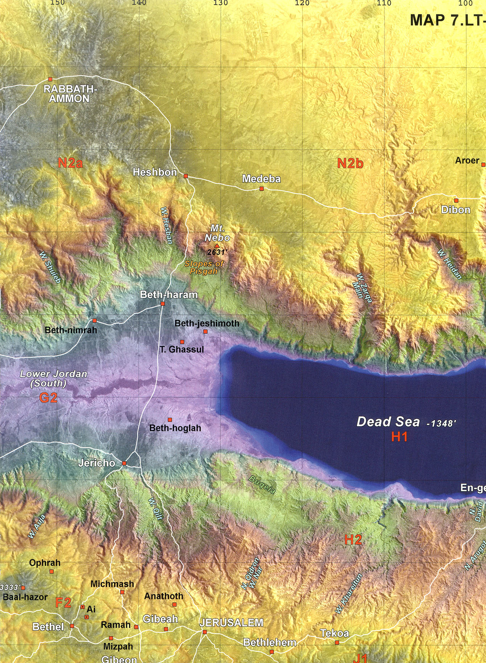

Slide 8
Deborah: women in leadership?
Jud 4:4: she’s married, she’s a leader, she tells men what to do, she’s approved by God.
How do you explain that?
How do you fit that with 1 Cor 14:33f and 1 Tim 2:11-15

Slide 9
Answers?
God uses women when there are no good men. --Barak whimpish
Deborah is an exception. Exceptions prove the rule
Progressive revelation: Paul’s statements tell the way it should be
Gal. 3:28 principle; Eph. 5:21—Scriptural dissonance-cultural issue
Competence and gifts not gender (Huldah, Philip’s prophesying daughters)

Slide 10
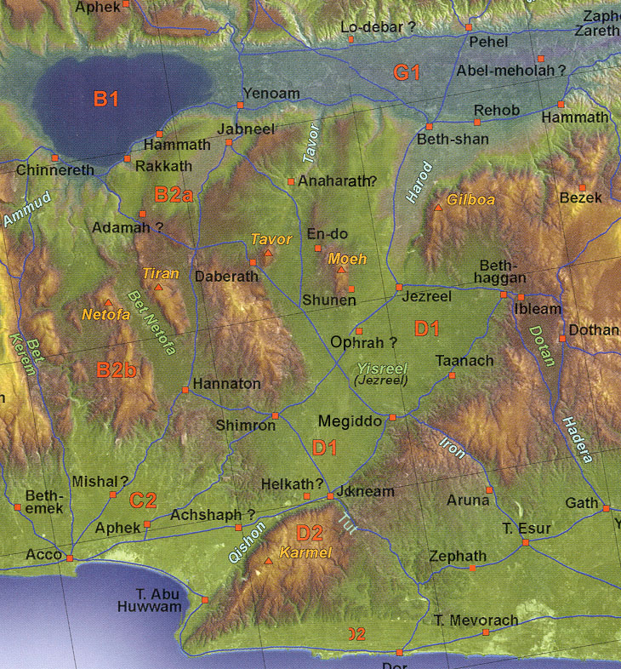
Galilee-Jezreel

Slide 11
Woman with a hammer
Sisera (Jabin of Hazor’s general) - Jael

Slide 12
Gideon and Midian: Judg 6
Threshing in the wine press? (6:11)
Call of Gideon: (6:12f)—Jeru-Baal 6:31f
Gideon’s fleece and determining God’s will → testing (6:36ff)

Slide 13
Avdat Winepress
http://biblicalelearning.org/avdat-360-images/

Slide 15
How does one determine God’s will?
Guidelines: Is it moral/divine will?—Is it good?
Pursue passions, gifts/calling / needed?
Wisdom (self, culture, risks, potential)
Open/closed doors, --opportunities
Open/closed hands—divine guidance
Family/friend’s advice
Multiplicity, flexibility, preparedness

Slide 16
Gideon and Midian: Judg 7
God’s getting the victory
Too many warriors (7:2)
Eliminating fearful (7:3)
Drinking separation (7:5f → 300):
few good warriors?
7:19ff Sword of the Lord and Gideon

Slide 17
Are there fables in the Bible? (Jud 9)
Jotham’s fable to Abimelech (killed 70 brothers): love it (9:6ff) trees elect a king
Thornbush rule: On power’s ability to corrupt
First Kingship attempt—Abi-melech?

Slide 18
Jephthah
Does God ever say the opposite of what He means? Jud 10:14
On using context to interpret
On making great vows to God (11:30f; cf. Eccl 5:2-6)
Does Jephthah smoke his daughter?
–virgin, mourn not marrying, ”or”, Num. 8:11 dedicating (Rom. 12:1f), Heb 11/1 Sam. 12:11
Shibboleth // sibboleth--Ephraimites versus Gileadites (12:6)

Slide 19
Samson (Σαμψων: Sampson)

Slide 20
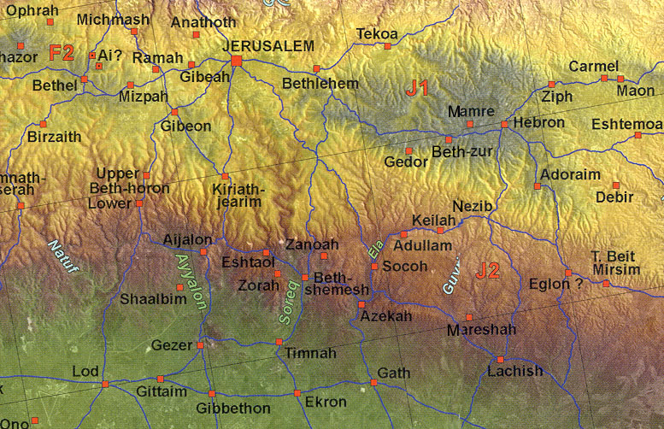
Judah-Heartland

Slide 21
Samson
Rebellion (13:1) -- retribution (13:1)
Three women in Samson’s life

Slide 22
Wife from Timnah (Jud 14)
Parents inability to say “no”
Samson’s riddle
Why are tears so powerful?
How not to treat a woman 14:16, 18
What is the relation of the Spirit to people in the OT? (Jud 14:6, 19)

Slide 23
Samson: cont.
Prostitute of Gaza: hauls walls (Jud 16:1)
Delilah (Jud 16)
Are love and lust always so easily separated?
On nagging: why does it work?
Samson’s stupidity?—time compression
Archaeology and Philistine temples
How could Samson be a hero? (Heb 11:32)

Slide 24
Tale of 2 Levites
Danite Levite (Jud. 17 and 18): Micah –idol, Levite stays, → goes with Danites idolatry center in the north; 18:29-31
Levite’s concubine (Judg. 19)

Slide 26
Dan High Place
http://biblicalelearning.org/dan-360-images/

Slide 27
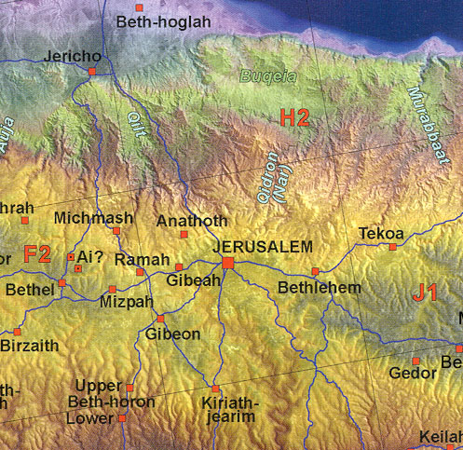
Jerusalem-Surroundings

Slide 28
Benjaminite tribal destruction
Story line: Levite to Bethlehem (Jud. 19)
Concubine raped and killed
Levite’s divide and conquer call for help
Benjaminite’s get wives—Jabesh Gilead + Shiloh dancers
Why does the Bible include such stories?

Slide 29
Ruth: Green Fried Steele Magnolias
Series of Tragedies
Famine→ Moab
Death husband and sons
Male roles in book
Use of Names in Ruth: Elimelech, Mahlon, Kilion, Naomi/Marah 1:20, Ruth, Boaz
On friendship: Naomi & Ruth discourse 1:16 (loyalty to Naomi/YHWH)

Slide 30
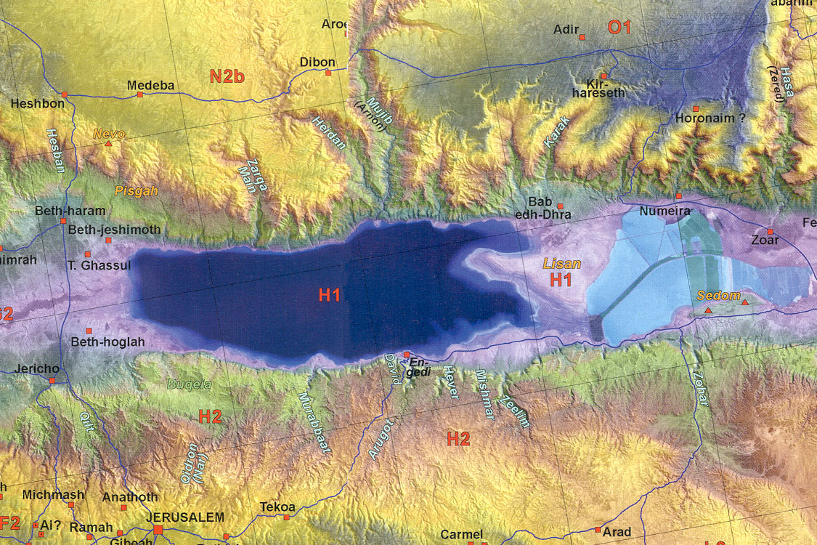
Dead Sea
Moab
Moab

Slide 31
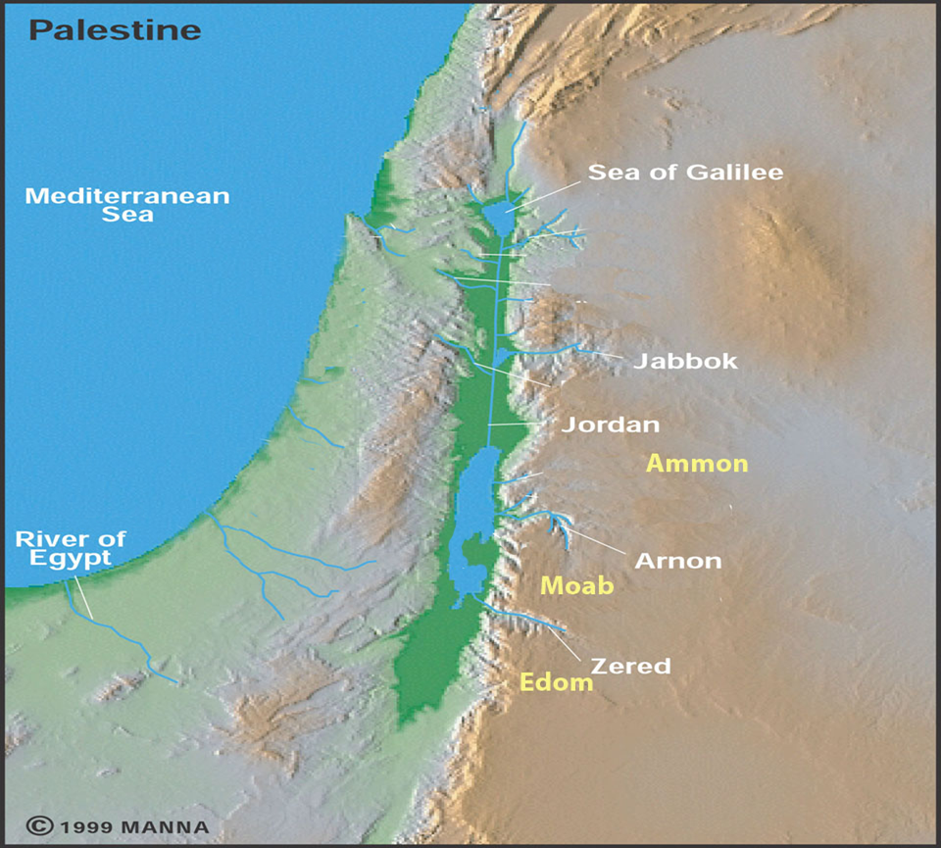
Bethlehem

Slide 32
Ruth: cont.
Do circumstances effect one’s view of God (1:20)
Gleaning machine: ch. 2
Boaz male role model: kinsman- redeemer, threshingfloor values
Levirate marriage, city gate
Benjaminite destruction / Ruth why?
Genealogy of David→Jesus

