Slide 1
Joshua: Taking the Land
3 Victories 2 Problems War

Slide 2
On nature of heroes
Transition of Leadership difficulties
God: the ever-present hero
Leader’s need for encouragement

Slide 3
Joshua the leader
Josh 1:6f: be strong and very courageous
Comp Moses: as I was with Moses…
Splitting waters Josh. 4:14
God hardens hearts of enemies 11:20
Holds up javelin to win 8:18 Ai
Victories put side by side ch. 12
Meets angel, take off sandals 5:15

Slide 4
Unity of Israel
All Israel (Josh 1:12f; 4:12) Reuben/Gad/ Half-Manasseh go with; 12 stones

Slide 5
Jericho
Why was the taking of Jericho such a big deal?
Location of Jericho

Slide 6
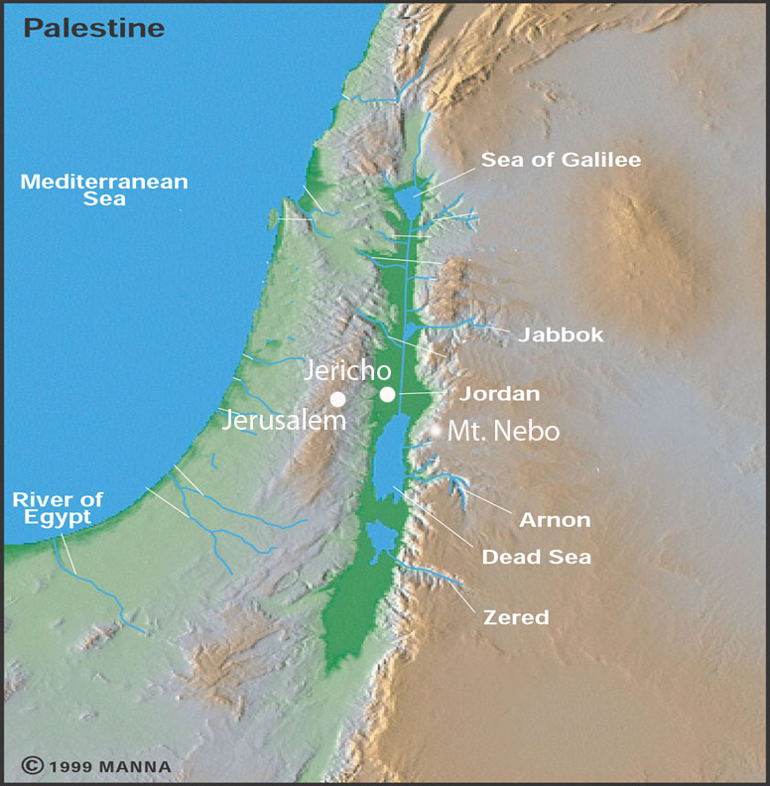
Israel-Topographical
King’s Highway
Coastal Highway

Slide 7
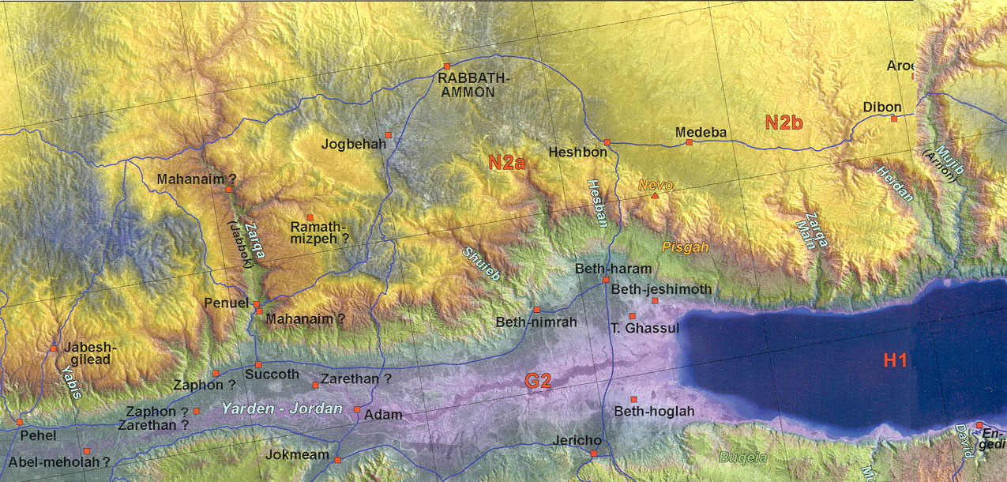
Ammon-PartA
E
N
S

Slide 9
https://faculty.gordon.edu/hu/bi/ted_hildebrandt/OTLit/IsraelVR/Jericho/Jericho_Pano2VR/index.html

Slide 10
Jericho
Rahab: heroine: Josh. 2:1-5
Is it okay to lie if have good reason? Where else have we seen this?
Rahab’s confession, Josh. 2:9ff
What do we learn about women and war? 2:15f

Slide 11
Jordan River
Width/depth
Crossing: miracle or natural phenomena: Josh. 3:16
Why 12 stones?—unity 4:8
“There till this day”? (Josh 4:9; 6:25)
3 Gilgal things: Passover, circumcision, manna stopped—etiology (5:9)

Slide 12
Walls of Jericho
Garstang– yes LB --1930’s
Kenyon – no LB only EB—1960-70’s
Bryant Wood – yes LB—1990’s
Archaeology = truth ?
Mount Ebal altar: Josh 8:30 yes/no?

Slide 13
Altar on Mount Ebal

Slide 14
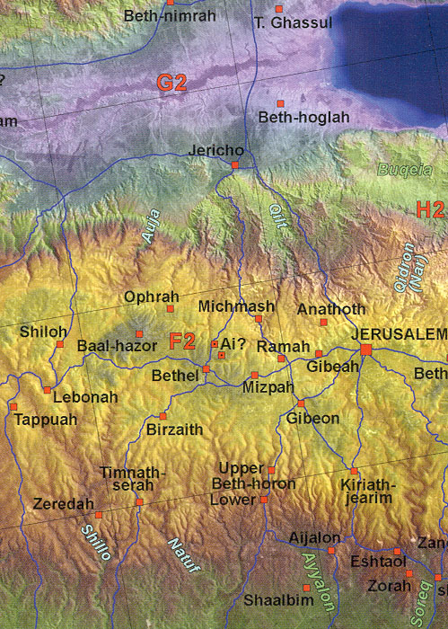
Benjamin

Slide 15
Southern Campaign
Gibeonites slickness (Josh. 9)
On marching all night and sun standing still (Josh. 10: 11ff)
What does the sun stood still mean?
Standing still --24 hrs extra (computer)
Silenced (cooled down)
Omen text (positioning) + Poetic Judg 5:20
What does it mean God listened to a man? (Josh. 10:14)

Slide 16
What is the book of Jasher?
Josh 10:13? Is the book of Jashar inspired? (cf. 2 Sam 1:18)

Slide 17
Northern Campaign
Josh 11:1, 4ff Jabin king of Hazor league

Slide 18
Israel-Topographical
Hazor

Slide 19
2 Problems:
Ai: Situation (Josh 7-8) Arrogance, First Loss (7:6f)
Problems: Achan’s sin—family sin? —social structure 7:14
Corporate Personality versus Individual
God predictable ... habituation rather than choice
“God is with us” assumption
They sin then Joshua blames God: 7:7
One sin effects community

Slide 20
Gibeonite deception
Situation—ruse 9:4f
Be careful of no-brainers 9:14 did not inquire of the Lord
Trust God in the uniqueness of each decision
Woodcutters and water bearers

Slide 21
Land division:
Four tribes to know
Ephraim, Benjamin, Judah, (Dan)
Six cities to know:
Jericho, Gibeon, Jerusalem, Bethlehem, Hebron, Beersheba

Slide 22
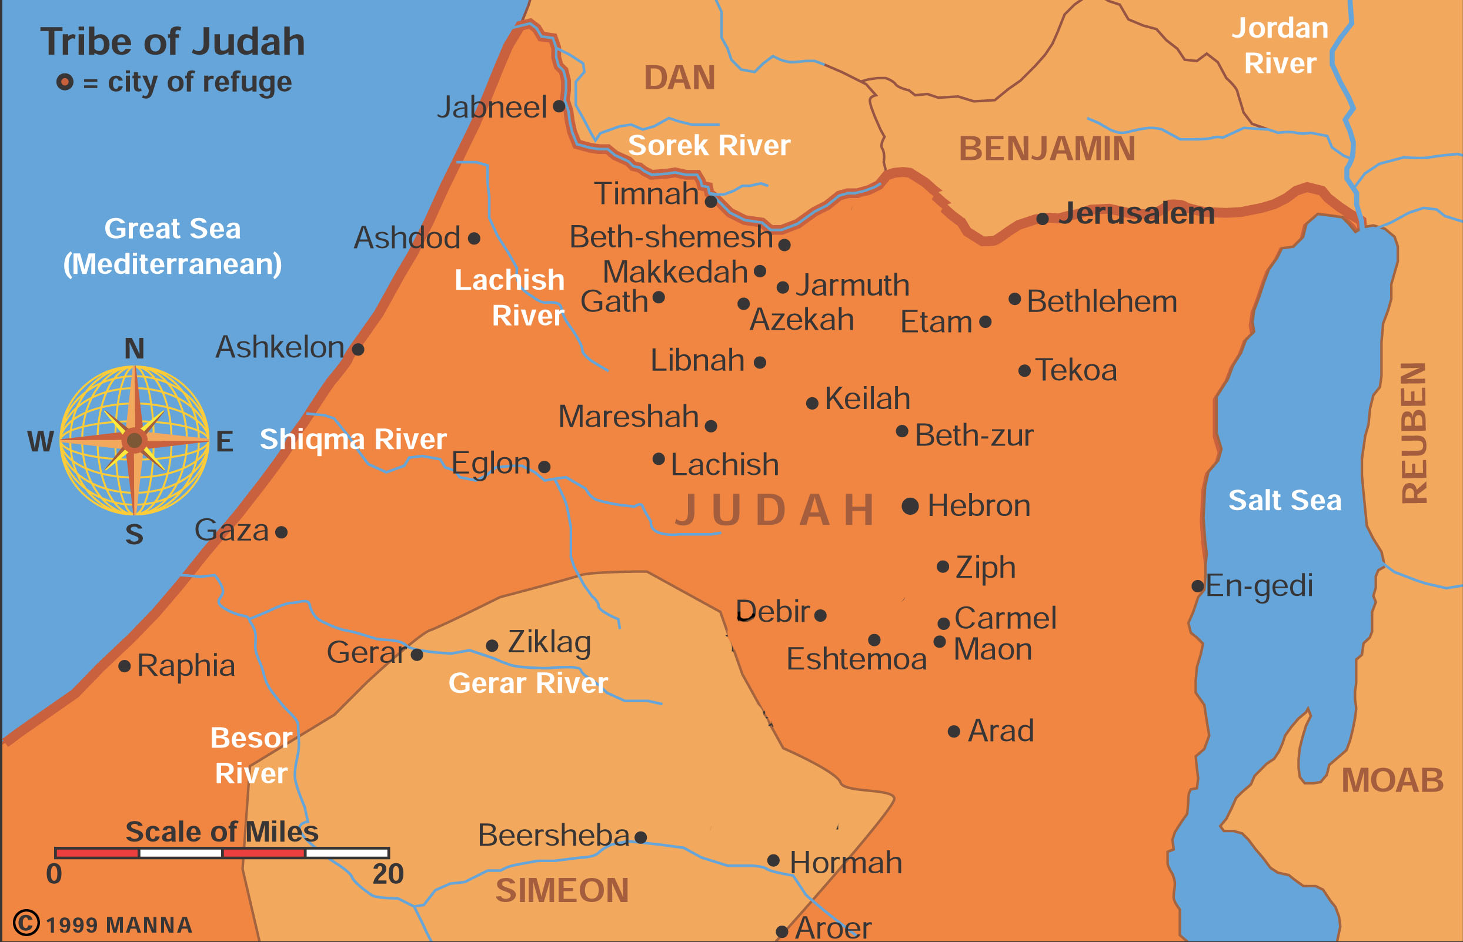
Tribal Map-Judah

Slide 23
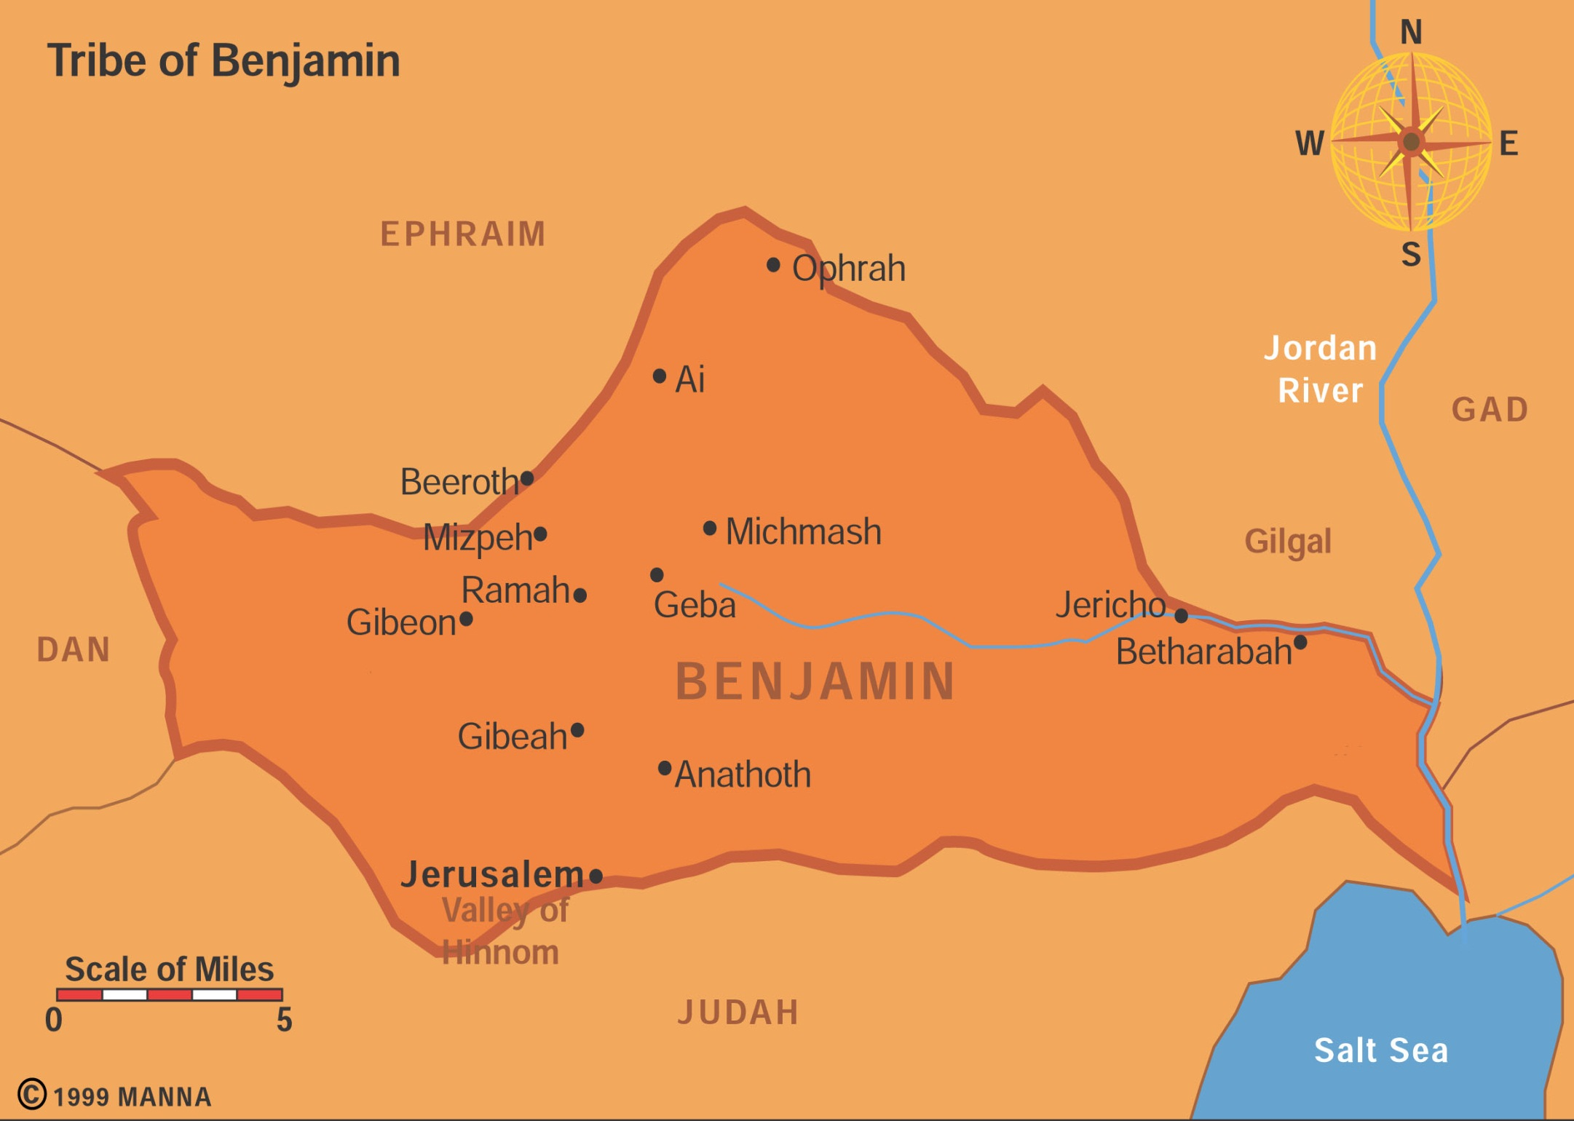
Tribal Map – Benjamin

Slide 24
Manasseh
Ephraim
Gad
Dan
Benjamin
Philstines
Reuben
Judah

Slide 25
Edwin Starr, War, 1970
https://www.youtube.com/watch?v=BW0AudMnw6g

Slide 26
How can a holy God kill babies?
Holy War: Herem (Deut 7; 20:1-20; Josh 6:21)—
Give peace a chance Deut. 20:10
Judgment on sin of Amorites (Gen 15:16; Deut. 9:5)—Lord hardened hearts so no peace treaty Josh. 11:19f
Leaving them in land would lead Israel into sin a la Judges –Deut. 20:18
Victory Rhetoric and hyperbole Josh 11:15, 23 – Lawson Younger
God’s life/death prerogative—innocent parties?
Rarely practiced: Jericho, Ai, Hazor…
Day of the Lord harbinger –warning
Not universal principle – special command by God
Prophet speaking for God directly

Slide 27
War: What is it good for?
What do you think of war? Is it ever legitimate?
What would you be willing to die for?
For what would you kill someone?
Can academics decide this issue?

Slide 28
War 4 views: Non-resistance
Mat 5:39: turn the cheek;
Peter uses sword rebuked Mat 26:52-54;
Love neighbor not = killing (?) [murder]
Separation of church and state (Jn 18:36 If my kingdom were of this world my servants would fight)
Christ’s dying for others example

Slide 29
Problem with Non-resistance
Dualism: spiritual / natural world; do you eat?
Dual citizenship
Other Scriptural remarks: Matt 10:34; Lk 22:35-38—I did not come to bring peace but the sword…
What if you saw someone being raped, would you not act forcefully? Dialogue?

Slide 30
Pacifism:
Mic 4:3 beat swords into plowshares
Kingdom of God: lion laying down with calf (Isa 11:6-9) Shalom rules
Passive resistance: dying / self-sacrifice
Possibility of individual calling (diversity)—nation?
Beware of flag burners, spitting on Vets
Caution Prophets of Shalom: Jer 6:14/ 8:11; 23:16f

Slide 31
Just War theory
Go to war for good cause
What constitutes a good cause?
Joshua – some wars are right—Some say: War is never the answer! Is that true?
Eccles 3:8 -- a time for war
God portraying himself as a warrior (Exod. 15:3; Ps. 18:8ff.).
Jesus too (SM versus Revelation on Scripture twisting, Rev. 19:15, 21 ) —J. Wallis: sword out of mouth=justice/peace?
How does one fight a good war?

Slide 32
Reasons for going to war
Biblical reasons for going to war:
land --Og
divine command --Jericho
moral violation --Gibeah & concubine
insult --Rabbah & David
defense -- Sennacherib
oppression -- Gideon
helping others – Gibeonites & Joshua

Slide 33
Preventive War
First strike to avoid latter conflict or prevent damage
What do you think?
Future problems: nukes in cities; killer robots, biological blackmail, no national entity—ideological groups of individuals not nations

Slide 34
Final Thoughts: TANAK
Beginning Prophets-Josh 1:8, Kethubim Ps. 1:2 same idea- TaNaK
Do not let this book of the Law depart from your mouth; meditate on it day and night, so that you may be careful to do everything written in it. Then you will be prosperous and successful. Josh 1:8
Ps. 1:2 but whose delight is in the law of the LORD, and in his law he meditates day and night.

Slide 35
Shechem
http://biblicalelearning.org/shechem-360-images/

Slide 36
Final words
Covenant renewal at Shechem 24:25f—adds to the Book of the Law as an approved prophet of God.
Final call to decision: 24:15 as for me…

