Slide 1
Exodus: the way out (Greek)
“These are the names” Hebrew Title

Slide 2
Exodus Background
What is Exodus about? 5 things
Birth & Call of Moses
10 Plagues of Egypt
Crossing of the Reed Sea
Tabernacle
Giving of the Torah/Law/Covenant at Sinai

Slide 3
Oral or written?
Who wrote this material? Was it just oral?
Exod. 17:14;
Exod. 24:4, 7
John says … Jn. 1:17 For the Law was given through Moses…(Jn 7:19-22; Lk. 24:44)
How is it viewed elsewhere in the Bible? Metaphor for deliverance, great redemptive act in OT –on prayer 2:23f

Slide 4
Exodus Echoes in the Prophets/NT
Prophets
Hos 11:1: When Israel was a child, I loved him, and out of Egypt, I called my son. But the more I called Israel the further they went from me.
Jesus comes out of Egypt --Mat. 2:15
Passover→ Lord’s supper 1 Cor. 5:7
Plagues in Revelation echo

Slide 5
Exodus in Psalms
Great Hallel (Ps 114-118; cf. 78)
When Israel came out of Egypt,
the house of Jacob from a people of foreign tongue, Judah became God’s sanctuary, Israel his dominion. The sea looked and fled, the Jordan turned back; the mountains skipped like rams, the hills like lambs.

Slide 6
What is Egypt like?
Gift of the Nile
History
Old Kingdom: Pyramid age 2700-2100 BC
First Intermediate Period: 2160-1991 BC
Middle Kingdom: 1991-1670 BC arts & literature
Second Intermediate Period: 1670-1568 BC: Hyksos
New Kingdom: 1568-1085 BC; Expansion to Euphrates– Third Intermediate Period – David/Solomon

Slide 7
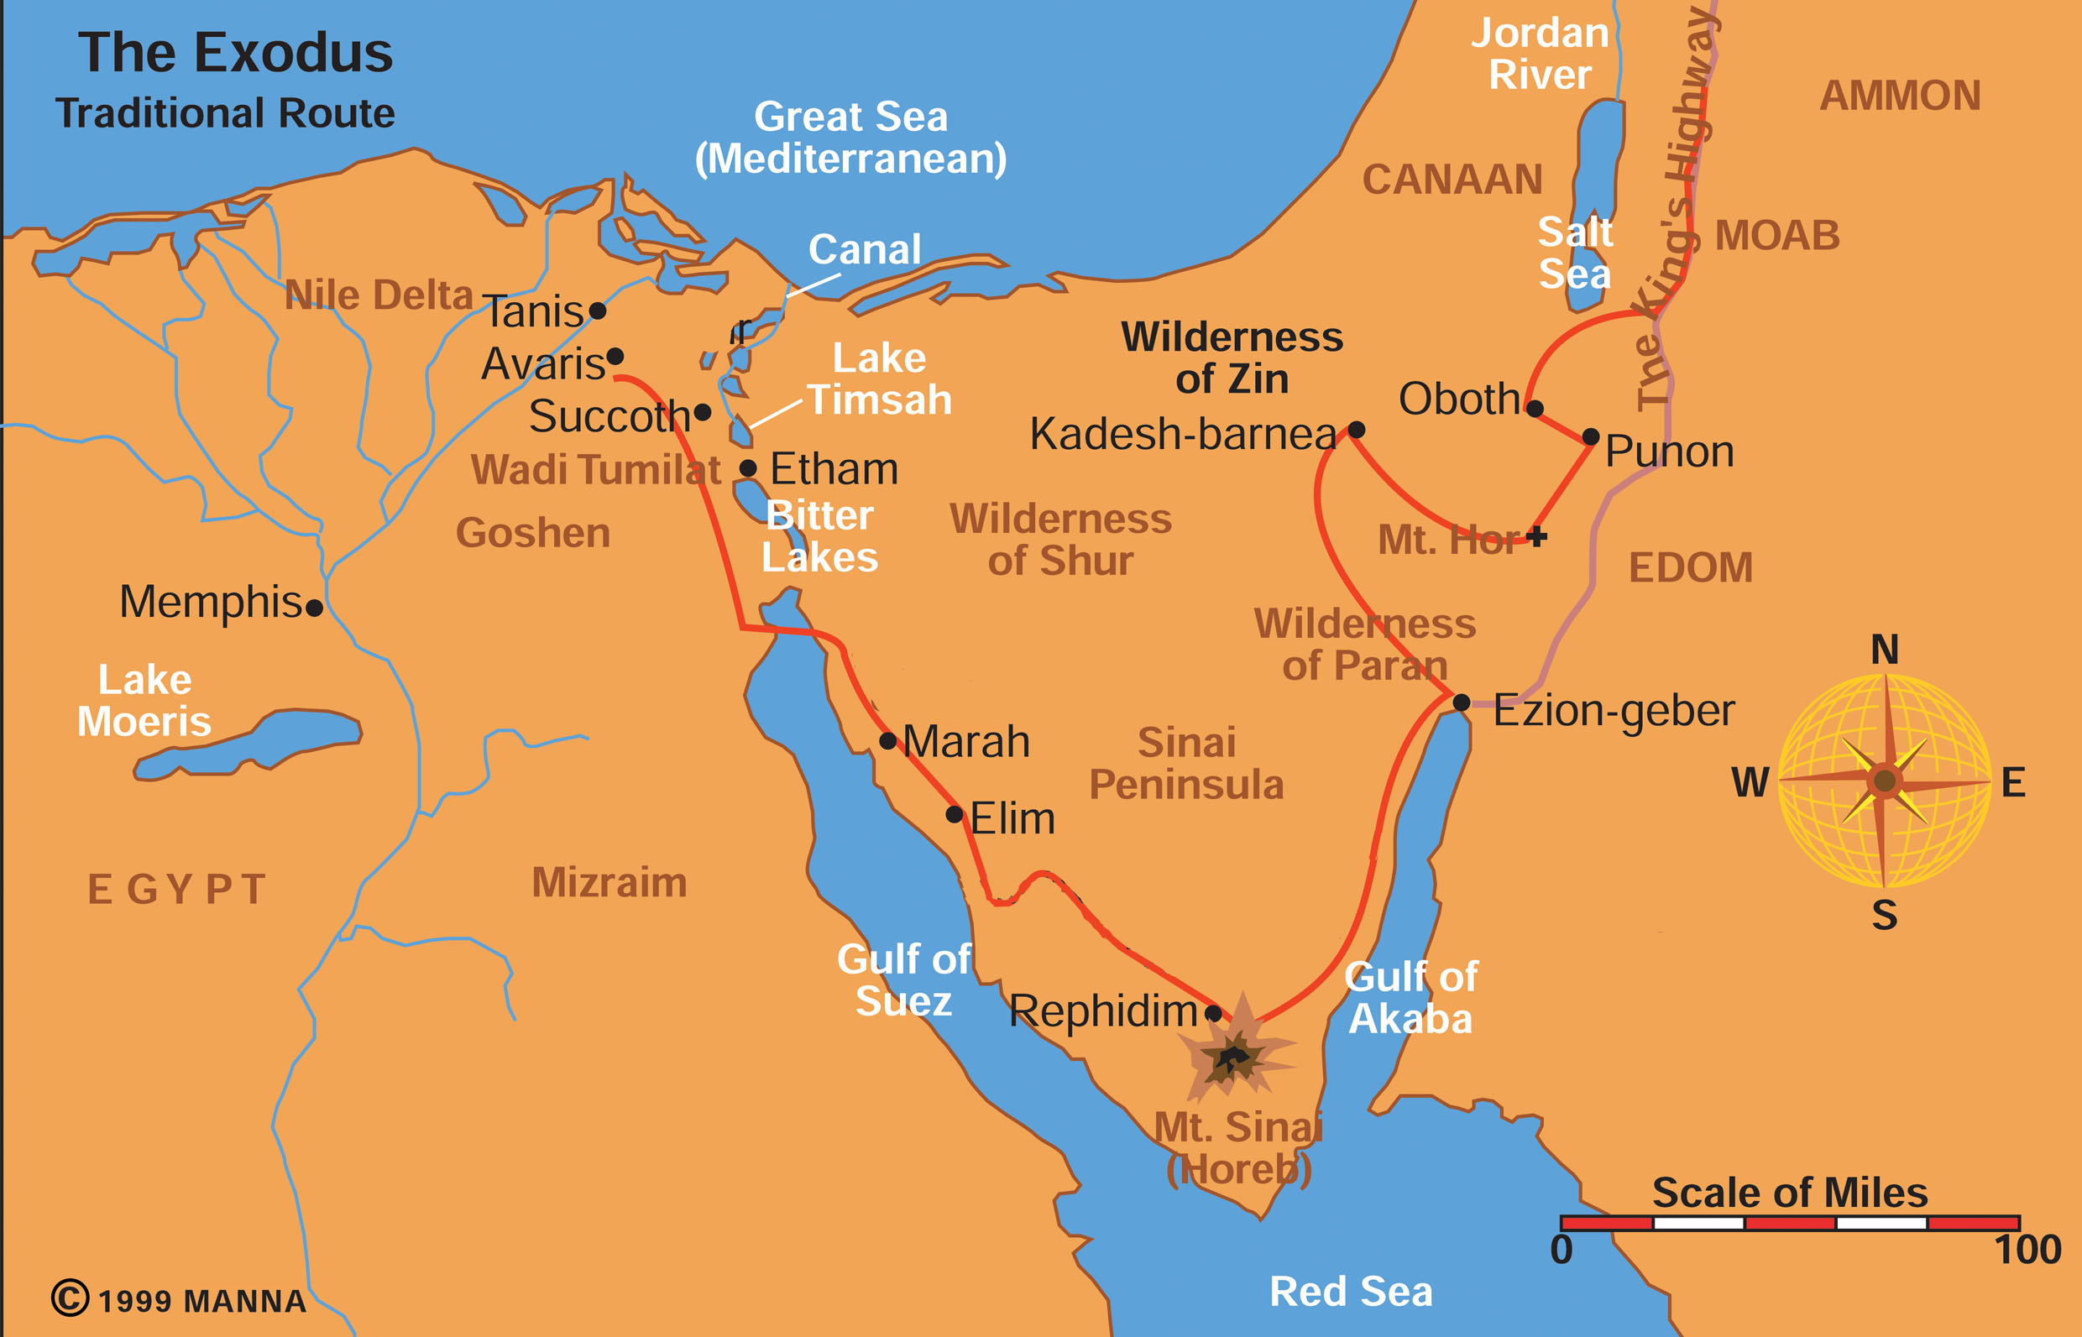
The Exodus

Slide 8
Pharaoh’s ways of dominating Jews
Multiplying of the seed and Pharaoh as resisting God’s plan (Ex. 1:7-9)
Taskmasters (Exod 1:8-14)
Midwives (Exod 1:15-21)
Is it okay to lie sometimes? Altruistic sinning
Does God bless liars? -- to save lives, war
Does this mean total relativism?
Throw them into the river (Ex. 1:22)
Moses—drawn out (Ex. 2)

Slide 9
Moses: 3 Stages of life
Pharaoh’s daughter’s son (40 yrs)
Desert Shepherd in Midian (40 yrs)
Deliverer (40 yrs) Leading in Desert

Slide 10
What was Moses relationship to God like?
Call of Moses, Exodus--response to prayer
Is it ever alright to resist God’s will?
No status (Exod 3:11)—I am with you
No message (Exod 3:13)—YHWH/LORD
No belief (Exod 4:1) –What’s in hand?
No gift of speech (Exod 4:10)—Who made
Send someone else (Exod 4:13)—Aaron, prophet? –7:1f

Slide 11
Burning bush: angel or God?
Exod 3:2-6
On holy ground & holy things

Slide 12
What does “I am” mean?
On names in ANE
Self-existent one: I am what I am (need nothing)
Sovereignty view: I will be what I will be (you will see)
Covenant keeper: I am what I said I would be (what I promised to the patriarchs)

Slide 13
Exod 6:3 contradicts Gen 49:18?
Critical Scholarship: Sources/Editors
J = Jehovah writer (ca 850 BC)
E = Elohim writer (ca 750 BC)
D = Deuteronomist writer (620 BC)
P = Priestly writer (ca 450 BC)
Simple to complex evolution
Solution: meaning of name YHWH not known—covenant keeper

Slide 14
What is happening with Zipporah in Ex. 4:24-26
Who did God attack?
Why did God attack?
Similar stories: Jacob, Balaam

Slide 15
Circumcision of Gershom: 3 approaches
B.S. Childs: Boy sick, boy circumcised, etiological tale on importance of circumcision
Walter Kaiser: Moses sick; boy circumcised → obedience
Ross: Moses sick, boy circumcised, Zipporah (adolescent circumcision); she earlier refused neonate circumcision; she’s upset and leaves – feet? Last plague

Slide 16
When did Moses cross the Reed sea?
1445 BC (Early date) – 1 Kgs 6:1—480 before Solomon; Jud. 11:26—300 years before Jephthah, Merneptah Stele—1200 Israel in land, Amarna Letters—1400 BC
1260 BC (Late date)—Rameses—1200 BC, Burn levels (Lachish), 40 yrs. → 20 yrs. Generation—shrink 480 yrs. to 240

Slide 17
How many left Egypt?
Exod 12:37; 38:26; Num. 2:32=600,000 men
600,000 men
600,000 women
1,200,000 children (+ cattle)
-------------------------------
2, 400,000 How much is this? water, food, wadis, mid-wives; taking Canaan
Shrinking the number: eleph=clans or chiefs, hyperbole, later number inserted
How do you deal with conflicts like this?

Slide 18
Plague Cycles:
3 Reasons for Plagues:
Judgment on gods of Egypt (Exod 12:12)
That they/you may know that I am YHWH (Exod 7:5, 17; 8:22; 10:2...)
Lex talionis: Ex. 4:23: My firstborn, therefore your firstborn

Slide 19
Does God harden people’s hearts?
Who hardened Pharaoh’s heart?
God hardened it (Exod 4:21; 7:3)--judgment
Pharaoh hardened it (8:15, 32; 9:34f)--rebellion

Slide 20
10 Plagues Chart
Snake Blood Frogs Gnats Flies Livestock Boils Hail Locusts Dark Firstborn
God’s Announcement
God’s Instruction
Execution
Magicians
Pharaoh Responds
Moses & God
Pharaoh hardens
Ten Plagues

Slide 21
Magicians transition
Opposition to Moses/Aaron
Finger of God—gnats—testimonies of victory of YHWH -8:19
Separation of Goshen—8:22f

Slide 22
First Passover
Events & meal (Exod. 12)
Passover Lamb—blood placement, no bones broken
Bitter herbs
Unleavened bread—leave in haste
Children participate—12:26; 13:14
NT: Lord’s supper—the lamb, bread and the cup—new Exodus, Jesus 1 Cor 5:7

Slide 23
Where did Moses cross the Reed sea?
God leading Israel by pillar cloud/fire; not through way of the Philistines-13:21, 17
Middle -- Bitter Lakes/Timsah
Red Sea
Arabia?—Gulf of Aqaba
God as warrior: 14:14; 15:3
First reference to the kingdom 15:18; 19:6

Slide 24
The Exodus
Way to the
Philistines

Slide 25
Sinaitic Covenant
Moses on Mount Sinai—covenant founding the nation
Kingdom of priests, holy nation 19:6
Breaking of the Covenant – 2 Tablets 32:19 – 10 commandments (Ex 20/Dt 5)
Abrahamic, Mosaic/Sinaitic, Davidic Covenants

Slide 26
Sabbath?
Why do we keep 9 out of 10 commandments?
Compare Ex. 20:11 (creation basis) and Deut. 5:15 (deliverance from Egypt basis).

Slide 27
Sabbath Principles
Remembrance principle
Rhythm/cycles principle
Renunciation of work as master
Refreshment
Role model—God rested
Re-evaluation
Rom 14:5 grace

Slide 28
Tabernacle
Emmanuel concept: Ex. 25:8 “Then have them make a sanctuary for me, and I will dwell among them.”
Heaven on earth? Return to Garden of Eden?
More tenting with his people
Drawing

Slide 29
Tabernacle
150 ‘
North
45’
Holy of
Holies
Lamp
75’
15’
Altar of Incense
East
Ark
Laver
Altar of
Burnt Off
Table of Shew Bread Bread of the Presence

Slide 30
On 3 things in/with the ark
Ten Commandments
Aaron’s budding rod
Pot of manna—What is it?

Slide 31
Exod 21:22f on fetus as human?
Woman injury -- punishment – eye for eye—lex talionis—case law “if”
Apodictic law—thou shalt not…
Premature birth -- with baby injury -- pay fee
Implications for fetus as human?
Does intent have any effect?
Is the point here abortion?

