Slide 1
Jacob: Strife & Deception

Slide 2
Jacob: Childhood Images (Gen. 25:23f)
How can God choose one and reject another before they were born?
Predestination versus free will debate, --antinomy
If a person is not chosen are they responsible?
Is that fair?
What do you think? SSQ

Slide 3
Name’s of the two boys
Birth -- heel grabber (Gen 25:26): Jacob
Birth -- Edom (Red) (Gen 25:30): Esau—hairy, Harry
Esau’s view of birthright bartering (Gen 25:32, 34)
Nuzu laws

Slide 4
Deception of Isaac
What are some of the problems with parental favoritism? Gen. 25:28
Jacob’s lie & Isaac’s blessing—Gen. 27
Power of father’s word
What were the consequences of Jacob’s lie?
Isaac –27:33 shaken
Esau—27:41 plots death of brother
Rebekah—27:46 –daughters’-in-law
Jacob—20 years flees to Haran

Slide 5
Meeting God at Beth-el (Gen 28)
What did Bethel mean in Jacob’s spiritual development?—Jacob’s ladder--ziggurat?
On personal encounter 28:10ff Covenant renewal
Abraham’s God now becomes his
Cf. College years
Why a Memorial stone (28:18)? Beth-El
Pre-law tithe (28:22) SSQ

Slide 6
Working your way through marriage
Jacob & well--7 yrs for Rachel (Gen 29:17-20)
Not odd in Nuzu customs
What separates between love and lust? 29:20
Why is Jacob’s wedding night ironic? 29:25
Jacob is a polygamous? Is that okay? Separating the Normative/non-normative in historical narratives (descriptive/prescriptive)
Why does God open Leah’s womb? (Gen 29:31) –weak eyes (refined/lovely/soft)--positive?-Is 47;1

Slide 7
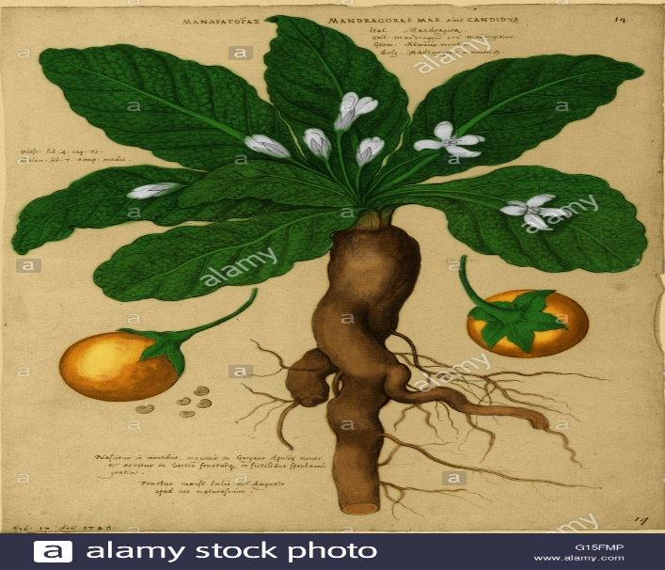
What’s with the mandrakes?
Why was Rachel so interested in getting the mandrakes? (Gen. 30:14ff) (Mandragora officinarum)—human form roots
Who gives Rachel her son? (Gen 30:22)
Who is Rachel’s first son?
Who is her last son?

Slide 8
Leaving Haran & Laban
How and why did Rachel steal the family gods? (Gen 31:30, 35)
Inheritance – Nuzu laws (probably not)
Blessing/travel protection/children
Metonymy: 31:42 // 31:53 Fear of Isaac

Slide 9
WFW angel wrestling match
Who did Jacob wrestle with? (Gen 32:24ff)
Should we pray when we’re in trouble?
Why did Jacob name the place Peniel? 32:30
Why did the angel change Jacob’s name?
Jacob --
Israel – 32:28
Does Gen 32:32 show it is written by a later editor?

Slide 10
Meeting Esau
On meeting family years later
Jacob’s lie—importance of geography
Esau -- Edomites -- Obadiah – Herod
Summary, Significance, Questions

Slide 11
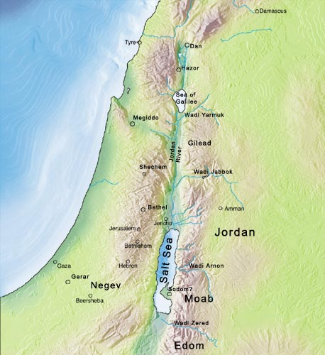
Israel-Patriarchal-Genesis Fertile Crescent

Slide 12
Jacob Returns to Bethel (Gen 35)
Gets rid of foreign gods (Gen 35:4)
Reiterates name change (Gen 35:10)
God reiterates covenant (Gen 35:11)
Rachel dies having Benjamin near Bethlehem (Gen 35:19)—Jesus’ birth Mt. 2:18 (Rachel/Jeremiah [31:15; exile]/Jesus)

Slide 13
Jacob and the twelve tribes
Leah: Reuben, Levi, Simeon, Judah, Issachar, Zebulon, Dinah
Zilpah: Gad, Asher
Rachel: Joseph, Benjamin
Bilhah: Dan, Naphtali

Slide 14
Dinah /Judah & Tamar
Why is it Christians ignore Gen 34 & 38?
Raping of Dinah -- story line (Gen. 34)
Story Line—Judah and Tamar (Gen. 38)
Why did God put these two stories in the Bible?
Elimination of older brothers
Focus on Joseph by contrast
SSQ

Slide 15
Joseph narrative
Comparison of Joseph and Jacob stories
Supremacy of younger
Family strife and deception— sibling rivalry, parental favoritism (Gen 37:3)
20 yr separation from family
Prosperity in foreign land
Reunion with estranged brothers

Slide 16
Joseph and wisdom
Story line: Where have I heard this before?
Resisting wild woman—Gen. 39:7-9
Dreams -- comp. Daniel (cup-bearer, baker; Pharaoh 7 years)
Egyptian Wisdom: silent man—Gen. 42:24
Fear of God motif: (Gen 42:18)
Classic Line: Gen 50:20
Summary, Significance, Questions

