Slide 1
Abraham: God’s Friend
And the scripture was fulfilled that says, "Abraham believed God, and it was credited to him as righteousness," and he was called God's friend. (Jam 2:23; Isa 41:8)

Slide 2
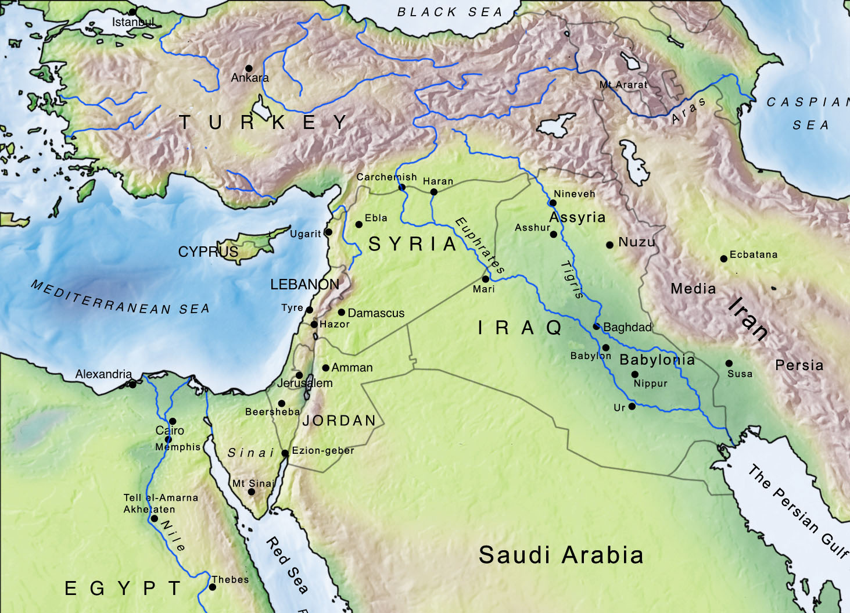

Slide 3
Mesopotamia Map
Ur Chaldees N
Ebla 1800
Haran
Nineveh
Ugarit 1000’s
Damascus
Nuzu 5,000
Med. Sea
Mari 25,000
Babylon
Ur
Persian Gulf

Slide 4
Mari Tablet ca. 1750
Zimrilim versus Hammurabi

Slide 5
Ebla Tablet ca. 2400 BC

Slide 6
Ugarit 1400-1200 BC--Alphabetic

Slide 7
Three Cuts
L 6
Cutting family ties (Gen 12:2f)
Why is it that when God calls there is often a “leaving” involved?
Did only the Jews know God? Melchizedek king of Salem (Gen 14:17ff)
Cuts the animal (Gen 15:10, 17) Why?
Union symbolized: as animal was one now we are one
Acting out the curse: Jer 34:18f --solemnizing/ratifying the covenant

Slide 8
Three Cuts
Cut flesh (Gen 17)
On circumcision
Unconditional covenant (berit)—ratifying the covenant
Abrahamic Covenant:
Land --promised land (Canaan; Palestine)-15:16ff
Seed /descendants (stars, sand, dust),
Blessing—all nations→ Jesus

Slide 9
3 Problems:
1)Camels and critics: Gen. 12:16
2) Hittites/Philistines and critics Gen. 15:20; 26:1 [2 Abimelek’s of Gerar; cf. Jabin]
3) Gen. 14:14 talks of “Dan” can’t be Dan—anachronism (Josh. 19:47; Judg. 18:29); updating the text
Summary, significance, questions

Slide 10
Three Kids

Slide 11
Three Kids
Eliezer of Damascus: adopted son (Gen 15:2)
Hagar-Surrogate Wife, Gen. 16
Code of Hammurabi 144-147
Caution on Criticizing patriarchs—telling/teaching or description/prescription or normative/non-normative distinction
How badly does God get on Abraham’s case
Isaac: son of the promise -- laughter

Slide 12
4 Abraham Questions

Slide 13
Well ah...she’s my sister?
Why do they always want to marry his sister? (Gen. 12, 20, 26 – 3X)
Custom: adopting sister -- protection -- marry her off
Bible and flawed heroes

Slide 14
Does God really interact with man?
Gen 18:26ff: Bartering with God
Is this real? Does foreknowledge really solve the problem?
Is this just anthropomorphic or anthropopathic speaking—so we can understand?
Can a human have impact on God?
Will not the God of all the earth do right? Gen. 18:25

Slide 15
Are all sins the same? Gen 18:21
Hospitality issue at Sodom.. the real issue?
On recontextualizing the messages of Scripture
Is this homosexual rape? Lot’s daughters
Are homosexual acts sin? Lev. 18:22; Rom 1:26f; 1 Cor 6:9, 1 Tim 1:10
How should Christians react to homosexual behavior?
-loving the sinner, hating the sin

Slide 16
How does God’s role toward Abraham change in Gen 22?
Struggle for a son—Akedah (binding)
Rapid fire ... why no emotions shown? on good literature: God blesser→ tester
Painful obedience
Levels of faith
Easy Faith
Resignation faith
Unreasonable pure faith—the precious
God’s friend **** SSQ

