Slide 1
Old Testament History, Literature, and Theology
BCM101
Dr. Ted Hildebrandt

Slide 2
Is there a God? Why would you believe that?
Teleological Argument: design/order
Intelligent Design
Pascal’s wager
Jesus: liar, lunatic, Lord—legend? Jn 10:33
Personal testimony
Predictive prophecy, miracles, Jews

Slide 3
Old Testament Overview
P-PEW C-JU D-ERA
Primeval History: Adam/Eve, Cain/Abel, Noah/Flood, Babel
Patriarchs: Abraham, Isaac, Jacob, Joseph
Exodus: Pharaoh, Plagues, Moses, and Red Sea
Wilderness: Sinai Covenant, 10 commands, Tabernacle, Manna, 40 years in desert

Slide 4
OT Overview C-JU
Conquest: Joshua/Jericho, tribes get land
Judges: Deborah/Barak, Gideon, Jephthah, Samson, Samuel
United Monarchy: Saul, David, Solomon

Slide 5
OT Overview D-ERA
Divided Monarchy: Kings north all bad (Ahab); Kings of South some good (Hezekiah, Josiah), Prophets, Assyria 722 BC and Babylon 586 BC
Exile: Judah to Babylon 70 years, temple destroyed, Daniel, Ezekiel
Return: Ezra, Nehemiah, Esther, Jerusalem walls and temple rebuilt
Apocrypha: Maccabees and Antiochus Epiphanes, Persian→ Greek→ Rome

Slide 6
Five OT Dates:
2000 BC Abraham
1000 David
722 Northern kingdom scattered (Assyria)
586 Judah exiled [temple/Babylon]
400 end of OT
*** Summarize, significance, questions
Bible-Robics: Genesis 1-25

Slide 7
Where & how did we get the Bible?

Slide 8
Where did our Bible come from? 4 Step Process from God to us
Inspiration: God speaks to prophets, prophets speak to people, written down
Canonization – community collects sacred writings
Transmission – scribal copying
Translation: Hebrew, Aramaic, Greek→ Eng.
L. 1

Slide 9
Does the Bible claim to be from God? Inspiration
2 Tim. 3:16 God-breathed
2 Peter 1:21 origin in God not man
God

Slide 10
External Corroboration
Moral Quality: Love God, love neighbor, 10 commandments, yet not simplistic, interfaces with culture yet deep values on human life—what you’d expect of God
Historicity: camels? Hittites? David? Jeremiah’s scribe, Balaam, Mesha, Omri, Sennacherib, resurrection witnesses
Fulfilled prophecy: Tyre (Ezk 26:12), Isaiah –Cyrus (Isa. 44:28, 45:1), Jesus (Isa 53; Mic. 5:2 ); 1 Kgs. 13:2—Josiah

Slide 11
Inspiration Processes
Spoke to Moses face to face (Num 12:6-8); prophets: “Thus saith the Lord” Jer.1:1-4; Isa. 7:7
Spoke through His Son --Jesus (word incarnate)
Heb 1:1-2; John 1:1-12
Some did historical research--Luke 1:1-4
Some edited former works--Prov 25:1
Some quoted secular sources--Acts 17:28

Slide 12
8/15 BAR
The first of the clay bullae, which surfaced during Mazar’s excavation of what may be king David’s palace bears the name “Yehuchal [or Jehucal] ben Shelemyahu [Shelemiah]” (pictured above left). The second was found in the First Temple period strata reads “Gedalyahu [Gedaliah] ben Pashur” (pictured above right). These two men are mentioned together in the Bible as ministers of King Zedekiah (597–587 B.C.E.). As the Babylonians closed in on Jerusalem during the last years of the First Temple period, Jeremiah, prophet to Judah’s last kings, advised Zedekiah and the people of the city to surrender to Nebuchadnezzar’s men so that their lives and city might be spared. But not everyone liked Jeremiah’s message, including Gedaliah son of Pashur and Jehucal son of Shelemiah. According to Jeremiah 38:1–13, the two ministers had Jeremiah thrown into a pit because they did not like the message of surrender he was preaching to the people of Jerusalem.

Slide 13
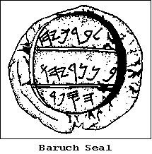
Archaeological Confirmation
Bullae
A collection of small, burnt, clay seals was found in 1975 about 44 miles southwest of Jerusalem. They dated from the time of Jeremiah, the Prophet. Each small lump of clay had been impressed with a seal. These served as an official signature for individuals. Amongst the seals, four contained the names biblical figures mentioned in the 36th chapter of the book of Jeremiah. One of these seals reads: Berekhyahu son of Neriyahu the Scribe. We also have them bullae from Jeremiah; incl. Jaramael, Seriah & Gemaryaha (see Jer.36:26, 22, & 10-12). *** Summarize, significance, questions

Slide 14
Canonization
Immediately authoritative deposited; Dan 9:2-Jeremiah
Peter of Paul 2 Pet 3:15f
Psalms longer process: David →Ps. 137 after the destruction of the temple 586 BC
Proverbs 25 edited by Hezekiah’s people
Certain books not accepted--which? why? – Book of Jashar (Josh. 10:13)…
39 Books OT, 27 NT = 66 books for our Bible
Hebrew Bible 24 books

Slide 15
Criterion of Canonization
1) Is it inspired by God? -- Thus saith the
Lord (Isa. 7:7)
2) Is it written by a prophet/apostle?
3) Does it agree with previous revelation?
4) Was it received by the people of God?

Slide 16
Canonization Process
Antilegomena: questioned books
Proverbs
Ezekiel
Esther
Ecclesiastes
Song of Songs
TaNaK: Torah, Nebi’im; Kethubim
Apocrypha Pros/cons

Slide 17
Tanakh: Torah, Nebi’im; Kethubim—24 books
Torah 5: Gen. Exod. Lev. Numb. Deut.
Nebi’im 8: Josh. Jud. Sam. Kings. Isa. Jer. Ezek. Twelve
Kethubim 11: Ps. Job, Prov. 5 Megillot (Ruth, Song of Songs, Eccles. Lam. Esther; read at Purim etc.) Dan. Ezr/Neh. Chronicles
Ours 39: PHPP– Pentateuch, History Josh-Ezra/Neh, Poetry [Psalms/Prov/Job], Prophets [major/minor]

Slide 18
Levels of “Canonization”
Pseudepigrapha
OT Apocrypha
Canon of OT TaNaK: PHPP
Antilegomena
*** Summarize, significance, questions

Slide 19
Transmission – Did God use flawed processes to preserve His word?
Moses wrote it 1440 BC how did we get it?
Copied over and over
Copying process not always 100%

Slide 20
1 Sam 13:1 Age of Saul?
KJV/NJKV -- Saul reigned one year; and when he had reigned two years over Israel,
ASV/NASB -- Saul was forty years old when he began to reign, and he reigned thirty-two years over Israel.
NIV/NLT -- Saul was thirty years old when he became king, and he reigned over Israel forty- two years
NRS/ESV -- Saul was ... years old when he began to reign; and he reigned ... and two years over Israel.

Slide 21
Other major Textual variants
Mark 16
1 Jn 5:7
Jer 27:1 Jehoiakim=KJV // Zedekiah=NIV/NRSV/NLT/ESV
Jer 39:13 Rab-mag=KJV/NRSV/ESV (name) → high official (title) NIV /NLT (Akkadian copied)
How do we correct for that?
Why didn’t God preserve it perfectly?

Slide 22
Scribal errors: Internal Evidence
Misreading Gen 10:4 Dodanim [KJV/ESV] // Rodanim [NIV/NLT/NRSV] r / d; ד ר
Mis-hearing Ps 100:3; not we / we are his
Metathesis: thier
Conflation: church of God / church of Lord→ Church of Lord God

Slide 23
Text Criticism: External
Older manuscripts better—MT [Hebrew Masoretic Text -- 800-1000 AD],
LXX [Septuagint-Greek OT ca. 200-100 BC]
DSS—Dead Sea Scrolls (ca. 200 BC-100 AD)
Silver amulet of Numbers 6:24ff (700 BC)

Slide 24
Bar mitzvah Torah Scroll

Slide 25
Hebrew Scroll

Slide 26
Masoretic Text: MT -- 800-1000 AD

Slide 27
Dead Sea Scroll Book of Wars
Ca 200 BC – 100 AD

Slide 28
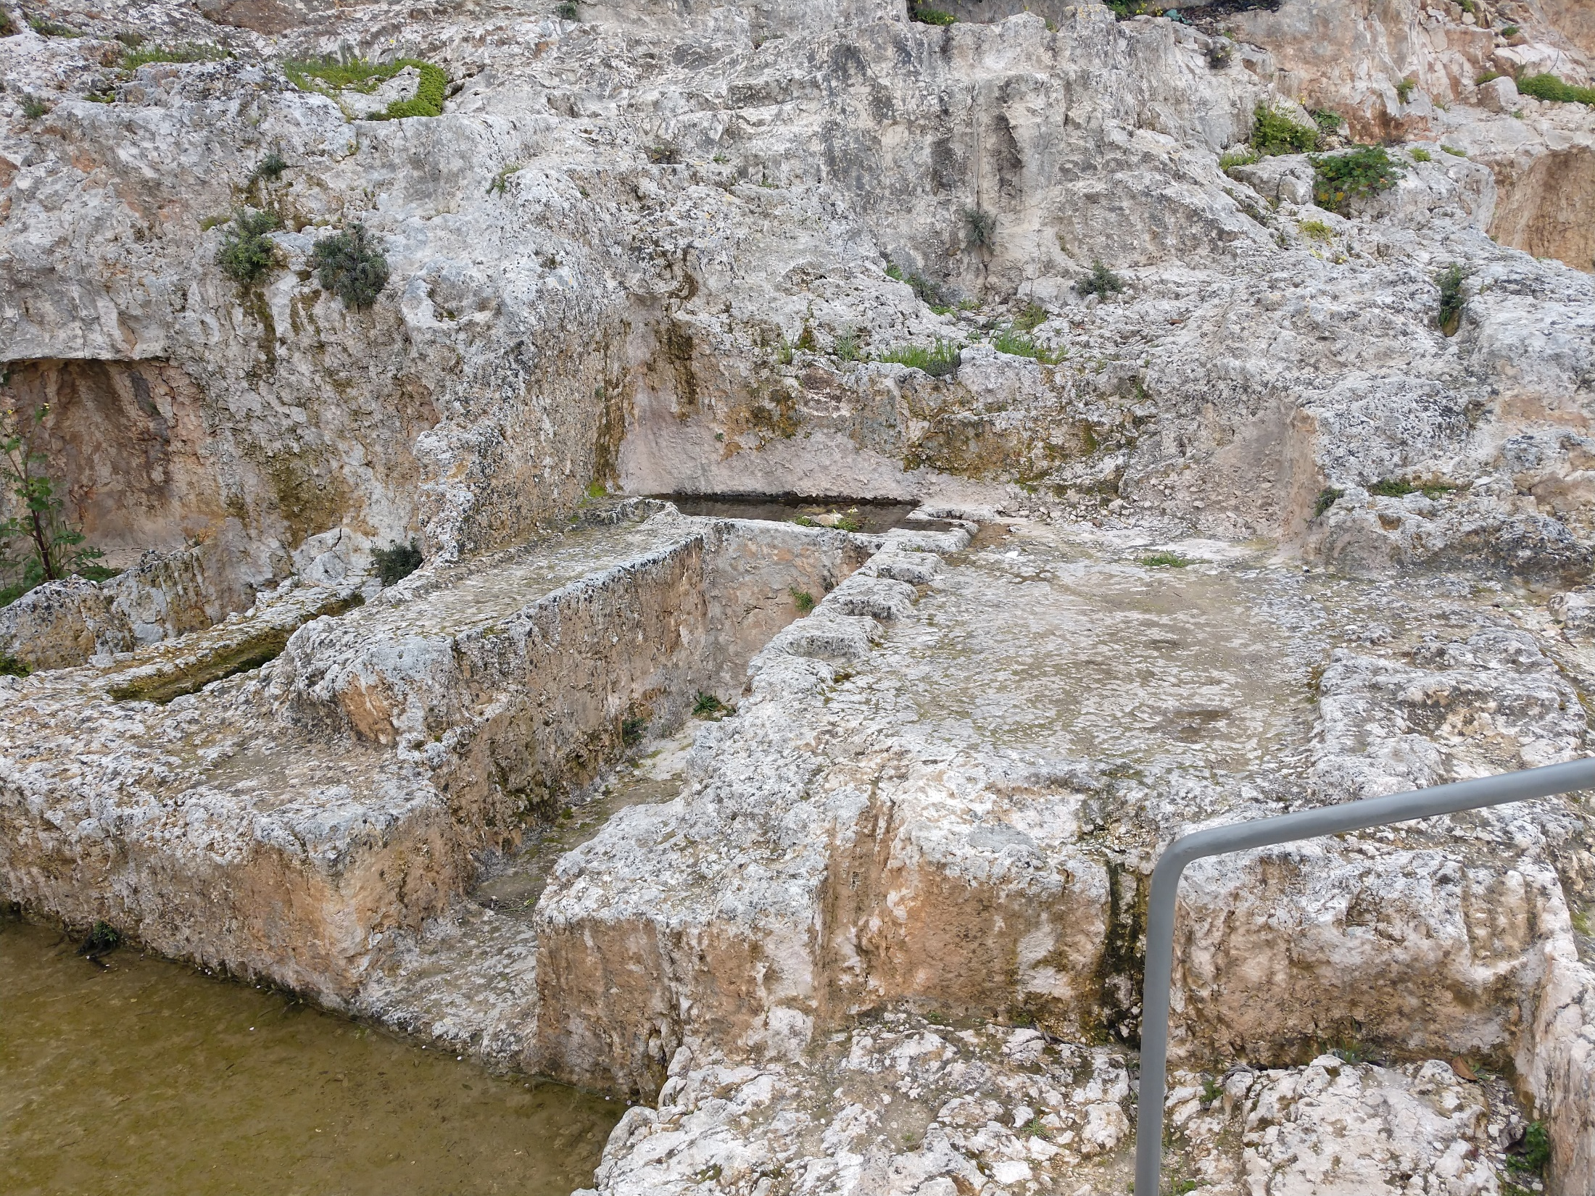
Numbers 6:24ff – Lord bless

Slide 30
Literary Factors
Psalm 1:1
Blessed is the one
who does not
walk in step with the wicked
or stand in the way of sinners: NIV pre-2011
or stand in the way that sinners take--NIV
or stand in the path with sinners—TAH
or sit in the company of mockers,

Slide 31
Translation Theory
Literal word for word … pros/cons Prov 10:5 –NASB, ESV
Modified literal… pros/cons-NIV/NRSV/KJV
Dynamic equivalence: meaning for meaning… pro/cons, NLT, Message
Politically Corrected texts… pros/cons TNIV

Slide 32
Proverbs 10:5 KJV
אֹגֵ֣ר בַּ֭קַּיִץ בֵּ֣ן מַשְׂכִּ֑יל נִרְדָּ֥ם בַּ֜קָּצִ֗יר בֵּ֣ן מֵבִֽישׁ׃
KJV: He that gathereth in summer is a wise son, but he that sleepeth in harvest is a son that causeth shame.

Slide 33
Proverbs 10:5 NIV
NASB: He who gathers in summer is a son who acts wisely, But he who sleeps in harvest is a son who acts shamefully.
NIV: He who gathers crops in summer is a wise→prudent son, but he who sleeps during harvest is a disgraceful son. –NRSV/ESV
Prudent=wary, careful, cautious
1 Sam 18:14,15 successful, prosperous

Slide 34
Proverbs 10:5 NLT
NLT: A wise youth works hard all summer; a youth who sleeps away the hour of opportunity brings shame.
Message: Make hay while the sun shines -- that's smart, go fishing during harvest --that's stupid.

Slide 35
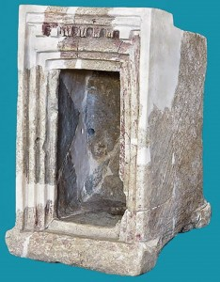
Translation Theory
MT → LXX→ Vulgate→ KJV/NIV/NRSV et al
Different ways to translate: which one is right?
Do translators make mistakes: Prov 26:23 KJV: Burning lips and/with a wicked heart are like a potsherd covered with silver dross.
New Discoveries: 1 Kgs 6:31 mezuzot –5 recessed – Tel Qeiyafa (BAR Aug 2015)
Does language change: 2 Cor 8:1 KJV: “We do you to wit of the grace of God bestowed on ….”

Slide 36
Conclusions
Better manuscript evidence than ever before
No major doctrine is affected
Realistic view on transmission and translation issues
Confidence in God’s word… benefit of plurality of translations
God speaks the language of the people

