Slide 1
Welcome to Mastering NT Greek
By Ted Hildebrandt © 2019
Baker Academic

Slide 2
Introductory Matters
Welcome
Syllabus read through & course introduction

Slide 3
Why study Greek?
God has spoken – study as the highest form of worship—2 Tim. 3:16; Heb. 1:1; 4:12; Ps. 119:11; Jn. 6:63; 2 Pet. 1:21. On reading love letters
Context determines meaning
Why not just read it in an English translation? E.g. “trunk—
Car
Tree
Luggage
Body
Train line

Slide 4
εἰρήνη--peace?
Semantic Domains between languages may not match up exactly
Lk 2:14 (peace?); “Glory to God in the highest and on earth peace—shalom?”
Mk 5:34 (health); unclean woman touches Jesus, healed “Go in peace and be freed from your suffering”
Lk 2:29 (tranquility) "Sovereign Lord, as you have promised, you now dismiss your servant in peace.
Lk 11:21(safe/secure) When a strong man, fully armed, guards his own house, his possessions are safe.”
Luke 10:5 (Blessing) "When you enter a house, first say, 'Peace to this house.'
1 Thessalonians 5:3 (no war) While people are saying, "Peace and safety," destruction will come on them suddenly,

Slide 5
δίκαιος—righteous Mt. 1:19 skip
Cultural impact: Joseph, Mary’s husband
Causal: Because Joseph righteous → did not want to make a public example
Concessive: Despite Joseph being righteous → he did not want to…. (NIV)
Appositional: Joseph is righteous = not wanting to…

Slide 6
Why study Greek?
Thinking for yourself
Seeing things closely: author’s style,
Things that matter in a “whatever” culture: Jn 6:63
Learning English through Greek
Beware--Power corrupts: “In the Greek it means…”

Slide 7
How should we study Greek?
Goal – the dream
Memorizing—28 chants
Time, Consistency, Persistence
Discipline (bottom line), buddy system
Vocab building
Grammatical muscle building (verbs, nouns, adjectives, pronouns, article, etc.)
Morphology: sg/pl.; m/f; 1st person…
Inch by inch it’s a cinch, yard
Humility (“in the Greek this means”)

Slide 8
What is Koine Greek?
Stages of Greek Language
Pre-Homeric (1400-1100 BC) Mycenaean= Linear B
Epic (Homer 800 BC)
Classical (500-300 BC) – dialects: Ionic→ Attic [Athens], Doric, Aeolic
Koine/Hellenistic (330 BC – AD 330)
Byzantine (330-1453 AD)
Modern (1453 – present) Katharevousa (official until 1976); Demotike –common oral

Slide 9
What is Koine Greek?
Semitic background-alpha-bet (ox + house; Greeks added vowels), right to left; Boustrophedon
Three influences: Semitic, literary koine, vernacular koine (Wallace, 28)
Koine as Holy Spirit Greek→ Common
God speaks the language of the people

Slide 10
Classical/Koine shifts: skip Diacrhonic/Synchronic
Shifts in meaning Classical to Koine [synonyms] (ἕτερος/heteros//ἄλλος/allos: 2 Cor 11:4; Gal. 6:1) Classical clear separation: another=additional//different
KJV 2 Corinthians 11:4 For if he that cometh preacheth another (allon) Jesus, whom we have not preached, or if ye receive another (eteron) spirit, which ye have not received, or another (eteron) gospel, which ye have not accepted, ye might well bear with him.
KJV Galatians 1:6 I marvel that ye are so soon removed from him that called you into the grace of Christ unto another (heteron) gospel:
Galatians 1:7 Which is not another (allo); but there be some that trouble you, and would pervert the gospel of Christ.

Slide 11
Koine (333BC-300AD)
Hellenism – Alexander (333 B.C.)—universal--LXX
Incredible timing: Gal. 4:4 “in the fullness of time God sent his son…”
Uncials/Miniscules & manuscripts
Inspiration and copying processes: text criticism [lower criticism] versus higher criticism (source, form, redaction criticism)

Slide 12
External Evidence
Copies: types
# 96 299 2,812
Papyri
AD 120-300
Uncials
AD 300-500
Miniscules
AD 500-
P52, P46
A, B, x, D
1059, 1087

Slide 13
P52–John 18:31-33 (ca. 125 AD)

Slide 14
Codex Sinaiticus -4th century AD

Slide 15
Sinaiticus 4th century AD

Slide 16
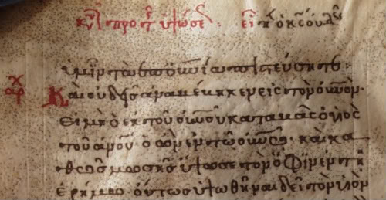
Miniscules--later

Slide 17
Alphabet
α / Α Alpha sounds like “a” in father
β / Β Beta sounds like “b” in Bible
γ / Γ Gamma sounds like “g” in gone
δ / Δ Delta sounds like “d” in dog
ε / Ε Epsilon sounds like “e” in met

Slide 18
Alphabet (cont.)
ζ / Ζ Zeta sounds like “z” in daze when it begins a word, “dz” when it's in the middle of a word
η / Η Eta sounds like “e” in obey
θ / Θ Theta sounds like “th” think

Slide 19
Alphabet (Cont.)
ι / Ι Iota short sounds like initial “i” in sit long sounds like the second “i” in machine When it begins a name = “y” ( Ἰησοῦς Yesus)
κ / Κ Kappa sounds like “k” in kitchen
λ / Λ Lambda sounds like “l” in law

Slide 20
Alphabet (Cont.)
μ / Μ Mu sounds like “m” in mother
ν / Ν Nu sounds like “n” in new
ξ / Ξ Xsi sounds like “x” in axe

Slide 21
Alphabet (Cont.)
ο / Ο Omicron sounds like “o” in not some pronounce it like modern Greek long “o” as in “obey” others like the “ou” in thought
π / Π Pi sounds like “p” in peach
ρ / Ρ Rho sounds like “r” in rod

Slide 22
Alphabet (Cont.)
σ / Σ Sigma sounds like “s” in set sigma looks like “ς” when it comes at the end of a word (final sigma, σοφός)
τ / Τ Tau sounds like “t” in talk
υ / Υ Upsilon sounds like “oo” in “hoops”

Slide 23
Alphabet (Cont.)
φ / Φ Phi sounds like “ph” in phone
χ / Χ Chi sounds like “ch” in chemical
ψ / Ψ Psi sounds like “ps” in lips
ω / Ω Omega sounds like “o” in tone

Slide 24
Whole Alphabet Chant through
α β γ δ ε ζ η θ ι κ λ μ ν ξ ο π ρ σ τ υ φ χ ψ ω
Α Β Γ Δ Ε Ζ Η Θ Ι Κ Λ Μ Ν Ξ Ο Π Ρ Σ Τ Υ Φ Χ Ψ Ω

Slide 25
Double Consonants
θ
ξ
φ
χ
ψ

Slide 26
Easy to confuse letters
η (with n)
ν (with v)
ρ (with p)
χ (with x)
ω (with w)

Slide 27
Nasal gamma
When gamma comes before γ, κ, χ, ξ it is pronounced like an “n”
ἄγγελος = angelos

Slide 28
Vowels
α, ε, η, ι, ο, υ, ω
Always Short: ε, ο
Always Long: η, ω
Long or short: α, ι, υ

Slide 29
Vowel Chart
Short
ε
ο
Long
η
ω
Both α, ι, υ

Slide 30
Diphthongs -- 2 vowels = 1 sound
αι as in "aisle"
ει as in "eight"
οι as in "oil"
υι as in "suite"
αυ as in "sauerkraut"
ευ, ηυ as in "feud“
ου as in “boutique"

Slide 31
Iota Subscripts
ᾳ, ῃ, ῳ

Slide 32
Diaeresis ¨
Cancels the diphthong effect – keeps the two vowels separate.
Ἠσαϊας = ‘Η –σα-ι -ας

Slide 33
Phonetic Chart
Labials (lips) π β φ
Dentals (teeth) τ δ θ
Velars (tongue/ κ γ χ
roof)

Slide 34
Phonetic Addition
Labial + σ = ψ (π + σ = ψ)
Palatal + σ = ξ (κ + σ = ξ)
Dental + σ = σ (τ + σ = σ)

Slide 35
Chapter 1 Vocabulary
ἄγγελός, -ου, ὁ
angel

Slide 36
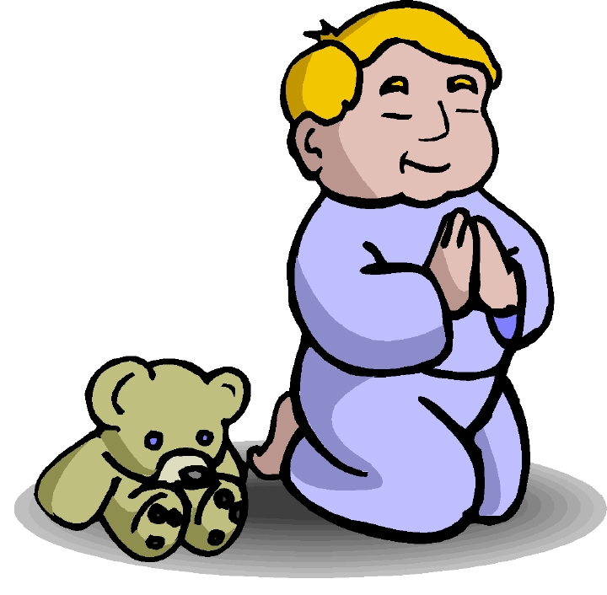
Chapter 1 Vocabulary
ἀμήν
truly, verily

Slide 37
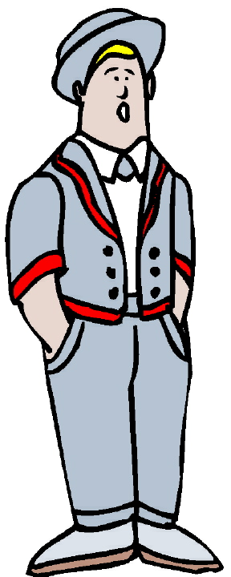
Chapter 1 Vocabulary
ἄνθρωπος, -ου, ὁ
man, human

Slide 38
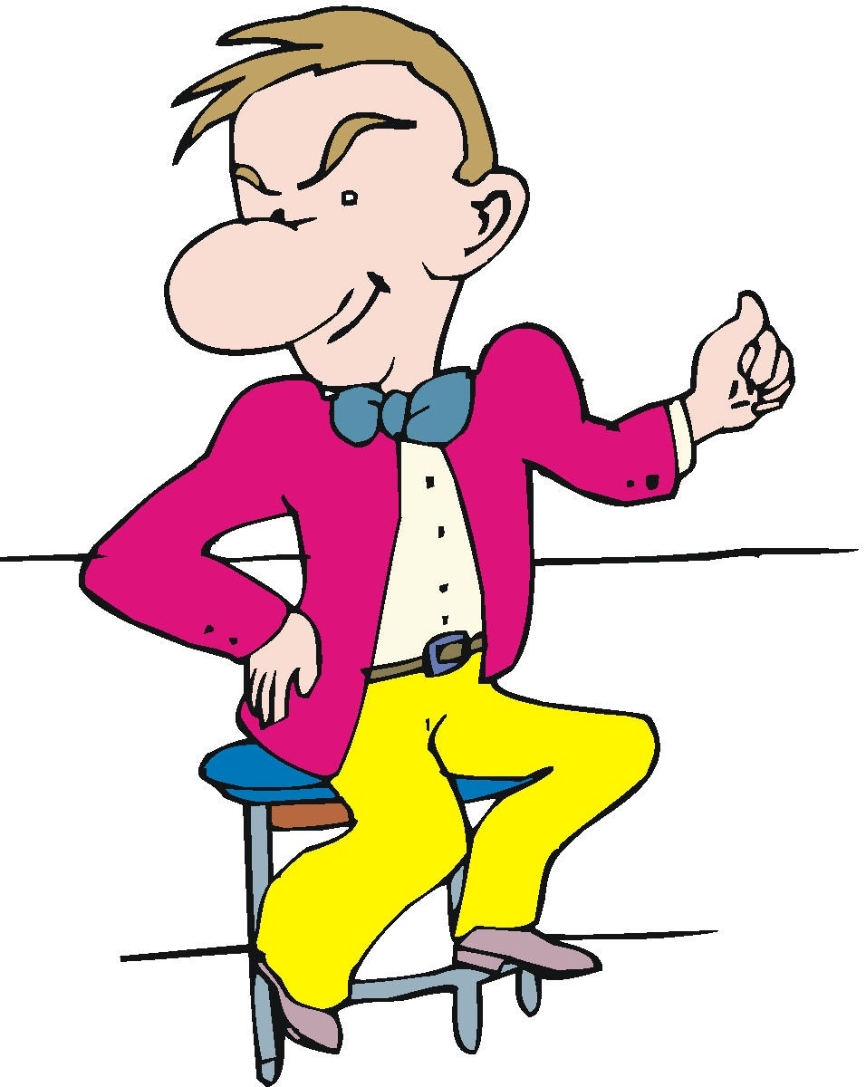
Chapter 1 Vocabulary
ἐγώ
I--ego

Slide 39
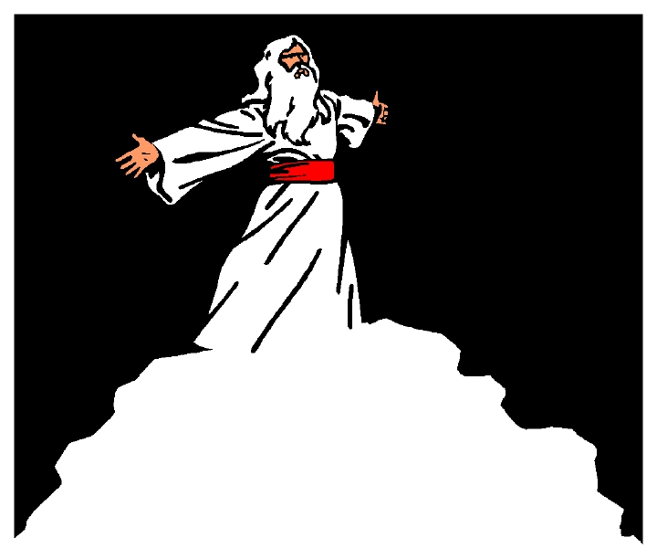
Chapter 1 Vocabulary
θεός, -οῦ, ὁ
God

Slide 40
Chapter 1 Vocabulary
καί
and

Slide 41
Chapter 1 Vocabulary
καρδία, -ας, ἡ
heart

Slide 42
Chapter 1 Vocabulary
λέγω
I say

Slide 43
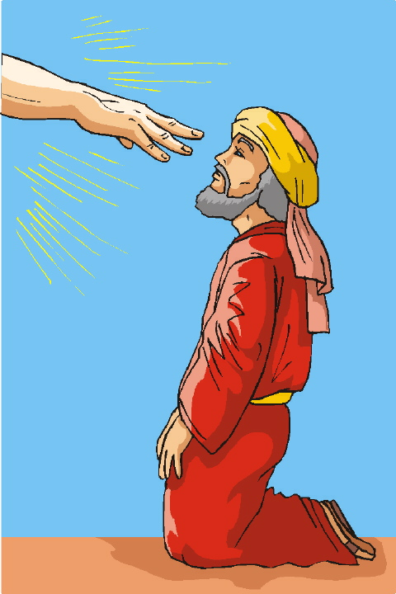
Chapter 1 Vocabulary
προφήτης, -ου, ὁ
prophet

Slide 44
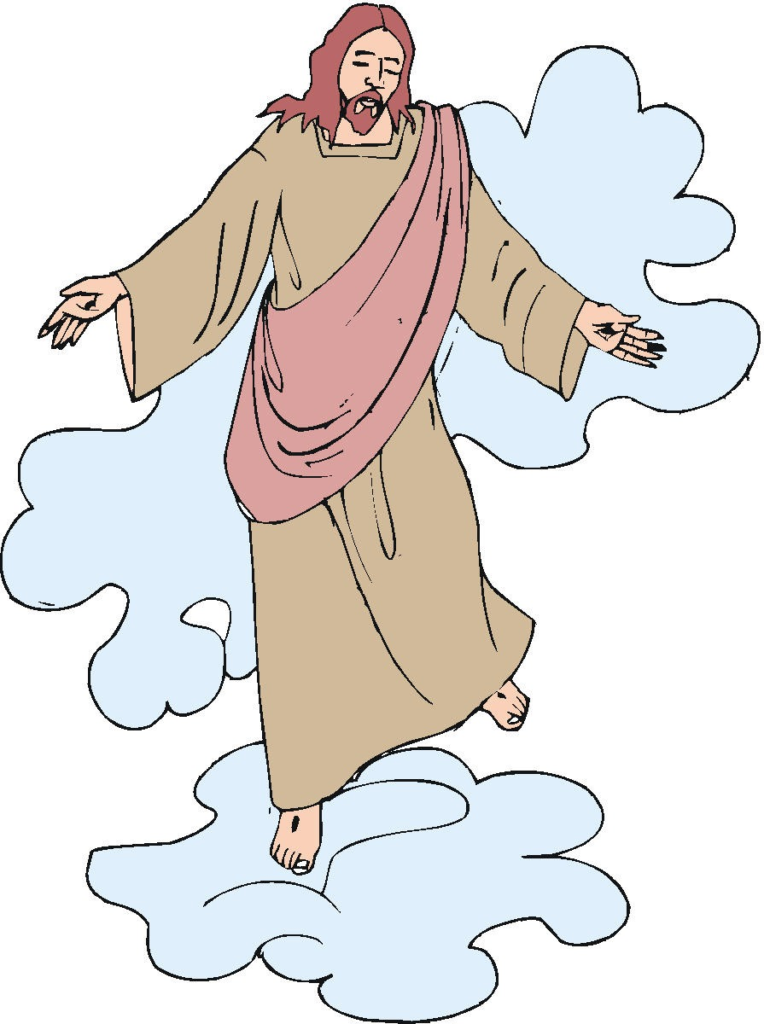
Chapter 1 Vocabulary
Χριστός, -οῦ, ὁ
Christ, Messiah, anointed one

Slide 45
Alphabet Razzle/Dazzle - Call out the name drill
χ
ξ
δ
σ
β
λ
κ

Slide 46
Alphabet Razzle/Dazzle Drill
θ
η
ρ
υ
ψ
τ
γ

Slide 47
Alphabet Razzle/Dazzle Drill
φ
μ
ζ
α
ι
π
ω

Slide 48
Alphabet Razzle/Dazzle Drill
γ
ψ
λ
κ
σ
ζ
β

Slide 49
Alphabet Drill Teams Drill
θ
φ
ρ
τ
ν
δ
ξ

Slide 50
Alphabet Drill Teams Drill
π
η
ω
χ
μ
ι
ε

Slide 51
Uncial capital Letters Drill
Ξ
Ρ
Σ
Ζ
Β
Λ
Ω

Slide 52
Uncial capital Letters Drill
Γ
Θ
Υ
Μ
Φ
Δ
Κ

Slide 53
Uncial capital Letter Drill
Ν
Η
Ψ
Α
Π
Ο
Τ

Slide 54
Diphthong sound offs
ει
αι
οι
υι
αυ
ευ
ηυ
ου

Slide 55
Greek Words –what is the English
ἀμήν
ἀπολογία
ἀπόστολος
δαίμων
διάκονος
εἰκών
ἐπιστολή

Slide 56
Greek Words –what is the English
θεραπεία
θρόνος
κόσμος
λεπρός
μάρτυς
παραβολή
πρεσβύτης
ῥαββι

Slide 57
Greek Words –what is the English
σάββατον
σχίσμα
ὕβρις
ὑποκριτής
φιλοσοφία
ὡσαννά

