Slide 1
Mastering NT Greek
26. Numbers and Interrogatives
By Ted Hildebrandt © 2003
Baker Academic

Slide 2
Warm-ups

Slide 3
Rapping the Lord’s Prayer
Πάτερ ἡμῶν ὁ ἐν τοῖς οὐρανοῖς father our the one in heaven
ἁγιασθήτω τὸ ὄνομά σου make holy name your
ἐλθέτω ἡ βασιλεία σου let come kingdom your
γενηθήτω τὸ θέλημά σου, let be will your

Slide 4
Rapping the Lord’s Prayer
ὡς ἐν οὐρανῷ καὶ ἐπὶ γῆς· as in heaven also on earth
τὸν ἄρτον ἥμῶν τὸν the bread our
ἐπιούσιον δὸς ἡμῖν σήμερον· daily give us today

Slide 5
Rapping the Lord’s Prayer
καὶ ἄφες ἡμῖν τὰ ὀφειλήματα ἡμῶν and forgive us trespasses our
ὡς καὶ ἡμεῖς ἀφήκαμεν as also we have forgiven
τοῖς ὀφειλέταις ἡμῶν the ones trespassing us

Slide 6
Rapping the Lord’s Prayer
καὶ μὴ εἰσενέγκῃς ἡμᾶς and do not lead us εἰς πειρασμόν into temptation ἀλλὰ ῥῦσαι ἡμᾶς ἀπὸ but deliver us from τοῦ πονηροῦ the evil one

Slide 7
2-1-2 Paradigms - Chant this
2 1 2
λόγος γραφή ἱερόν
λόγου γραφῆς ἱεροῦ
λόγῳ γραφῇ ἱερῷ
λόγον γραφήν ἱερόν
λόγοι γραφαί ἱερά
λόγων γραφῶν ἱερῶν
λόγοις γραφαῖς ἱεροῖς
λόγους γραφάς ἱερά

Slide 8
3rd Declension Chantables
χαρίς ὄνομα, πίστις
χάρις ὄνομα πίστις
χάριτος ὀνόματος πίστεως
χάριτι ὀνόματι πίστει
χάριτα ὄνομα πίστιν
χάριτες ὀνόματα πίστεις
χαρίτων ὀνομάτων πίστεων
χάρισι(ν) ὀνόμασι(ν) πίστεσι(ν)
χάριτας ὀνόματα πίστεις

Slide 9
PAI Verb Chant
λύω λύομεν
λύεις λύετε
λύει λύουσι(ν)

Slide 10
The "is" verb PAI -- εἰμί
εἰμί ἐσμέν εἶ ἐστέ ἐστί(ν) εἰσί(ν)

Slide 11
Imperfect εἰμί
ἤμην ἦμεν ἦς ἦτε ἦν ἦσαν

Slide 12
Person Personal Pronoun Chant
Singular Plural
Nom. ἐγώ σύ ἡμεῖς
Gen. μου σου ἡμῶν Dat. μοι σοι ἡμῖν Acc. με σε ἡμάς
αὐτός, αὐτη, αὐτό (he, she, it)

Slide 13
Present Middle/Passive Indicative
λύομαι, -ομεθα -ῃ, -εσθε -εται, -ονται
I am loosed/am being loosed
I loose myself/am loosing [for myself]

Slide 14
Shape of the Future in Greek
λύσω λύσομεν I will loose We will loose
λύσεις λύσετε You will loose You all will loose
λύσει λύσουσι(ν) S/he/it will loose They will loose
Chant this one

Slide 15
Future Middle Paradigm
λύσομαι -όμεθα -ῃ -εσθε -εται -ονται
I will loose (for myself) We will loose (for ourselves) …

Slide 16
Demonstrative and Relative Pronouns Summary
ἐκεῖνος, ἐκείνη, ἐκεῖνο = that
οὗτος, αὕτη, τοῦτο τούτου, ταύτης, τούτου = this
ὅς ἥ ὅ = Relative (who, which) οὗ ἧς οὗ

Slide 17
Imperfect Active Paradigm of λύω
Chant: ἐλυον, ν, ς, ε, μεν, τε, ν I was loosing, …

Slide 18
Imperfect Middle/Passive (IM/PI)
Chant: ἐλυόμην ου, ετο, ομεθα, εσθε, οντο
I was being loosed

Slide 19
Second Aorist Active Chant
ἔλαβον ν, σ, ε, μεν, τε, ν

Slide 20
Second Aorist Middle Chant
ἐγενόμην -ου, -ετο, -ομεθα, -εσθε, -οντο

Slide 21
Aorist Stem Changes -- 8 to know
ἔρχομαι == ἦλθον (I came, went)
βλέπω == εἶδον (I saw)
λέγω == εἶπον (I said)
γίνομαι == ἐγενόμην (I became)
γινώσκω == ἔγνων (I knew)
ἔχω == ἔσχον ( I had)
λαμβάνω == ἔλαβον (I took)
εὑρίσκω == εὗρον (I found)

Slide 22
1st Aorist Active Paradigm
Learn: ἔλυσα: I loosed… --, ς, ε, μεν, τε, ν

Slide 23
1st Aorist Middle Paradigm
Learn: ἐλυσάμην: I loosed for myself -ω, -ατο, -αμεθα, -ασθε, -αντο

Slide 24
Chanting the Present Particple Chant
Present Active: ptc = participle
Nom. λύων λύουσα λῦον Gen. λύοντος λύουσης λύοντος
Present Middle/Passive
Nom. λυόμενος λυομένη λυόμενον Gen. λυομένου λυομένης λυομένου

Slide 25
Aorist Participle Chant
First Aorist Active 3-1-3 (chant)
Nom. λύσας λύσασα λύσαν Gen. λύσαντος λυσάσης λύσαντος
Nom. λυθείς λυθεῖσα λυθέν Gen. λυθέντος λυθείσης λυθέντος
First Aorist Middle 2-1-2 (non-chant)
Nom. λυσάμενος λυσαμένη λυσάμενον Gen. λυσαμένου λυσαμένης λυσαμένου

Slide 26
Perfect Participle Chant
Perfect Active Participles (know these)
3 1 3 λελυκώς λελυκυῖα λελυκός λελυκότος λελυκυίας λελυκότος
Perfect Middle/Passives Participles
2 1 2 λελυμένος λελυμένη λελυμένον λελυμένου λελυμένης λελυμένου

Slide 27
Infinitive Endings to Chant
λύειν (to loose)
Present: ειν εσθαι
Second Aorist: εῖν εσθαι ῆναι
First Aorist: αι ασθαι ῆναι
Perfect: ναι σθαι
Hint: often when seeing an "αι" on the end of a verb suspect an infinitive.

Slide 28
Subjunctive Chant
PAS λύω, λύῃς, λύῃ, λύωμεν, λύητε, λύωσι(ν)
PM/P S λύωμαι, -ῃ, ῃται, -ωμεθα, -ησθε, -ωνται

Slide 29
Imperative ending soft shoe
Present Imperative
-ε, -τω, -τε, -τωσαν (Active) -ου, -σθω, -σθε, -σθωσαν (M/Pas)
First Aorist Imperative
-ν, -τω, -τε, -τωσαν (Active) -αι, -σθω, -σθε, -σθωσαν (Mid) -τι, -τω, -τε, -τωσαν (Pas)
Second Aorist endings = present endings + -τι in the passive

Slide 30
6 Types of Pronouns
Personal Pronouns: ἐγώ, σύ, αὐτός
Demonstrative: οὗτος, ἐκεῖνος
Reciprocal pronoun: ἀλλήλων (one another)
Relative Pronouns: ὅς, ἥ, ὅ who, which
Reflexive: myself, yourself (ἐμαυτοῦ, σεαυτοῦ, ἑαυτοῦ)
Indefinite Pronoun: τις / τι (someone)

Slide 31
Reflexive Pronouns-- of myself
ἐμαυτοῦ -ῆς of myself (Masc)
Singular Plural
Gen. ἐμαυτοῦ ἑαυτῶν Dat. ἐμαυτῷ ἑαυτοῖς Acc. ἐμαυτόν ἑαυτούς

Slide 32
Reflexive Pronouns- of myself
ἐμαυτοῦ -ῆς of myself (Fem)
Singular Plural
Gen. ἐμαυτῆς ἑαυτῶν Dat. ἐμαυτῇ ἑαυταῖς Acc. ἐμαυτήν ἑαυτάς

Slide 33
Reflexive Pronoun -- of yourself
σεαυτοῦ -ῆς of yourself (Masc)
Singular Plural
Gen. σεαυτοῦ/ῆς ἑαυτῶν Dat. σεαυτῷ/ῇ ἐαυτοῖς/αῖς Acc. σεαυτόν/ήν ἐαυτούς/άς

Slide 34
Reflexive Pronoun -- of him/her/itself
ἑαυτοῦ -ῆς of him/her/itself
Singular Plural
Gen. ἑαυτοῦ? ἑαυτῶν Dat. ἑαυτῷ ἑαυτοῖς Acc. ἑαυτόν ἑαυτούς

Slide 35
Possessive Adjectives
ἐμός -- my σός -- your
ἥμέτερος -- our ὑμέτερος -- your
These are sometimes uses instead of the Genitive case of the personal pronouns

Slide 36
Indefinite Pronouns
τις / τι someone, anything (enclitic/grave)
Singular (note 3rd decl.)
M/F Neut
Nom. τις τι Gen. τινός τινός Dat. τινί τινί Acc. τινά τι
Note: Accent on the last syllable, with no accent when single syllable

Slide 37
Indefinite Pronouns
Plural (note 3rd decl.)
M/F Neut
Nom. τινές τινά Gen. τινῶν τινῶν Dat. τισί(ν) τισί(ν) Acc. τινάς τινά
Note: Accent on the last syllable, with no accent when single syllable

Slide 38
6 ways to ask a question
Interrogatives
πότε when?
ποῦ where?
πῶς how?
τίς, τί who? which? what?
διὰ τί why?
τί why?

Slide 39
Interrogative Pronoun
τίς / τί who? which? what? (n.b. accent)
Singular (note 3rd decl.)
M/F Neut
Nom. τίς τί Gen. τίνος τίνος Dat. τίνι τίνι Acc. τίνα τί
Note: Accent on first syllable, accented when single syllable

Slide 40
Interrogative Pronoun
Plural (note 3rd decl.)
M/F Neut
Nom. τίνες τίνα Gen. τίνων τίνων Dat. τίσι(ν) τίσι(ν) Acc. τίνας τίνα
Note: Accent on first syllable, accented when single syllable

Slide 41
Greek Numbers
Two types:
Cardinal numbers: 1, 2, 3, 4....
Ordinal numbers: first, second, third
Greek Ordinals (tell order)
πρῶτος, -η, -ον first
δεύτερος, -α, -ον second
τρίτος, -η, -ον third
τέταρτος, -η, -ον fourth

Slide 42
Counting to 10: Cardinals
εἷς 1 ἕξ 6 δύο 2 ἑπτά 7 τρεῖς 3 ὀκτώ 8 τέσσαρες 4 ἐννέα 9 πέντε 5 δέκα 10
Practice counting to ten

Slide 43
Other numbers to know:
Teens: ἕνδεκα (11), δώδεκα (12), τρισκαίδεκα (13), δεκατέσσαρες (14) δεκαπέντε (15)…
Tens: εἴκοσι, τριάκοντα, τεσσαράκοντα, πεντήκοντα…
ἑκατόν 100
χίλιοι, -αι, -α 1000

Slide 44
Paradigm of One
Masc. Fem. Neut.
Nom. εἷς μία ἕν Gen. ἑνός μιᾶς ἑνός Dat. ἑνί μιᾲ ἑνί Acc. ἕνα μίαν ἕν

Slide 45
Cardinal counting chant:
εἷς 1 ἕξ 6 δύο 2 ἑπτά 7 τρῖς 3 ὀκτώ 8 τέσσαρες 4 ἐννέα 9 πέντε 5 δέκα 10
ἑκατόν (100),
χίλιοι (1000)

Slide 46
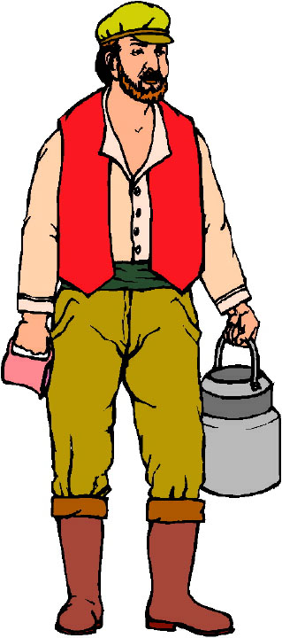
Chapter 26 Vocabulary
ἑαυτοῦ, -ῆς
of him/her/itself

Slide 47
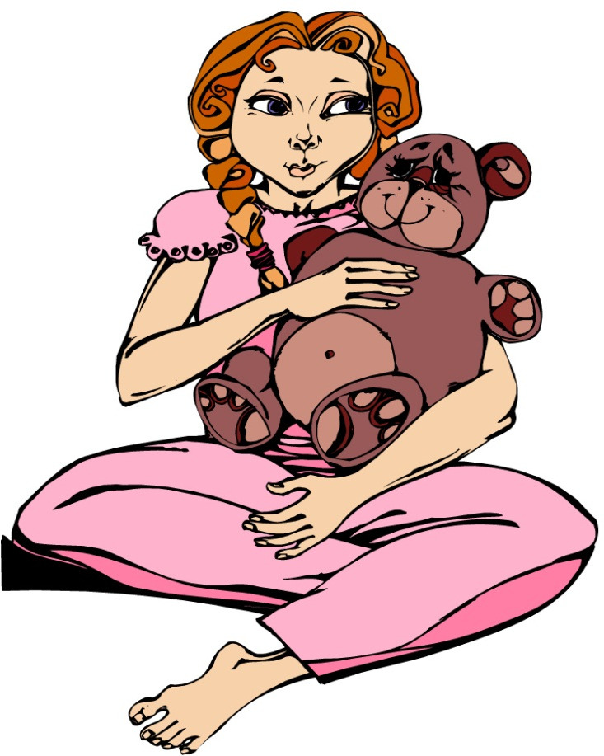
Chapter 26 Vocabulary
ἐμός, -ή, -όν
my, mine

Slide 48
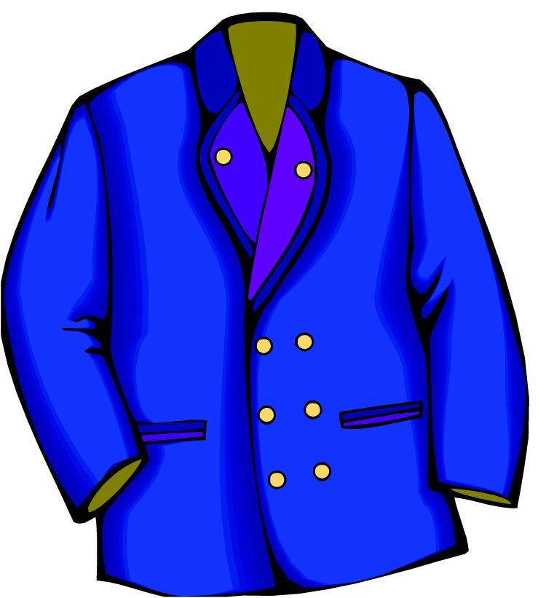
Chapter 26 Vocabulary
ἰμάτιον, -ου, τό
garment

Slide 49
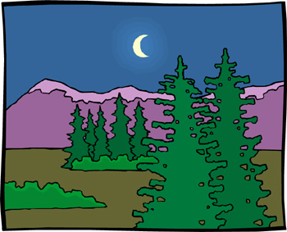
Chapter 26 Vocabulary
νύξ, νυκτός, ἡ
night

Slide 50
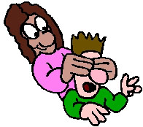
Chapter 26 Vocabulary
ὅστις, ἥτις, ὅτι
whoever

Slide 51
Chapter 26 Vocabulary
ποῦ
where?

Slide 52
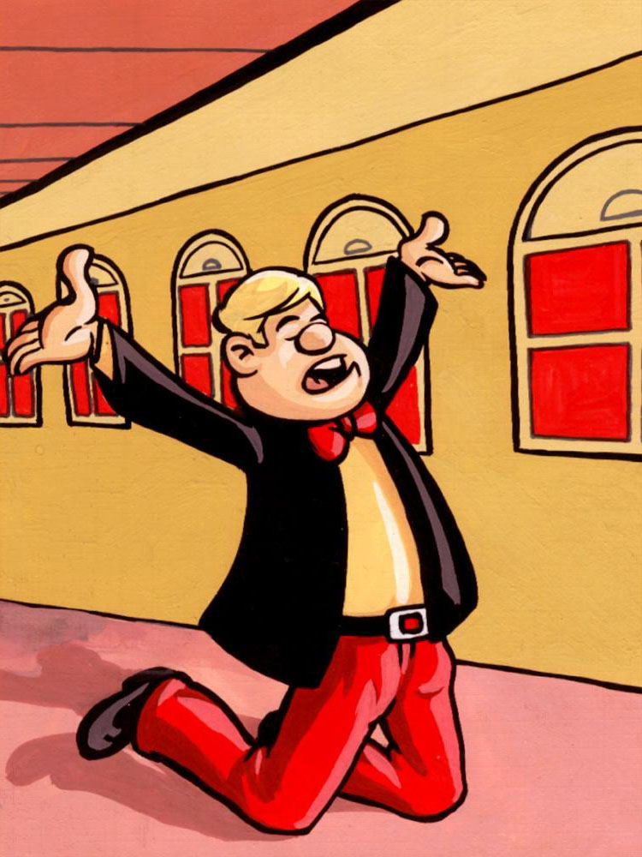
Chapter 26 Vocabulary
προσκυνέω
I worship

Slide 53
Chapter 26 Vocabulary
τις, τι
someone, something

Slide 54
Chapter 26 Vocabulary
τίς, τί
who? which? what?

Slide 55
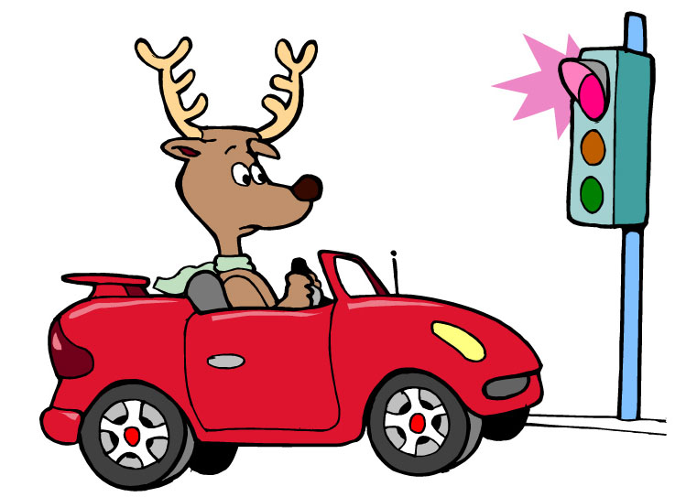
Chapter 26 Vocabulary
ὧδε
here, hither

Slide 56
Vocabulary Review

Slide 57
Chapter 26 Vocabulary
ἑαυτοῦ, -ῆς
of him/her/itself
ἐμός, -ή, -όν
my, mine
ἱμάτιον, -ου, τό
garment
νύξ, νυκτός, ἡ
night
ὅστις, ἥτις, ὅτι
whoever

Slide 58
Chapter 26 Vocabulary
ποῦ
where?
προσκυνέω
I worship
τις, τι
someone, something
τίς, τί
who? which?
ὧδε
here, hither

Slide 59
Chapter 25 Vocabulary
ἀνίστημι
I raise, erect
ἀπόλλυμι
I destroy
ἀφίημι
I let go, dismiss
δίδωμι
I give, put
ἤδη
now, already

Slide 60
Chapter 25 Vocabulary
ἵστημι
I set, stand
κηρύσσω
I proclaim
παραδίδωμι
I entrust
τίθημι
I put, place
φημί
I say

Slide 61
Chapter 24 Vocabulary
ἀγαπητός, -ή, -όν
beloved
γραμματεύς, -έως, ὁ
scribe
δαιμόνιον, -ου, τό
demon
δοκέω
I think
δοξάζω
I glorify, honor

Slide 62
Chapter 24 Vocabulary
ἔξω
outside
ἐρωτάω
I ask
θέλημα, -ατος, τό
will
θρόνος, -ου, ὁ
throne
ὄρος, -ους, τό
mountain

Slide 63
Chapter 23 Vocabulary
ἄγω
I lead, bring
ἀπολύω
I set free
εἴτε
if, whether
ἐντολή, -ῆς, ἡ
commandment
καρπός, -οῦ, ὁ
fruit

Slide 64
Chapter 23 Vocabulary
πιστός, -ή, -όν
faithful
πρεσβύτερος, -α, -ον
elder
ῥῆμα, -ατος, τό
word
σάββατον, -ου, τό
Sabbath
φέρω
I bear, carry

Slide 65
Chapter 22 Vocabulary
αἰτέω
I ask
αἰώνιος, -ον
eternal
ἀποκτείνω
I kill
κεφαλή, -ῆς, ἡ
head
πίνω
I drink

Slide 66
Chapter 22 Vocabulary
πλοῖον, -ου, τό
boat
πῦρ, -ός, τό
fire
τηρέω
I keep, guard
ὕδωρ, -ατος, τό
water
χαίρω
I rejoice

Slide 67
Chapter 21 Vocabulary
ἀνοίγω
I open
βαπτίζω
I baptize
εὐαγγέλιον, -ου, τό
gospel
μαρτυρέω
I witness
πέμπω
I send

Slide 68
Chapter 21 Vocabulary
προνηρός, -ά, -όν
evil, bad
πρόσωπον, -ου, τό
face
σημεῖον, -ου, τό
sign, miracle
στόμα, -ατος, τό
mouth
ὑπάγω
I go away

Slide 69
Chapter 20 Vocabulary
ἀναβαίνω
I go up
ἄρχω
I rule, begin (in mid.)
ἕκαστος, -η, -ον
each, every
ἐκβάλλω
I drive out
κἀγώ
and I, but I

Slide 70
Chapter 20 Vocabulary
καταβαίνω
I go down
μᾶλλον
more, rather
μήτηρ, -ός, ἡ
mother
ὅπου
where, since
ὥστε
therefore, so that

Slide 71
Chapter 19 Vocabulary
ἀκολουθέω
I follow
ἐνώπιον
before
θάλασσα, -ης, ἡ
sea, lake
κάθημαι
I sit
καιρός, -οῦ, ὁ
time

Slide 72
Chapter 19 Vocabulary
οὔτε
and not, nor, neither
πίπτω
I fall
πούς, ποδός, ὁ
foot
προσέρχομαι
I come/go to
προσεύχομαι
I pray

Slide 73
Chapter 18 Vocabulary
genna<w
I beget
dikaiosu<nh, -hj, h[
righteousness
e]a<n
if, when
ei]rh<nh, -hj, h[
peace
oi#da
I know

Slide 74
Chapter 18 Vocabulary
oi]ki<a, -aj, h[
house
o[ra<w
I see
peripate<w
I walk
pw?j
how?
fobe<omai
I fear

Slide 75
Chapter 17 Vocabulary
εἰ
if, that
ἐσθίω
I eat
ζάω
I live
ζητέω
I seek
ἤ
or, either

Slide 76
Chapter 17 Vocabulary
καλέω
I call
λαλέω
I speak, say
παρακαλέω
I urge, exhort
πληρόω
I fill, complete
ποιέω
I do, make

Slide 77
Chapter 16 Vocabulary
αἰων, -ῶνος, ὁ
Age, eternity
ἀλλήλων
one another
ἀριερεύς, -έως, ὁ
High priest
γυνή, -αικός, ἡ
woman
δύναμαι
I can, am able

Slide 78
Chapter 16 Vocabulary
ἔθνος, -ους, τό
nation
ὅσος, -η, -ον
as great as
πόλις, -εως, ἡ
city
τέ
And, and so
χείρ, χειρός, ἡ
hand

Slide 79
Chapter 15 Vocabulary
ἄλλος, -η, -ο
other
ἄρτος, -ου, ὁ
bread
δεῖ
it is necessary
ἐξουσία, -ας, ἡ
authority
ἕτερος, -α, -ον
different

Slide 80
Chapter 15 Vocabulary
ἔτι
yet, still
ὀφθαλμός, -οῦ, ὁ
eye
τέκνον, -ου, τό
child
τόπος, -ου, ὁ
place
φῶς, φωτός, τό
light

Slide 81
Chapter 14 Vocabulary
αἷμα, -ματος, τό
blood
αἴρω
I raise, take up
διδάσκω
I teach
ἴδιος, -α, -ον
one's own
καλός, -ή, -όν
good

Slide 82
Chapter 14 Vocabulary
μέλλω
I am about to, intend
ὁδός, -οῦ, ἡ
way
πολύς, πολλή, πολύ
much, many
σῶμα, -ματος, τό
body
ψυχή, -ῆς, ἡ
soul, life

Slide 83
Chapter 13 Vocabulary
ἀνήρ, ἀνδρός, ὁ
man, husband
βασιλεύς, -ἐως, ὁ
king
δύναμις, -εως, ἡ
power, miracle
ὄνομα, -ματος, τό
name
πᾶς, πᾶσα, πᾶν
each, every, all

Slide 84
Chapter 13 Vocabulary
πατήρ, πατρός, ὁ
father
πιστις, πίστεως, ἡ
faith, belief
πνεῦμα, -ατος, τό
spirit, wind
σάρξ, σαρκός, ἡ
flesh, body
χάρις, -ιτος, ἡ
grace, kindness

Slide 85
Chapter 12 Vocabulary
ἀποθνῄσκω
I die
ἐκεῖ
there
ἕως
until
ἰδού
behold

Slide 86
Chapter 12 Vocabulary
ἵνα
in order that, that
Ἰωάννης, -ου, ὁ
John
μέν
on the one hand, indeed
ὅλος, -η, -ον
whole, entire

Slide 87
Chapter 12 Vocabulary
ὅτε
when
σύν
with

Slide 88
Chapter 11 Vocabulary
ἀπέρχομαι
I go away, leave
ἐκεῖνος
that
Ἰουδαῖος, -α, -ον
Jewish
καθώς
as, just as

Slide 89
Chapter 11 Vocabulary
ὅς, ἥ, ὅ
who, which
ὅταν
when
πάλιν
again
οὗτος, αὗτη, τοῦτο
this

Slide 90
Chapter 11 Vocabulary
Πέτρος, -ου, ὁ
Peter
ὑπέρ
for, about (gen.)
above, beyond (acc.)

Slide 91
Chapter 11 Vocabulary
ὑπέρ
for, about (gen.)
above, beyond (acc.)

Slide 92
Vocabulary Ch. 10
life
ζωή, -ῆς, ἡ
death
θάνατος, -ου, ὁ
I judge
κρίνω
I remain
μένω
only, alone
μόνος, -η, -ον

Slide 93
Vocabulary Ch. 10
now
νῦν
and not, nor
οὐδέ
Paul
Παῦλος
I save
σῴζω
then
τότε

Slide 94
Vocabulary Ch. 9
I answer
ἀποκρίνομαι
I send
ἀποστέλλω
I throw
βάλλω
I become
γίνομαι
I come in
εἰσέρχομαι

Slide 95
Vocabulary Ch. 9
I go out
ἐξέρχομαι
I come/go
ἔρχομαι
I wish
θέλω
thus, so
οὕτως
I go
πορεύομαι

Slide 96
Vocabulary Ch. 8
he/she/it
αὐτός, -ή, -ό
land, earth, region
γῆ, -ῆς, ἡ
I, we
ἐγώ, ἡμεῖς
day
ἡμέρα, -ας, ἡ
that, so that
ὅτι

Slide 97
Vocabulary Ch. 8
so, then, therefore
οὖν
crowd
ὄχλος, -ου, ὁ
from
παρά (with Gen.)
beside, with
παρά (with Dat.)
alongside, beside
παρά (with Acc.)

Slide 98
Vocabulary Ch. 8
you / you (pl)
σύ / ὑμεῖς
by, at the hands of
ὑπό (with Gen.)
under, below
ὑπό (with Acc.)

Slide 99
Vocabulary -- Ch. 7
good
ἀγαθός, -ή, -όν
Holy
ἅγιος, -α, -ον
righteous
δίκαιοις, -α, -ον

Slide 100
Vocabulary – Ch. 7
I am
εἰμί
Jewish, a Jew
Ἰουδαῖος, -α, -ον
Great
μέγας, μεγάλη, μέγα

Slide 101
Vocabulary -- Ch. 7
dead
νεκρός, -ά, -όν
no, not
οὐ, οὐκ, οὐχ
first
πρῶτος, -η, -ον
voice
φωνή, -ῆς, ἡ

Slide 102
Chapter 6 Vocabulary
ἀπό (Gen.)
from
διά (Gen.)
through
διά (Acc.)
on account of
εἰς (Acc.)
into

Slide 103
Chapter 6 Vocabulary
ἐκ (Gen.)
out of, from
ἐν (Dat.)
in
ἐπί (Gen.)
on, over
ἐπί (Dat.)
on, at, against, on the basis of

Slide 104
Chapter 6 Vocabulary
ἐπί (Acc.)
on, to, toward, against
κατά (Gen.)
down, against
κατά (Acc.)
according to
μετά (Gen.)
with

Slide 105
Chapter 6 Vocabulary
μετά (Acc.)
after, behind
περί (Gen.)
about, concerning
περί (Acc.)
around, near
πρός (Acc.)
to

Slide 106
Ch. 5 -- Vocabulary
love
ἀγάπη, -ης, ἡ
truth
ἀλήθεια, -ας, ἡ
sin
ἁμαρτία, -ας, ἡ
kingdom
βασιλεία, -ας, ἡ
writing, Scripture
γραφή, -ῆς, ἡ

Slide 107
Ch. 5 -- Vocabulary
I raise up
ἐγείρω
assembly, church
ἐκκλησία, -ας, ἡ
work
ἔργον, -ου, τό
disciple
μαθητής, -οῦ, ὁ
Hour
ὥρα, -ας, ἡ

Slide 108
Ch. 4 -- Vocabulary
I love
ἀγαπάω
I write
γράφω
but, and
δέ
servant, slave
δοῦλος, -ου, ὁ
I find
εὑρίσκω

Slide 109
Ch. 4 -- Vocabulary
temple
ἱερόν, -οῦ, τό
People
λαός, -οῦ, ὁ
law
νόμος, -ου, ὁ
house
οἶκος, -ου, ὁ
as, about, how
ὡς

Slide 110
Ch. 3 -- Vocabulary
but, yet
ἀλλἀ
apostle, sent one
ἀπόστολος, -ου, ὁ
I see
βλέπω
for, then
γάρ
I know
γινώσκω

Slide 111
Ch. 3 -- Vocabulary
Jesus
Ἰησοῦς, -οῦ, ὁ
I take, receive
λαμβάνω
I loose
λύω
heaven
οὐρανός, -οῦ, ὁ
I believe
πιστεύω

Slide 112
Ch. 2 -- Vocabulary
brother
ἀδελφός, -οῦ, ὁ
I hear, obey
ἀκούω
glory, fame
δόξα, -ης, ἡ
I have
ἔχω
world
κόσμος, -ου, ὁ

Slide 113
Ch. 2 -- Vocabulary
Lord, sir
κύριος, -ου, ὁ
word
λόγος, -ου, ὁ
Peter
Πἑτρος, -ου, ὁ
son
υἱός, -οῦ, ὁ
Pharisee
Φαρισαῖος, -ου, ὁ

Slide 114
Ch. 1 -- Vocabulary
angel, messenger
ἄγγελος, -ου, ὁ
verily, truly
ἀμήν
man, humankind
ἄνθρωπος, -ου, ὁ
I
ἐγώ
God
θεός, -οῦ, ὁ

Slide 115
Ch. 1 -- Vocabulary
and, also, even
καί
heart
καρδία, -ας, ἡ
I say
λέγω
prophet
προφήτης, -ου, ὁ
Christ, Messiah
Χριστός, -οῦ, ὁ

Slide 116
In Order Vocabulary Review

Slide 117
Ch. 1 -- Vocabulary
angel, messenger
ἄγγελος, -ου, ὁ
verily, truly
ἀμήν
man, humankind
ἄνθρωπος, -ου, ὁ
I
ἐγώ
God
θεός, -οῦ, ὁ

Slide 118
Ch. 1 -- Vocabulary
and, also, even
καί
heart
καρδία, -ας, ἡ
I say
λέγω
prophet
προφήτης, -ου, ὁ
Christ, Messiah
Χριστός, -οῦ, ὁ

Slide 119
Ch. 2 -- Vocabulary
brother
ἀδελφός, -οῦ, ὁ
I hear, obey
ἀκούω
glory, fame
δόξα, -ης, ἡ
I have
ἔχω
world
κόσμος, -ου, ὁ

Slide 120
Ch. 2 -- Vocabulary
Lord, sir
κύριος, -ου, ὁ
word
λόγος, -ου, ὁ
Peter
Πἑτρος, -ου, ὁ
son
υἱός, -οῦ, ὁ
Pharisee
Φαρισαῖος, -ου, ὁ

Slide 121
Ch. 3 -- Vocabulary
but, yet
ἀλλἀ
apostle, sent one
ἀπόστολος, -ου, ὁ
I see
βλέπω
for, then
γάρ
I know
γινώσκω

Slide 122
Ch. 3 -- Vocabulary
Jesus
Ἰησοῦς, -οῦ, ὁ
I take, receive
λαμβάνω
I loose
λύω
heaven
οὐρανός, -οῦ, ὁ
I believe
πιστεύω

Slide 123
Ch. 4 -- Vocabulary
I love
ἀγαπάω
I write
γράφω
but, and
δέ
servant, slave
δοῦλος, -ου, ὁ
I find
εὑρίσκω

Slide 124
Ch. 4 -- Vocabulary
temple
ἱερόν, -οῦ, τό
People
λαός, -οῦ, ὁ
law
νόμος, -ου, ὁ
house
οἶκος, -ου, ὁ
as, about, how
ὡς

Slide 125
Ch. 5 -- Vocabulary
love
ἀγάπη, -ης, ἡ
truth
ἀλήθεια, -ας, ἡ
sin
ἁμαρτία, -ας, ἡ
kingdom
βασιλεία, -ας, ἡ
writing, Scripture
γραφή, -ῆς, ἡ

Slide 126
Ch. 5 -- Vocabulary
I raise up
ἐγείρω
assembly, church
ἐκκλησία, -ας, ἡ
work
ἔργον, -ου, τό
disciple
μαθητής, -οῦ, ὁ
Hour
ὥρα, -ας, ἡ

Slide 127
Chapter 6 Vocabulary
ἀπό (Gen.)
from
διά (Gen.)
through
διά (Acc.)
on account of
εἰς (Acc.)
into

Slide 128
Chapter 6 Vocabulary
ἐκ (Gen.)
out of, from
ἐν (Dat.)
in
ἐπί (Gen.)
on, over
ἐπί (Dat.)
on, at, against, on the basis of

Slide 129
Chapter 6 Vocabulary
ἐπί (Acc.)
on, to, toward, against
κατά (Gen.)
down, against
κατά (Acc.)
according to
μετά (Gen.)
with

Slide 130
Chapter 6 Vocabulary
μετά (Acc.)
after, behind
περί (Gen.)
about, concerning
περί (Acc.)
around, near
πρός (Acc.)
to

Slide 131
Vocabulary -- Ch. 7
good
ἀγαθός, -ή, -όν
Holy
ἅγιος, -α, -ον
righteous
δίκαιοις, -α, -ον

Slide 132
Vocabulary – Ch. 7
I am
εἰμί
Jewish, a Jew
Ἰουδαῖος, -α, -ον
Great
μέγας, μεγάλη, μέγα

Slide 133
Vocabulary -- Ch. 7
dead
νεκρός, -ά, -όν
no, not
οὐ, οὐκ, οὐχ
first
πρῶτος, -η, -ον
voice
φωνή, -ῆς, ἡ

Slide 134
Vocabulary Ch. 8
he/she/it
αὐτός, -ή, -ό
land, earth, region
γῆ, -ῆς, ἡ
I, we
ἐγώ, ἡμεῖς
day
ἡμέρα, -ας, ἡ
that, so that
ὅτι

Slide 135
Vocabulary Ch. 8
so, then, therefore
οὖν
crowd
ὄχλος, -ου, ὁ
from
παρά (with Gen.)
beside, with
παρά (with Dat.)
alongside, beside
παρά (with Acc.)

Slide 136
Vocabulary Ch. 8
you / you (pl)
σύ / ὑμεῖς
by, at the hands of
ὑπό (with Gen.)
under, below
ὑπό (with Acc.)

Slide 137
Vocabulary Ch. 9
I answer
ἀποκρίνομαι
I send
ἀποστέλλω
I throw
βάλλω
I become
γίνομαι
I come in
εἰσέρχομαι

Slide 138
Vocabulary Ch. 9
I go out
ἐξέρχομαι
I come/go
ἔρχομαι
I wish
θέλω
thus, so
οὕτως
I go
πορεύομαι

Slide 139
Vocabulary Ch. 10
life
ζωή, -ῆς, ἡ
death
θάνατος, -ου, ὁ
I judge
κρίνω
I remain
μένω
only, alone
μόνος, -η, -ον

Slide 140
Vocabulary Ch. 10
now
νῦν
and not, nor
οὐδέ
Paul
Παῦλος
I save
σῴζω
then
τότε

Slide 141
Chapter 11 Vocabulary
ἀπέρχομαι
I go away, leave
ἐκεῖνος
that
Ἰουδαῖος, -α, -ον
Jewish
καθώς
as, just as

Slide 142
Chapter 11 Vocabulary
ὅς, ἥ, ὅ
who, which
ὅταν
when
πάλιν
again
οὗτος, αὗτη, τοῦτο
this

Slide 143
Chapter 11 Vocabulary
Πέτρος, -ου, ὁ
Peter
ὑπέρ
for, about (gen.)
above, beyond (acc.)

Slide 144
Chapter 11 Vocabulary
ὑπέρ
for, about (gen.)
above, beyond (acc.)

Slide 145
Chapter 12 Vocabulary
ἀποθνῄσκω
I die
ἐκεῖ
there
ἕως
until
ἰδού
behold

Slide 146
Chapter 12 Vocabulary
ἵνα
in order that, that
Ἰωάννης, -ου, ὁ
John
μέν
on the one hand, indeed
ὅλος, -η, -ον
whole, entire

Slide 147
Chapter 12 Vocabulary
ὅτε
when
σύν
with

Slide 148
Chapter 13 Vocabulary
ἀνήρ, ἀνδρός, ὁ
man, husband
βασιλεύς, -ἐως, ὁ
king
δύναμις, -εως, ἡ
power, miracle
ὄνομα, -ματος, τό
name
πᾶς, πᾶσα, πᾶν
each, every, all

Slide 149
Chapter 13 Vocabulary
πατήρ, πατρός, ὁ
father
πιστις, πίστεως, ἡ
faith, belief
πνεῦμα, -ατος, τό
spirit, wind
σάρξ, σαρκός, ἡ
flesh, body
χάρις, -ιτος, ἡ
grace, kindness

Slide 150
Chapter 14 Vocabulary
αἷμα, -ματος, τό
blood
αἴρω
I raise, take up
διδάσκω
I teach
ἴδιος, -α, -ον
one's own
καλός, -ή, -όν
good

Slide 151
Chapter 14 Vocabulary
μέλλω
I am about to, intend
ὁδός, -οῦ, ἡ
way
πολύς, πολλή, πολύ
much, many
σῶμα, -ματος, τό
body
ψυχή, -ῆς, ἡ
soul, life

Slide 152
Chapter 15 Vocabulary
ἄλλος, -η, -ο
other
ἄρτος, -ου, ὁ
bread
δεῖ
it is necessary
ἐξουσία, -ας, ἡ
authority
ἕτερος, -α, -ον
different

Slide 153
Chapter 15 Vocabulary
ἔτι
yet, still
ὀφθαλμός, -οῦ, ὁ
eye
τέκνον, -ου, τό
child
τόπος, -ου, ὁ
place
φῶς, φωτός, τό
light

Slide 154
Chapter 16 Vocabulary
αἰων, -ῶνος, ὁ
Age, eternity
ἀλλήλων
one another
ἀρχιερεύς, -έως, ὁ
High priest
γυνή, -αικός, ἡ
woman
δύναμαι
I can, am able

Slide 155
Chapter 16 Vocabulary
ἔθνος, -ους, τό
nation
ὅσος, -η, -ον
as great as
πόλις, -εως, ἡ
city
τέ
And, and so
χείρ, χειρός, ἡ
hand

Slide 156
Chapter 17 Vocabulary
εἰ
if, that
ἐσθίω
I eat
ζάω
I live
ζητέω
I seek
ἤ
or, either

Slide 157
Chapter 17 Vocabulary
καλέω
I call
λαλέω
I speak, say
παρακαλέω
I urge, exhort
πληρόω
I fill, complete
ποιέω
I do, make

Slide 158
Chapter 18 Vocabulary
genna<w
I beget
dikaiosu<nh, -hj, h[
righteousness
e]a<n
if, when
ei]rh<nh, -hj, h[
peace
oi#da
I know

Slide 159
Chapter 18 Vocabulary
oi]ki<a, -aj, h[
house
o[ra<w
I see
peripate<w
I walk
pw?j
how?
fobe<omai
I fear

Slide 160
Chapter 19 Vocabulary
ἀκολουθέω
I follow
ἐνώπιον
before
θάλασσα, -ης, ἡ
sea, lake
κάθημαι
I sit
καιρός, -οῦ, ὁ
time

Slide 161
Chapter 19 Vocabulary
οὔτε
and not, nor, neither
πίπτω
I fall
πούς, ποδός, ὁ
foot
προσέρχομαι
I come/go to
προσεύχομαι
I pray

