Slide 1
Mastering NT Greek
23. Subjecting the Subjunctives
By Ted Hildebrandt © 2003
Baker Academic

Slide 2
Warm-ups

Slide 3
Rapping the Lord’s Prayer
Πάτερ ἡμῶν ὁ ἐν τοῖς οὐρανοῖς father our the one in heaven
ἁγιασθήτω τὸ ὄνομά σου make holy name your
ἐλθέτω ἡ βασιλεία σου let come kingdom your
γενηθήτω τὸ θέλημά σου, let be will your

Slide 4
Rapping the Lord’s Prayer
ὡς ἐν οὐρανῷ καὶ ἐπὶ γῆς· as in heaven also on earth
τὸν ἄρτον ἥμῶν τὸν the bread our
ἐπιούσιον δὸς ἡμῖν σήμερον· daily give us today

Slide 5
Rapping the Lord’s Prayer
καὶ ἄφες ἡμῖν τὰ ὀφειλήματα ἡμῶν and forgive us trespasses our
ὡς καὶ ἡμεῖς ἀφήκαμεν as also we have forgiven
τοῖς ὀφειλέταις ἡμῶν the ones trespassing us

Slide 6
Rapping the Lord’s Prayer
καὶ μὴ εἰσενέγκῃς ἡμᾶς and do not lead us εἰς πειρασμόν into temptation ἀλλὰ ῥῦσαι ἡμᾶς ἀπὸ but deliver us from τοῦ πονηροῦ the evil one

Slide 7
2-1-2 Paradigms - Chant this
2 1 2
λόγος γραφή ἱερόν
λόγου γραφῆς ἱεροῦ
λόγῳ γραφῇ ἱερῷ
λόγον γραφήν ἱερόν
λόγοι γραφαί ἱερά
λόγων γραφῶν ἱερῶν
λόγοις γραφαῖς ἱεροῖς
λόγους γραφάς ἱερά

Slide 8
3rd Declension Chantables
χαρίς ὄνομα, πίστις
χάρις ὄνομα πίστις
χάριτος ὀνόματος πίστεως
χάριτι ὀνόματι πίστει
χάριτα ὄνομα πίστιν
χάριτες ὀνόματα πίστεις
χαρίτων ὀνομάτων πίστεων
χάρισι(ν) ὀνόμασι(ν) πίστεσι(ν)
χάριτας ὀνόματα πίστεις

Slide 9
PAI Verb Chant
λύω λύομεν
λύεις λύετε
λύει λύουσι(ν)

Slide 10
The "is" verb PAI -- εἰμί
εἰμί ἐσμέν εἶ ἐστέ ἐστί(ν) εἰσί(ν)

Slide 11
Imperfect εἰμί
ἤμην ἦμεν ἦς ἦτε ἦν ἦσαν

Slide 12
Person Personal Pronoun Chant
Singular Plural
Nom. ἐγώ σύ ἡμεῖς
Gen. μου σου ἡμῶν Dat. μοι σοι ἡμῖν Acc. με σε ἡμάς
αὐτός, αὐτη, αὐτό (he, she, it)

Slide 13
Present Middle/Passive Indicative
λύομαι, -ομεθα -ῃ, -εσθε -εται, -ονται
I am loosed/am being loosed
I loose myself/am loosing [for myself]

Slide 14
Shape of the Future in Greek
λύσω λύσομεν I will loose We will loose
λύσεις λύσετε You will loose You all will loose
λύσει λύσουσι(ν) S/he/it will loose They will loose
Chant this one

Slide 15
Future Middle Paradigm
λύσομαι -όμεθα -ῃ -εσθε -εται -ονται
I will loose (for myself) We will loose (for ourselves) …

Slide 16
Demonstrative and Relative Pronouns Summary
ἐκεῖνος, ἐκείνη, ἐκεῖνο = that
οὗτος, αὕτη, τοῦτο τούτου, ταύτης, τούτου = this
ὅς ἥ ὅ = Relative (who, which) οὗ ἧς οὗ

Slide 17
Imperfect Active Paradigm of λύω
Chant: ἐλυον, ν, ς, ε, μεν, τε, ν I was loosing, …

Slide 18
Imperfect Middle/Passive (IM/PI)
Chant: ἐλυόμην ου, ετο, ομεθα, εσθε, οντο
I was being loosed

Slide 19
Second Aorist Active Chant
ἔλαβον ν, σ, ε, μεν, τε, ν

Slide 20
Second Aorist Middle Chant
ἐγενόμην -ου, -ετο, -ομεθα, -εσθε, -οντο

Slide 21
Aorist Stem Changes -- 8 to know
ἔρχομαι == ἦλθον (I came, went)
βλέπω == εἶδον (I saw)
λέγω == εἶπον (I said)
γίνομαι == ἐγενόμην (I became)
γινώσκω == ἔγνων (I knew)
ἔχω == ἔσχον ( I had)
λαμβάνω == ἔλαβον (I took)
εὑρίσκω == εὗρον (I found)

Slide 22
1st Aorist Active Paradigm
Learn: ἔλυσα: I loosed… --, ς, ε, μεν, τε, ν

Slide 23
1st Aorist Middle Paradigm
Learn: ἐλυσάμην: I loosed for myself -ω, -ατο, -αμεθα, -ασθε, -αντο

Slide 24
Chanting the Present Particple Chant
Present Active: ptc = participle
Nom. λύων λύουσα λῦον Gen. λύοντος λύουσης λύοντος
Present Middle/Passive
Nom. λυόμενος λυομένη λυόμενον Gen. λυομένου λυομένης λυομένου

Slide 25
Aorist Participle Chant
First Aorist Active 3-1-3 (chant)
Nom. λύσας λύσασα λύσαν Gen. λύσαντος λυσάσης λύσαντος
Nom. λυθείς λυθεῖσα λυθέν Gen. λυθέντος λυθείσης λυθέντος
First Aorist Middle 2-1-2 (non-chant)
Nom. λυσάμενος λυσαμένη λυσάμενον Gen. λυσαμένου λυσαμένης λυσαμένου

Slide 26
Perfect Participle Chant
Perfect Active Participles (know these)
3 1 3 λελυκώς λελυκυῖα λελυκός λελυκότος λελυκυίας λελυκότος
Perfect Middle/Passives Participles
2 1 2 λελυμένος λελυμένη λελυμένον λελυμένου λελυμένης λελυμένου

Slide 27
Infinitive Endings to Chant
λύειν (to loose)
Present: ειν εσθαι
Second Aorist: εῖν εσθαι ῆναι
First Aorist: αι ασθαι ῆναι
Perfect: ναι σθαι
Hint: often when seeing an "αι" on the end of a verb suspect an infinitive.

Slide 28
Subjunctives

Slide 29
Introduction
Verbal Moods: Indicative, Subjunctive, Imperative, Optative
Indicative: statement portrayed as fact mood
King Kong climbed the Empire State building. [Zach shot the ball.]
Subjunctive: possibility "may" or “might”, contingency, doubt, uncertainty often by reason of futurity
Zach may shoot the ball.

Slide 30
Introduction
Imperative: command (expectation)
Zach, shoot the ball!
Optative: hoped for, wish
Oh that Zach would shoot the ball.

Slide 31
Subjunctives
Tense: only in present and aorist [οἰδά (Perf.) will appear in the Subjunctive but its rare.]
Aspect not tense:
Present: In progress, unfolding, immediacy, details, foregrounded
Aorist: Whole/complete/background
Time of subjunctive dependent on main verb or context (temporal particles)

Slide 32
Form
Uses primary endings:
Active: ω, εις, ει, ομεν...
Passive: μαι, ῃ, εται, ομεθα ...
The trick: the connecting vowel is lengthened ο to ω; ε to η
Present: λυ + ω + μεν = λύωμεν
we may continue to loose
Aorist: λυ + σ + ω + μεν = λύσωμεν
we may loose

Slide 33
Present Active (process, immediacy, foregrounding)
Active Singular Plural
1 λύω λύωμεν 2 λύῃς λύητε 3 λύῃ λύωσι(ν)
I may continue loosing (may be loosing) You may continue loosing

Slide 34
Present Mid/Passive (process, immediacy, foregrounding)
Mid/Pas Singular Plural
1 λύωμαι λυώμεθα 2 λύῃ λύησθε 3 λύηται λύωνται
I may continue to be loosed You may continue to be loosed

Slide 35
Aorist Active (whole, complete, background)
Active Singular Plural
1 λύσω λύσωμεν 2 λύσῃς λύσητε 3 λύσῃ λύσωσι(ν)
I may loose You may loose
Compare future form. What is relation of subj. and future?

Slide 36
Aorist Middle (whole, complete, background)
Mid Singular Plural
1 λύσωμαι λυσώμεθα 2 λύσῃ λύσησθε 3 λύσηται λύσωνται
I may loose (myself) You may loose (yourself)

Slide 37
Aorist Passive (whole, complete, background)
Passive Singular Plural
1 λυθῶ λυθῶμεν 2 λυθῇς λυθῆτε 3 λυθῇ λυθῶσι(ν)
I may be loosed You may be loosed

Slide 38
Second Aorist Active (λείπω = I leave)
Active Singular Plural
1 λίπω λίπωμεν 2 λίπῃς λίπητε 3 λίπῃ λίπωσι(ν)
I may leave You may leave

Slide 39
Subjunctivizing ei]mi<
Active Singular Plural
1 ὦ ὦμεν 2 ἦς ἦτε 3 ᾖ ὦσι(ν)
I may be You may be

Slide 40
Subjunctive Overview
PAS λύω, λύῃς, λύῃ, λύωμεν, λύητε, λύωσι(ν)
PM/P S λύωμαι, -ῃ, ηται, -ωμεθα, -ησθε, -ωνται
AAS λύσω, λύσῃς, λύσῃ, λύσωμεν, λύσητε, λύσωσι(ν)
AM S λύσωμαι, -ῃ, -ηται, -ωμεθα, -ησθε, -ωνται
APS λύθω, λύθῃς, λύθῃ, λύθωμεν, λύθητε, λύθωσι(ν)

Slide 41
Subjunctive Chant
PAS λύω, λύῃς, λύῃ, λύωμεν, λύητε, λύωσι(ν)
PM/P S λύωμαι, -ῃ, ῃται, -ωμεθα, -ησθε, -ωνται

Slide 42
Four Subjunctive Triggers
ἵνα = in order that + Subjunctive (ὅπως)
ἐάν = if/when + Subjunctive
ὅς ἄν = whoever + Subjunctive
ἕως = until + Subjunctive
Hint: whenever you see a ἵνα look for a subjunctive following it.

Slide 43
Four Functions of Subjunctives
Hortatory subjunctive: "Let us, let me"
Requires first person: me, we
Let us go, let us pray
Subordinate purpose/result clause:
in order that he might run
Prohibitive Subjunctive
Lead us not into temptation

Slide 44
Four Functions of Subjunctives
Deliberative subjunctive: rhetorical device not wanting an answer
What shall I say to you?

Slide 45
Four Types of Conditionals
1) Reality: if (since) you come, then I will...
εἰ + Indicative verb
2) Contrary to fact: "If you had come he would not have died (but you didn’t)"
εἰ + indicative + ἄν + indicative
3) Probability: if you come then you are my friend (but you have not yet)
ἔάν + Subjunctive

Slide 46
Four Types of Conditionals
4) Possibility: εἰ + Optative (if you should suffer)

Slide 47
Optatives
Mood of wish -- 67 in NT
Characterized by an internal addition of: οι, αι, or ει internal connector.
γάνοιτο -- Aorist of γίνομαι -- may it be
δυναίμην -- Present dep. 1s -- Oh that I would be able to ...
ἔχοιεν -- Present 3 Pl -- Oh that they would have

Slide 48
Negative Rhetorical Questions
οὐ implies a "yes" answer Elliott, you are going to study tonight, aren't you? -- yes, of course
μή implies a "no" answer (may = nay). "You are not going to study are you? -- no most likely not

Slide 49
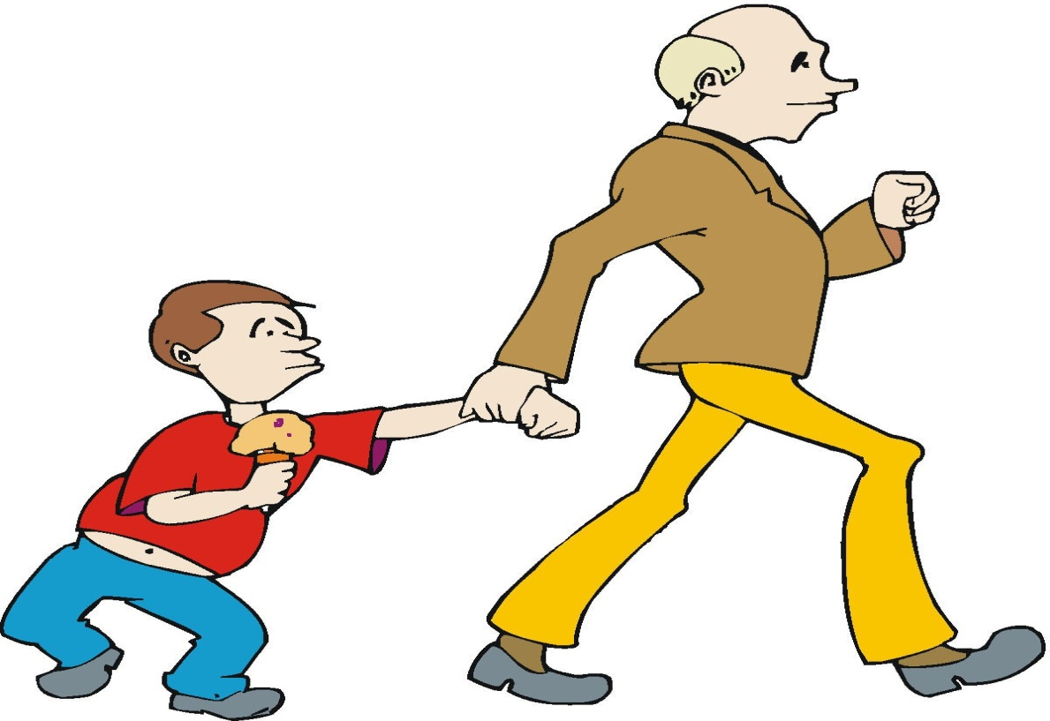
Chapter 23 Vocabulary
ἄγω
I lead, bring

Slide 50
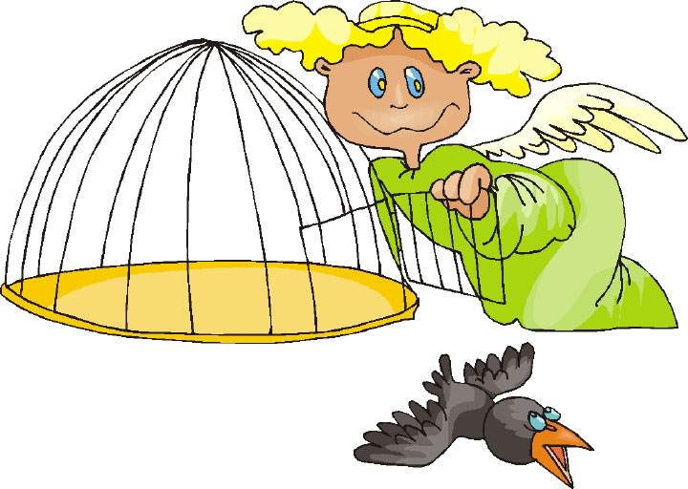
Chapter 23 Vocabulary
ἀπολύω
I set free

Slide 51
Chapter 23 Vocabulary
εἴτε
if, whether

Slide 52
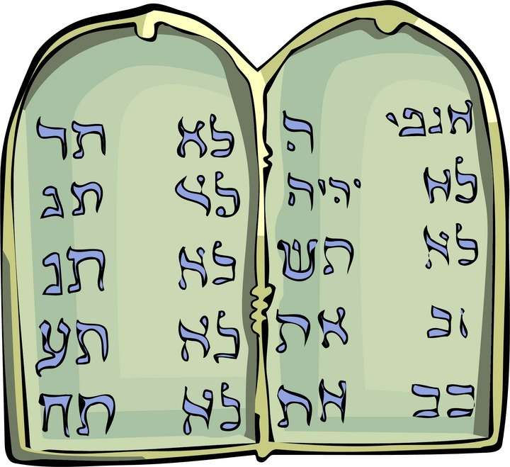
Chapter 23 Vocabulary
ἐντολή, -ῆς, ἡ
commandment

Slide 53
Chapter 23 Vocabulary
καρπός, -οῦ, ὁ
fruit

Slide 54
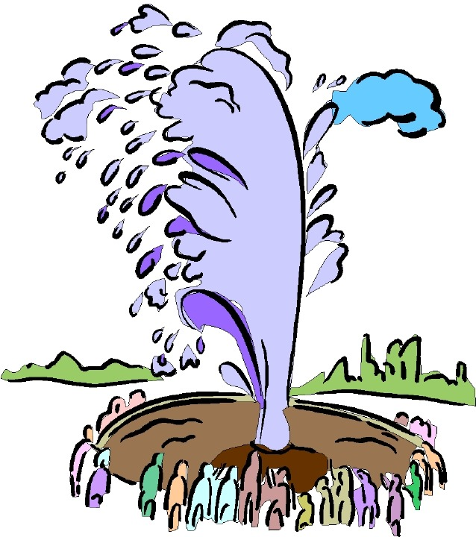
Chapter 23 Vocabulary
πιστός, -ή, -όν
faithful

Slide 55
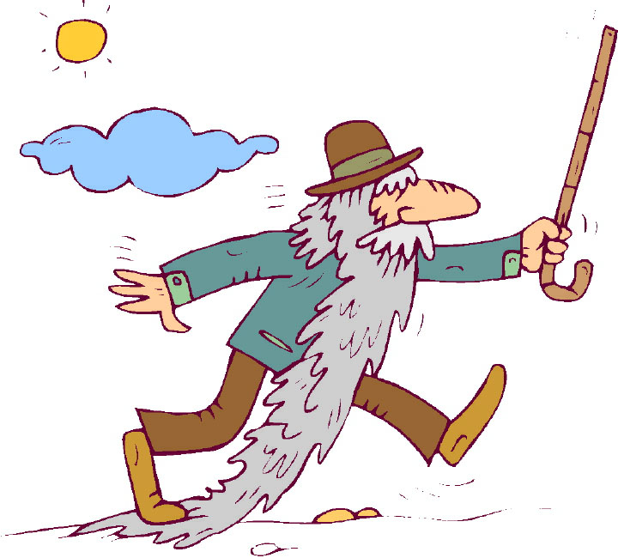
Chapter 23 Vocabulary
πρεσβύτερος, -α, -ον
elder

Slide 56
Chapter 23 Vocabulary
ῥῆμα, -ατος, τό
word

Slide 57
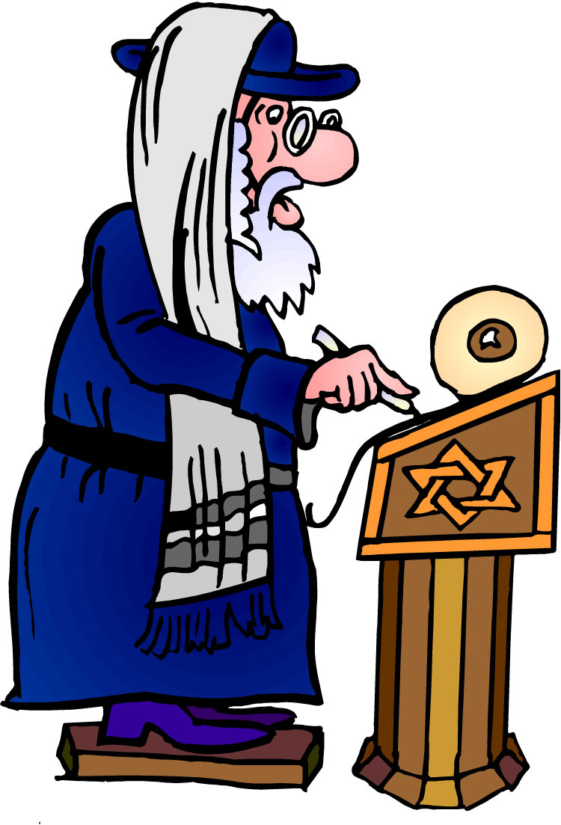
Vocabulary Ch. 23
σάββατον, -ου, τό
Sabbath

Slide 58
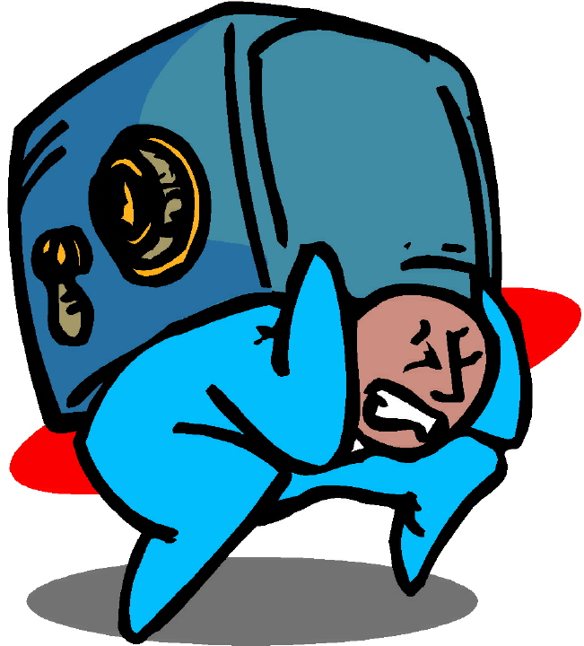
Chapter 23 Vocabulary
φέρω
I bear, carry

Slide 59
Vocabulary Review

Slide 60
Chapter 23 Vocabulary
ἄγω
I lead, bring
ἀπολύω
I set free
εἴτε
if, whether
ἐντολή, -ῆς, ἡ
commandment
καρπός, -οῦ, ὁ
fruit

Slide 61
Chapter 23 Vocabulary
πιστός, -ή, -όν
faithful
πρεσβύτερος, -α, -ον
elder
ῥῆμα, -ατος, τό
word
σάββατον, -ου, τό
Sabbath
φέρω
I bear, carry

Slide 62
Chapter 22 Vocabulary
αἰτέω
I ask
αἰώνιος, -ον
eternal
ἀποκτείνω
I kill
κεφαλή, -ῆς, ἡ
head
πίνω
I drink

Slide 63
Chapter 22 Vocabulary
πλοῖον, -ου, τό
boat
πῦρ, -ός, τό
fire
τηρέω
I keep, guard
ὕδωρ, -ατος, τό
water
χαίρω
I rejoice

Slide 64
Chapter 21 Vocabulary
ἀνοίγω
I open
βαπτίζω
I baptize
εὐαγγέλιον, -ου, τό
gospel
μαρτυρέω
I witness
πέμπω
I send

Slide 65
Chapter 21 Vocabulary
προνηρός, -ά, -όν
evil, bad
πρόσωπον, -ου, τό
face
σημεῖον, -ου, τό
sign, miracle
στόμα, -ατος, τό
mouth
ὑπάγω
I go away

Slide 66
Chapter 20 Vocabulary
ἀναβαίνω
I go up
ἄρχω
I rule, begin (in mid.)
ἕκαστος, -η, -ον
each, every
ἐκβάλλω
I drive out
κἀγώ
and I, but I

Slide 67
Chapter 20 Vocabulary
καταβαίνω
I go down
μᾶλλον
more, rather
μήτηρ, -ός, ἡ
mother
ὅπου
where, since
ὥστε
therefore, so that

Slide 68
Chapter 19 Vocabulary
ἀκολουθέω
I follow
ἐνώπιον
before
θάλασσα, -ης, ἡ
sea, lake
κάθημαι
I sit
καιρός, -οῦ, ὁ
time

Slide 69
Chapter 19 Vocabulary
οὔτε
and not, nor, neither
πίπτω
I fall
πούς, ποδός, ὁ
foot
προσέρχομαι
I come/go to
προσεύχομαι
I pray

Slide 70
Chapter 18 Vocabulary
genna<w
I beget
dikaiosu<nh, -hj, h[
righteousness
e]a<n
if, when
ei]rh<nh, -hj, h[
peace
oi#da
I know

Slide 71
Chapter 18 Vocabulary
oi]ki<a, -aj, h[
house
o[ra<w
I see
peripate<w
I walk
pw?j
how?
fobe<omai
I fear

Slide 72
Chapter 17 Vocabulary
εἰ
if, that
ἐσθίω
I eat
ζάω
I live
ζητέω
I seek
ἤ
or, either

Slide 73
Chapter 17 Vocabulary
καλέω
I call
λαλέω
I speak, say
παρακαλέω
I urge, exhort
πληρόω
I fill, complete
ποιέω
I do, make

Slide 74
Chapter 16 Vocabulary
αἰων, -ῶνος, ὁ
Age, eternity
ἀλλήλων
one another
ἀριερεύς, -έως, ὁ
High priest
γυνή, -αικός, ἡ
woman
δύναμαι
I can, am able

Slide 75
Chapter 16 Vocabulary
ἔθνος, -ους, τό
nation
ὅσος, -η, -ον
as great as
πόλις, -εως, ἡ
city
τέ
And, and so
χείρ, χειρός, ἡ
hand

Slide 76
Chapter 15 Vocabulary
ἄλλος, -η, -ο
other
ἄρτος, -ου, ὁ
bread
δεῖ
it is necessary
ἐξουσία, -ας, ἡ
authority
ἕτερος, -α, -ον
different

Slide 77
Chapter 15 Vocabulary
ἔτι
yet, still
ὀφθαλμός, -οῦ, ὁ
eye
τέκνον, -ου, τό
child
τόπος, -ου, ὁ
place
φῶς, φωτός, τό
light

Slide 78
Chapter 14 Vocabulary
αἷμα, -ματος, τό
blood
αἴρω
I raise, take up
διδάσκω
I teach
ἴδιος, -α, -ον
one's own
καλός, -ή, -όν
good

Slide 79
Chapter 14 Vocabulary
μέλλω
I am about to, intend
ὁδός, -οῦ, ἡ
way
πολύς, πολλή, πολύ
much, many
σῶμα, -ματος, τό
body
ψυχή, -ῆς, ἡ
soul, life

Slide 80
Chapter 13 Vocabulary
ἀνήρ, ἀνδρός, ὁ
man, husband
βασιλεύς, -ἐως, ὁ
king
δύναμις, -εως, ἡ
power, miracle
ὄνομα, -ματος, τό
name
πᾶς, πᾶσα, πᾶν
each, every, all

Slide 81
Chapter 13 Vocabulary
πατήρ, πατρός, ὁ
father
πιστις, πίστεως, ἡ
faith, belief
πνεῦμα, -ατος, τό
spirit, wind
σάρξ, σαρκός, ἡ
flesh, body
χάρις, -ιτος, ἡ
grace, kindness

Slide 82
Chapter 12 Vocabulary
ἀποθνῄσκω
I die
ἐκεῖ
there
ἕως
until
ἰδού
behold

Slide 83
Chapter 12 Vocabulary
ἵνα
in order that, that
Ἰωάννης, -ου, ὁ
John
μέν
on the one hand, indeed
ὅλος, -η, -ον
whole, entire

Slide 84
Chapter 12 Vocabulary
ὅτε
when
σύν
with

Slide 85
Chapter 11 Vocabulary
ἀπέρχομαι
I go away, leave
ἐκεῖνος
that
Ἰουδαῖος, -α, -ον
Jewish
καθώς
as, just as

Slide 86
Chapter 11 Vocabulary
ὅς, ἥ, ὅ
who, which
ὅταν
when
πάλιν
again
οὗτος, αὗτη, τοῦτο
this

Slide 87
Chapter 11 Vocabulary
Πέτρος, -ου, ὁ
Peter
ὑπέρ
for, about (gen.)
above, beyond (acc.)

Slide 88
Chapter 11 Vocabulary
ὑπέρ
for, about (gen.)
above, beyond (acc.)

Slide 89
Vocabulary Ch. 10
life
ζωή, -ῆς, ἡ
death
θάνατος, -ου, ὁ
I judge
κρίνω
I remain
μένω
only, alone
μόνος, -η, -ον

Slide 90
Vocabulary Ch. 10
now
νῦν
and not, nor
οὐδέ
Paul
Παῦλος
I save
σῴζω
then
τότε

Slide 91
Vocabulary Ch. 9
I answer
ἀποκρίνομαι
I send
ἀποστέλλω
I throw
βάλλω
I become
γίνομαι
I come in
εἰσέρχομαι

Slide 92
Vocabulary Ch. 9
I go out
ἐξέρχομαι
I come/go
ἔρχομαι
I wish
θέλω
thus, so
οὕτως
I go
πορεύομαι

Slide 93
Vocabulary Ch. 8
he/she/it
αὐτός, -ή, -ό
land, earth, region
γῆ, -ῆς, ἡ
I, we
ἐγώ, ἡμεῖς
day
ἡμέρα, -ας, ἡ
that, so that
ὅτι

Slide 94
Vocabulary Ch. 8
so, then, therefore
οὖν
crowd
ὄχλος, -ου, ὁ
from
παρά (with Gen.)
beside, with
παρά (with Dat.)
alongside, beside
παρά (with Acc.)

Slide 95
Vocabulary Ch. 8
you / you (pl)
σύ / ὑμεῖς
by, at the hands of
ὑπό (with Gen.)
under, below
ὑπό (with Acc.)

Slide 96
Vocabulary -- Ch. 7
good
ἀγαθός, -ή, -όν
Holy
ἅγιος, -α, -ον
righteous
δίκαιοις, -α, -ον

Slide 97
Vocabulary – Ch. 7
I am
εἰμί
Jewish, a Jew
Ἰουδαῖος, -α, -ον
Great
μέγας, μεγάλη, μέγα

Slide 98
Vocabulary -- Ch. 7
dead
νεκρός, -ά, -όν
no, not
οὐ, οὐκ, οὐχ
first
πρῶτος, -η, -ον
voice
φωνή, -ῆς, ἡ

Slide 99
Chapter 6 Vocabulary
ἀπό (Gen.)
from
διά (Gen.)
through
διά (Acc.)
on account of
εἰς (Acc.)
into

Slide 100
Chapter 6 Vocabulary
ἐκ (Gen.)
out of, from
ἐν (Dat.)
in
ἐπί (Gen.)
on, over
ἐπί (Dat.)
on, at, against, on the basis of

Slide 101
Chapter 6 Vocabulary
ἐπί (Acc.)
on, to, toward, against
κατά (Gen.)
down, against
κατά (Acc.)
according to
μετά (Gen.)
with

Slide 102
Chapter 6 Vocabulary
μετά (Acc.)
after, behind
περί (Gen.)
about, concerning
περί (Acc.)
around, near
πρός (Acc.)
to

Slide 103
Ch. 5 -- Vocabulary
love
ἀγάπη, -ης, ἡ
truth
ἀλήθεια, -ας, ἡ
sin
ἁμαρτία, -ας, ἡ
kingdom
βασιλεία, -ας, ἡ
writing, Scripture
γραφή, -ῆς, ἡ

Slide 104
Ch. 5 -- Vocabulary
I raise up
ἐγείρω
assembly, church
ἐκκλησία, -ας, ἡ
work
ἔργον, -ου, τό
disciple
μαθητής, -οῦ, ὁ
Hour
ὥρα, -ας, ἡ

Slide 105
Ch. 4 -- Vocabulary
I love
ἀγαπάω
I write
γράφω
but, and
δέ
servant, slave
δοῦλος, -ου, ὁ
I find
εὑρίσκω

Slide 106
Ch. 4 -- Vocabulary
temple
ἱερόν, -οῦ, τό
People
λαός, -οῦ, ὁ
law
νόμος, -ου, ὁ
house
οἶκος, -ου, ὁ
as, about, how
ὡς

Slide 107
Ch. 3 -- Vocabulary
but, yet
ἀλλἀ
apostle, sent one
ἀπόστολος, -ου, ὁ
I see
βλέπω
for, then
γάρ
I know
γινώσκω

Slide 108
Ch. 3 -- Vocabulary
Jesus
Ἰησοῦς, -οῦ, ὁ
I take, receive
λαμβάνω
I loose
λύω
heaven
οὐρανός, -οῦ, ὁ
I believe
πιστεύω

Slide 109
Ch. 2 -- Vocabulary
brother
ἀδελφός, -οῦ, ὁ
I hear, obey
ἀκούω
glory, fame
δόξα, -ης, ἡ
I have
ἔχω
world
κόσμος, -ου, ὁ

Slide 110
Ch. 2 -- Vocabulary
Lord, sir
κύριος, -ου, ὁ
word
λόγος, -ου, ὁ
Peter
Πἑτρος, -ου, ὁ
son
υἱός, -οῦ, ὁ
Pharisee
Φαρισαῖος, -ου, ὁ

Slide 111
Ch. 1 -- Vocabulary
angel, messenger
ἄγγελος, -ου, ὁ
verily, truly
ἀμήν
man, humankind
ἄνθρωπος, -ου, ὁ
I
ἐγώ
God
θεός, -οῦ, ὁ

Slide 112
Ch. 1 -- Vocabulary
and, also, even
καί
heart
καρδία, -ας, ἡ
I say
λέγω
prophet
προφήτης, -ου, ὁ
Christ, Messiah
Χριστός, -οῦ, ὁ

Slide 113
In Order Vocabulary Review

Slide 114
Ch. 1 -- Vocabulary
angel, messenger
ἄγγελος, -ου, ὁ
verily, truly
ἀμήν
man, humankind
ἄνθρωπος, -ου, ὁ
I
ἐγώ
God
θεός, -οῦ, ὁ

Slide 115
Ch. 1 -- Vocabulary
and, also, even
καί
heart
καρδία, -ας, ἡ
I say
λέγω
prophet
προφήτης, -ου, ὁ
Christ, Messiah
Χριστός, -οῦ, ὁ

Slide 116
Ch. 2 -- Vocabulary
brother
ἀδελφός, -οῦ, ὁ
I hear, obey
ἀκούω
glory, fame
δόξα, -ης, ἡ
I have
ἔχω
world
κόσμος, -ου, ὁ

Slide 117
Ch. 2 -- Vocabulary
Lord, sir
κύριος, -ου, ὁ
word
λόγος, -ου, ὁ
Peter
Πἑτρος, -ου, ὁ
son
υἱός, -οῦ, ὁ
Pharisee
Φαρισαῖος, -ου, ὁ

Slide 118
Ch. 3 -- Vocabulary
but, yet
ἀλλἀ
apostle, sent one
ἀπόστολος, -ου, ὁ
I see
βλέπω
for, then
γάρ
I know
γινώσκω

Slide 119
Ch. 3 -- Vocabulary
Jesus
Ἰησοῦς, -οῦ, ὁ
I take, receive
λαμβάνω
I loose
λύω
heaven
οὐρανός, -οῦ, ὁ
I believe
πιστεύω

Slide 120
Ch. 4 -- Vocabulary
I love
ἀγαπάω
I write
γράφω
but, and
δέ
servant, slave
δοῦλος, -ου, ὁ
I find
εὑρίσκω

Slide 121
Ch. 4 -- Vocabulary
temple
ἱερόν, -οῦ, τό
People
λαός, -οῦ, ὁ
law
νόμος, -ου, ὁ
house
οἶκος, -ου, ὁ
as, about, how
ὡς

Slide 122
Ch. 5 -- Vocabulary
love
ἀγάπη, -ης, ἡ
truth
ἀλήθεια, -ας, ἡ
sin
ἁμαρτία, -ας, ἡ
kingdom
βασιλεία, -ας, ἡ
writing, Scripture
γραφή, -ῆς, ἡ

Slide 123
Ch. 5 -- Vocabulary
I raise up
ἐγείρω
assembly, church
ἐκκλησία, -ας, ἡ
work
ἔργον, -ου, τό
disciple
μαθητής, -οῦ, ὁ
Hour
ὥρα, -ας, ἡ

Slide 124
Chapter 6 Vocabulary
ἀπό (Gen.)
from
διά (Gen.)
through
διά (Acc.)
on account of
εἰς (Acc.)
into

Slide 125
Chapter 6 Vocabulary
ἐκ (Gen.)
out of, from
ἐν (Dat.)
in
ἐπί (Gen.)
on, over
ἐπί (Dat.)
on, at, against, on the basis of

Slide 126
Chapter 6 Vocabulary
ἐπί (Acc.)
on, to, toward, against
κατά (Gen.)
down, against
κατά (Acc.)
according to
μετά (Gen.)
with

Slide 127
Chapter 6 Vocabulary
μετά (Acc.)
after, behind
περί (Gen.)
about, concerning
περί (Acc.)
around, near
πρός (Acc.)
to

Slide 128
Vocabulary -- Ch. 7
good
ἀγαθός, -ή, -όν
Holy
ἅγιος, -α, -ον
righteous
δίκαιοις, -α, -ον

Slide 129
Vocabulary – Ch. 7
I am
εἰμί
Jewish, a Jew
Ἰουδαῖος, -α, -ον
Great
μέγας, μεγάλη, μέγα

Slide 130
Vocabulary -- Ch. 7
dead
νεκρός, -ά, -όν
no, not
οὐ, οὐκ, οὐχ
first
πρῶτος, -η, -ον
voice
φωνή, -ῆς, ἡ

Slide 131
Vocabulary Ch. 8
he/she/it
αὐτός, -ή, -ό
land, earth, region
γῆ, -ῆς, ἡ
I, we
ἐγώ, ἡμεῖς
day
ἡμέρα, -ας, ἡ
that, so that
ὅτι

Slide 132
Vocabulary Ch. 8
so, then, therefore
οὖν
crowd
ὄχλος, -ου, ὁ
from
παρά (with Gen.)
beside, with
παρά (with Dat.)
alongside, beside
παρά (with Acc.)

Slide 133
Vocabulary Ch. 8
you / you (pl)
σύ / ὑμεῖς
by, at the hands of
ὑπό (with Gen.)
under, below
ὑπό (with Acc.)

Slide 134
Vocabulary Ch. 9
I answer
ἀποκρίνομαι
I send
ἀποστέλλω
I throw
βάλλω
I become
γίνομαι
I come in
εἰσέρχομαι

Slide 135
Vocabulary Ch. 9
I go out
ἐξέρχομαι
I come/go
ἔρχομαι
I wish
θέλω
thus, so
οὕτως
I go
πορεύομαι

Slide 136
Vocabulary Ch. 10
life
ζωή, -ῆς, ἡ
death
θάνατος, -ου, ὁ
I judge
κρίνω
I remain
μένω
only, alone
μόνος, -η, -ον

Slide 137
Vocabulary Ch. 10
now
νῦν
and not, nor
οὐδέ
Paul
Παῦλος
I save
σῴζω
then
τότε

Slide 138
Chapter 11 Vocabulary
ἀπέρχομαι
I go away, leave
ἐκεῖνος
that
Ἰουδαῖος, -α, -ον
Jewish
καθώς
as, just as

Slide 139
Chapter 11 Vocabulary
ὅς, ἥ, ὅ
who, which
ὅταν
when
πάλιν
again
οὗτος, αὗτη, τοῦτο
this

Slide 140
Chapter 11 Vocabulary
Πέτρος, -ου, ὁ
Peter
ὑπέρ
for, about (gen.)
above, beyond (acc.)

Slide 141
Chapter 11 Vocabulary
ὑπέρ
for, about (gen.)
above, beyond (acc.)

Slide 142
Chapter 12 Vocabulary
ἀποθνῄσκω
I die
ἐκεῖ
there
ἕως
until
ἰδού
behold

Slide 143
Chapter 12 Vocabulary
ἵνα
in order that, that
Ἰωάννης, -ου, ὁ
John
μέν
on the one hand, indeed
ὅλος, -η, -ον
whole, entire

Slide 144
Chapter 12 Vocabulary
ὅτε
when
σύν
with

Slide 145
Chapter 13 Vocabulary
ἀνήρ, ἀνδρός, ὁ
man, husband
βασιλεύς, -ἐως, ὁ
king
δύναμις, -εως, ἡ
power, miracle
ὄνομα, -ματος, τό
name
πᾶς, πᾶσα, πᾶν
each, every, all

Slide 146
Chapter 13 Vocabulary
πατήρ, πατρός, ὁ
father
πιστις, πίστεως, ἡ
faith, belief
πνεῦμα, -ατος, τό
spirit, wind
σάρξ, σαρκός, ἡ
flesh, body
χάρις, -ιτος, ἡ
grace, kindness

Slide 147
Chapter 14 Vocabulary
αἷμα, -ματος, τό
blood
αἴρω
I raise, take up
διδάσκω
I teach
ἴδιος, -α, -ον
one's own
καλός, -ή, -όν
good

Slide 148
Chapter 14 Vocabulary
μέλλω
I am about to, intend
ὁδός, -οῦ, ἡ
way
πολύς, πολλή, πολύ
much, many
σῶμα, -ματος, τό
body
ψυχή, -ῆς, ἡ
soul, life

Slide 149
Chapter 15 Vocabulary
ἄλλος, -η, -ο
other
ἄρτος, -ου, ὁ
bread
δεῖ
it is necessary
ἐξουσία, -ας, ἡ
authority
ἕτερος, -α, -ον
different

Slide 150
Chapter 15 Vocabulary
ἔτι
yet, still
ὀφθαλμός, -οῦ, ὁ
eye
τέκνον, -ου, τό
child
τόπος, -ου, ὁ
place
φῶς, φωτός, τό
light

Slide 151
Chapter 16 Vocabulary
αἰων, -ῶνος, ὁ
Age, eternity
ἀλλήλων
one another
ἀρχιερεύς, -έως, ὁ
High priest
γυνή, -αικός, ἡ
woman
δύναμαι
I can, am able

Slide 152
Chapter 16 Vocabulary
ἔθνος, -ους, τό
nation
ὅσος, -η, -ον
as great as
πόλις, -εως, ἡ
city
τέ
And, and so
χείρ, χειρός, ἡ
hand

Slide 153
Chapter 17 Vocabulary
εἰ
if, that
ἐσθίω
I eat
ζάω
I live
ζητέω
I seek
ἤ
or, either

Slide 154
Chapter 17 Vocabulary
καλέω
I call
λαλέω
I speak, say
παρακαλέω
I urge, exhort
πληρόω
I fill, complete
ποιέω
I do, make

Slide 155
Chapter 18 Vocabulary
genna<w
I beget
dikaiosu<nh, -hj, h[
righteousness
e]a<n
if, when
ei]rh<nh, -hj, h[
peace
oi#da
I know

Slide 156
Chapter 18 Vocabulary
oi]ki<a, -aj, h[
house
o[ra<w
I see
peripate<w
I walk
pw?j
how?
fobe<omai
I fear

Slide 157
Chapter 19 Vocabulary
ἀκολουθέω
I follow
ἐνώπιον
before
θάλασσα, -ης, ἡ
sea, lake
κάθημαι
I sit
καιρός, -οῦ, ὁ
time

Slide 158
Chapter 19 Vocabulary
οὔτε
and not, nor, neither
πίπτω
I fall
πούς, ποδός, ὁ
foot
προσέρχομαι
I come/go to
προσεύχομαι
I pray

Slide 159
Body/soul; mind/brain
28 kai> mh> fobhqh?te a]po> tw?n a]pokteino<ntwn to> sw?ma th>n de> yuxh>n mh> duname<nwn a]poktei?nai:
fobei?sqe de> ma?llon to>n duna<menon kai> yuxh>n kai> sw?ma a]pole<sai [to destroy a]pollumi] e]n gee<nn^

