Slide 1
Mastering NT Greek
20. Aorist Participles
By Ted Hildebrandt © 2003
Baker Academic

Slide 2
Rapping the Lord’s Prayer
Πάτερ ἡμῶν ὁ ἐν τοῖς οὐρανοῖς father our the one in heaven
ἁγιασθήτω τὸ ὄνομά σου make holy name your
ἐλθέτω ἡ βασιλεία σου let come kingdom your
γενηθήτω τὸ θέλημά σου, let be will your

Slide 3
Rapping the Lord’s Prayer
ὡς ἐν οὐρανῷ καὶ ἐπὶ γῆς· as in heaven also on earth
τὸν ἄρτον ἥμῶν τὸν the bread our
ἐπιούσιον δὸς ἡμῖν σήμερον· daily give us today

Slide 4
Rapping the Lord’s Prayer
καὶ ἄφες ἡμῖν τὰ ὀφειλήματα ἡμῶν and forgive us trespasses our
ὡς καὶ ἡμεῖς ἀφήκαμεν as also we have forgiven
τοῖς ὀφειλέταις ἡμῶν the ones trespassing us

Slide 5
Rapping the Lord’s Prayer
καὶ μὴ εἰσενέγκῃς ἡμᾶς and do not lead us εἰς πειρασμόν into temptation ἀλλὰ ῥῦσαι ἡμᾶς ἀπὸ but deliver us from τοῦ πονηροῦ the evil one

Slide 6
2-1-2 Paradigms - Chant this
2 1 2
λόγος γραφή ἱερόν
λόγου γραφῆς ἱεροῦ
λόγῳ γραφῇ ἱερῷ
λόγον γραφήν ἱερόν
λόγοι γραφαί ἱερά
λόγων γραφῶν ἱερῶν
λόγοις γραφαῖς ἱεροῖς
λόγους γραφάς ἱερά

Slide 7
3rd Declension Chantables
χαρίς ὄνομα, πίστις
χάρις ὄνομα πίστις
χάριτος ὀνόματος πίστεως
χάριτι ὀνόματι πίστει
χάριτα ὄνομα πίστιν
χάριτες ὀνόματα πίστεις
χαρίτων ὀνομάτων πίστεων
χάρισι(ν) ὀνόμασι(ν) πίστεσι(ν)
χάριτας ὀνόματα πίστεις

Slide 8
PAI Verb Chant
λύω λύομεν
λύεις λύετε
λύει λύουσι(ν)

Slide 9
The "is" verb PAI -- εἰμί
εἰμί ἐσμέν εἶ ἐστέ ἐστί(ν) εἰσί(ν)

Slide 10
Imperfect εἰμί
ἤμην ἦμεν ἦς ἦτε ἦν ἦσαν

Slide 11
Person Personal Pronoun Chant
Singular Plural
Nom. ἐγώ σύ ἡμεῖς
Gen. μου σου ἡμῶν Dat. μοι σοι ἡμῖν Acc. με σε ἡμάς
αὐτός, αὐτη, αὐτό (he, she, it)

Slide 12
Present Middle/Passive Indicative
λύομαι, -ομεθα -ῃ, -εσθε -εται, -ονται
I am loosed/am being loosed
I loose myself/am loosing [for myself]

Slide 13
Shape of the Future in Greek
λύσω λύσομεν I will loose We will loose
λύσεις λύσετε You will loose You all will loose
λύσει λύσουσι(ν) S/he/it will loose They will loose
Chant this one

Slide 14
Future Middle Paradigm
λύσομαι -όμεθα -ῃ -εσθε -εται -ονται
I will loose (for myself) We will loose (for ourselves) …

Slide 15
Demonstrative and Relative Pronouns Summary
ἐκεῖνος, ἐκείνη, ἐκεῖνο = that
οὗτος, αὕτη, τοῦτο τούτου, ταύτης, τούτου = this
ὅς ἥ ὅ = Relative (who, which) οὗ ἧς οὗ

Slide 16
Imperfect Active Paradigm of λύω
Chant: ἐλυον, ν, ς, ε, μεν, τε, ν I was loosing, …

Slide 17
Imperfect Middle/Passive (IM/PI)
Chant: ἐλυόμην ου, ετο, ομεθα, εσθε, οντο
I was being loosed

Slide 18
Second Aorist Active Chant
ἔλαβον ν, σ, ε, μεν, τε, ν

Slide 19
Second Aorist Middle Chant
ἐγενόμην -ου, -ετο, -ομεθα, -εσθε, -οντο

Slide 20
Aorist Stem Changes -- 8 to know
ἔρχομαι == ἦλθον (I came, went)
βλέπω == εἶδον (I saw)
λέγω == εἶπον (I said)
γίνομαι == ἐγενόμην (I became)
γινώσκω == ἔγνων (I knew)
ἔχω == ἔσχον ( I had)
λαμβάνω == ἔλαβον (I took)
εὑρίσκω == εὗρον (I found)

Slide 21
1st Aorist Active Paradigm
Learn: ἔλυσα: I loosed… --, ς, ε, μεν, τε, ν

Slide 22
1st Aorist Middle Paradigm
Learn: ἐλυσάμην: I loosed for myself -ω, -ατο, -αμεθα, -ασθε, -αντο

Slide 23
Chanting the PA and PM/P Participle
Present Active: ptc = participle
Nom. λύων λύουσα λῦον Gen. λύοντος λύουσης λύοντος
Present Middle/Passive
Nom. λυόμενος λυομένη λυόμενον Gen. λυομένου λυομένης λυομένου

Slide 24
Introduction: Aorist Ptc.
Present Participles = continuous action
Aorist Participles = complete/wholistic action
Aorist means it just states that the action took place

Slide 25
3 Usages of the Participle: AAS
Adjective: modifies a noun "The woman who sat on the right“
Note the use of a past tense verb rather than an –ing verb “the boy who came, was the first choice”
Adverb: "After running up the hill, she sat"
Substantive: "The one who sat there was"

Slide 26
Participles and time
Aorist participles time is relative to the main verb. The action of the aorist participle takes place prior/before the action of the main verb. "After speaking, he went his way."
Aorist may also describe attendant circumstances.

Slide 27
Adverbial Options
Cause: εἰδότες (ptc) ὅτι ὁ ἐτείρας τὸν κύριον Ἰησοῦν
Knowing (because we know?) that the one who raised up the Lord Jesus (2 Cor 4:14)
Instrumental: ἀλλὰ ἑαυτὸν ἐκένωσεν μορφὴν δούλου λαβών
He emptied himself by taking the form of a servant etc. (Stevens, 318)

Slide 28
Participle Voice
Active: word the participle modifies does the action -- The man who ran to the store was the first to come
Middle: self-interest -- After freeing himself, he ran to the store.
Passive: Receives the action of the participle -- The boy who was stung by the bees ran

Slide 29
First Aorist Active Participle Formation
Masculine/Neuter (participles NO AUGMENT)
Stem Aor. Ptc + 3rd Decl. λυ + σα + ντ + ος = λύσαντος
Feminine
Stem Aor Ptc σ + 1st Decl λυ + σα + σ + ης = λυσάσης

Slide 30
First Aorist Active Ptc
3 1 3
Singular Masc Fem Neut
Nom. λύσας λύσασα λῦσαν Gen. λύσαντος λύσασης λύσαντος Dat. λύσαντι λυσάσῃ λύσαντι Acc. λύσαντα λύσασαν λῦσαν
3 uses: who loosed (Adj.), after loosing (Adv.), one who loosed (Subst.),

Slide 31
First Aorist Active Ptc
3 1 3
Plural Masc Fem Neut
Nom. λύσαντες λύσασαι λύσαντα Gen. λυσάντων λυσανσῶν λυσάντων Dat. λύσασι(ν) λυσάσαις λύσασι(ν) Acc. λύσαντας λυσάσας λύσαντα
3 uses: who loosed (Adj.), after loosing (Adv.), one who loosed (Subst.)

Slide 32
First Aorist Middle Formation
Masculine/Neuter
Stem Aor. Ptc + 2rd Decl. λυ + σα + μεν + ος = λύσαμενος
Feminine
Stem Aor. Ptc + 1st Decl. λυ + σα + μεν + η = λυσαμένη

Slide 33
First Aorist Middle Ptc
2 1 2
Singular Masc Fem Neut
Nom. λυσάμενος λυσαμένη λυσάμενον Gen. λυσαμένου λυσαμένης λυσαμένου Dat. λυσαμένῳ λυσαμένῃ λυσαμέν& Acc. λυσάμενον λυσαμένην λυσάμενον
3 uses: who loosed himself (Adj.), after loosing himself (Adv.), one who loosed himself (Subst.)

Slide 34
First Aorist Active Ptc
2 1 2
Plural Masc Fem Neut
Nom. λυσάμενοι λυσάμεναι λυσάμενα Gen. λυσαμένων λυσαμένων λυσαμένων Dat. λυσαμένοις λυσαμέναις λυσαμένοις Acc. λυσαμένους λυσαμένας λυσάμενα
3 uses: who loosed himself (Adj.), after loosing himself (Adv.), one who loosed himself (Subst.)

Slide 35
First Aorist Passive Formation
Masculine/Neuter
Stem Aor. Pass + 3rd Decl. λυ + θε + ντος = λυθέντος
Feminine
Stem Aor. Pas + 1rd Decl. λυ + θεισ + α = λυθεῖσα

Slide 36
First Aorist Passive Ptc
3 1 3
Singular Masc Fem Neut
Nom. λυθείς λυθεῖσα λυθέν Gen. λυθέντος λυθείσης λυθέντος Dat. λυθέντι λυθείσῃ λύθεντι Acc. λυφέντα λυθεῖσαν λυθέν
3 uses: who was loosed (Adj.), after being loosed (Adv.), one who was loosed (Subst.)

Slide 37
First Aorist Passive Ptc
3 1 3
Plural Masc Fem Neut
Nom. λυθέντες λυθεῖσαι λυθέντα Gen. λυθέντων λυθεισῶν λυθέντων Dat. λυθεῖσι(ν) λυθείσαις λυθεῖσι(ν) Acc. λυθέντας λυθείσας λυθέντα
3 uses: who was loosed (Adj.), after being loosed (Adv.), one who was loosed (Subst.)

Slide 38
Forms to Chant to
First Aorist Active 3-1-3 (chant)
Nom. λύσας λύσασα λύσαν Gen. λύσαντος λυσάσης λύσαντος
Nom. λυθείς λυθεῖσα λυθέν Gen. λυθέντος λυθείσης λυθέντος
First Aorist Middle 2-1-2 (non-chant)
Nom. λυσάμενος λυσαμένη λυσάμενον Gen. λυσαμένου λυσαμένης λυσαμένου

Slide 39
Second Aorist Participles
Second Aorist Stem changes + Present participle endings
λαβών λαβόντος, λαβόντι
λαβόμενος, λαβομένου ...
γραφείς, γραφέντος ...
Contract Verbs
ἀγαπησας, ἀγαπήσαντος …

Slide 40
Chapter 20 Vocabulary
ἀναβαίνω
I go up

Slide 41
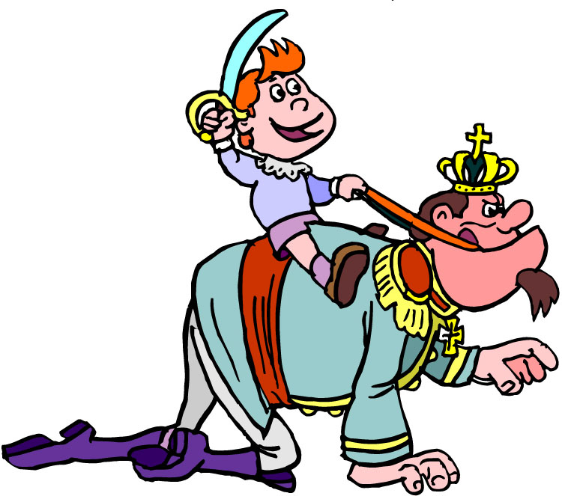
Chapter 20 Vocabulary
ἄρχω
I rule, begin (in mid.)

Slide 42
Chapter 20 Vocabulary
ἕκαστος, -η, -ον
each, every

Slide 43
Chapter 20 Vocabulary
ἐκβάλλω
I drive out

Slide 44
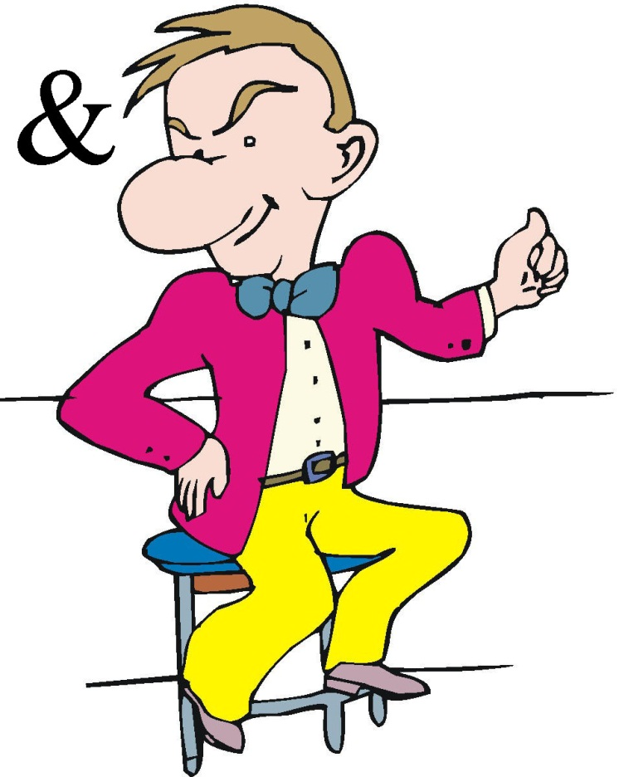
Chapter 20 Vocabulary
κἀγώ
and I, but I

Slide 45
Chapter 20 Vocabulary
καταβαίνω
I go down

Slide 46
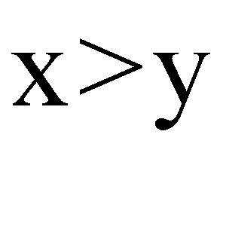
Chapter 20 Vocabulary
μᾶλλον
more, rather

Slide 47
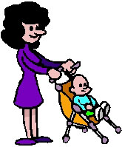
Chapter 20 Vocabulary
μήτηρ, -ός, ἡ
mother

Slide 48
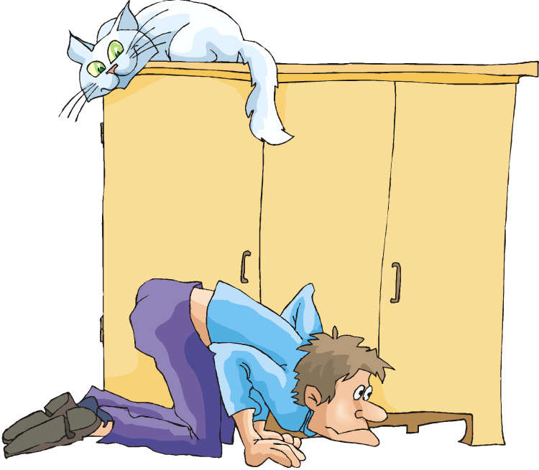
Chapter 20 Vocabulary
ὅπου
where, since

Slide 49
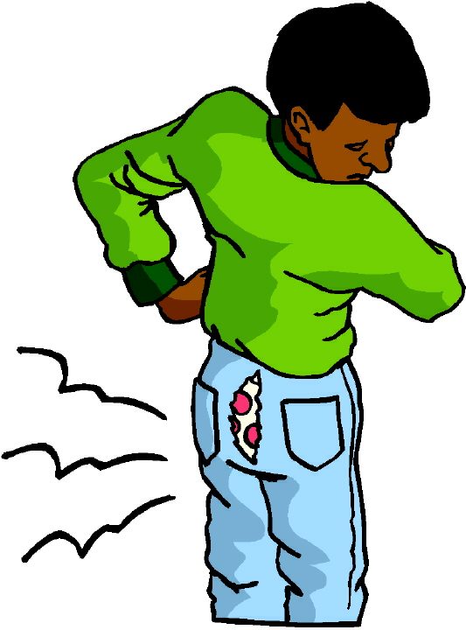
Chapter 20 Vocabulary
ὥστε
therefore, so (that)

Slide 50
Reverse Vocabulary Review

Slide 51
Chapter 19 Vocabulary
ἀκολουθέω
I follow
ἐνώπιον
before
θάλασσα, -ης, ἡ
sea, lake
κάθημαι
I sit
καιρός, -οῦ, ὁ
time

Slide 52
Chapter 19 Vocabulary
οὔτε
and not, nor, neither
πίπτω
I fall
πούς, ποδός, ὁ
foot
προσέρχομαι
I come/go to
προσεύχομαι
I pray

Slide 53
Chapter 18 Vocabulary
genna<w
I beget
dikaiosu<nh, -hj, h[
righteousness
e]a<n
if, when
ei]rh<nh, -hj, h[
peace
oi#da
I know

Slide 54
Chapter 18 Vocabulary
oi]ki<a, -aj, h[
house
o[ra<w
I see
peripate<w
I walk
pw?j
how?
fobe<omai
I fear

Slide 55
Chapter 17 Vocabulary
εἰ
if, that
ἐσθίω
I eat
ζάω
I live
ζητέω
I seek
ἤ
or, either

Slide 56
Chapter 17 Vocabulary
καλέω
I call
λαλέω
I speak, say
παρακαλέω
I urge, exhort
πληρόω
I fill, complete
ποιέω
I do, make

Slide 57
Chapter 16 Vocabulary
αἰων, -ῶνος, ὁ
Age, eternity
ἀλλήλων
one another
ἀριερεύς, -έως, ὁ
High priest
γυνή, -αικός, ἡ
woman
δύναμαι
I can, am able

Slide 58
Chapter 16 Vocabulary
ἔθνος, -ους, τό
nation
ὅσος, -η, -ον
as great as
πόλις, -εως, ἡ
city
τέ
And, and so
χείρ, χειρός, ἡ
hand

Slide 59
Chapter 15 Vocabulary
ἄλλος, -η, -ο
other
ἄρτος, -ου, ὁ
bread
δεῖ
it is necessary
ἐξουσία, -ας, ἡ
authority
ἕτερος, -α, -ον
different

Slide 60
Chapter 15 Vocabulary
ἔτι
yet, still
ὀφθαλμός, -οῦ, ὁ
eye
τέκνον, -ου, τό
child
τόπος, -ου, ὁ
place
φῶς, φωτός, τό
light

Slide 61
Chapter 14 Vocabulary
αἷμα, -ματος, τό
blood
αἴρω
I raise, take up
διδάσκω
I teach
ἴδιος, -α, -ον
one's own
καλός, -ή, -όν
good

Slide 62
Chapter 14 Vocabulary
μέλλω
I am about to, intend
ὁδός, -οῦ, ἡ
way
πολύς, πολλή, πολύ
much, many
σῶμα, -ματος, τό
body
ψυχή, -ῆς, ἡ
soul, life

Slide 63
Chapter 13 Vocabulary
ἀνήρ, ἀνδρός, ὁ
man, husband
βασιλεύς, -ἐως, ὁ
king
δύναμις, -εως, ἡ
power, miracle
ὄνομα, -ματος, τό
name
πᾶς, πᾶσα, πᾶν
each, every, all

Slide 64
Chapter 13 Vocabulary
πατήρ, πατρός, ὁ
father
πιστις, πίστεως, ἡ
faith, belief
πνεῦμα, -ατος, τό
spirit, wind
σάρξ, σαρκός, ἡ
flesh, body
χάρις, -ιτος, ἡ
grace, kindness

Slide 65
Chapter 12 Vocabulary
ἀποθνῄσκω
I die
ἐκεῖ
there
ἕως
until
ἰδού
behold

Slide 66
Chapter 12 Vocabulary
ἵνα
in order that, that
Ἰωάννης, -ου, ὁ
John
μέν
on the one hand, indeed
ὅλος, -η, -ον
whole, entire

Slide 67
Chapter 12 Vocabulary
ὅτε
when
σύν
with

Slide 68
Chapter 11 Vocabulary
ἀπέρχομαι
I go away, leave
ἐκεῖνος
that
Ἰουδαῖος, -α, -ον
Jewish
καθώς
as, just as

Slide 69
Chapter 11 Vocabulary
ὅς, ἥ, ὅ
who, which
ὅταν
when
πάλιν
again
οὗτος, αὗτη, τοῦτο
this

Slide 70
Chapter 11 Vocabulary
Πέτρος, -ου, ὁ
Peter
ὑπέρ
for, about (gen.)
above, beyond (acc.)

Slide 71
Chapter 11 Vocabulary
ὑπέρ
for, about (gen.)
above, beyond (acc.)

Slide 72
Vocabulary Ch. 10
life
ζωή, -ῆς, ἡ
death
θάνατος, -ου, ὁ
I judge
κρίνω
I remain
μένω
only, alone
μόνος, -η, -ον

Slide 73
Vocabulary Ch. 10
now
νῦν
and not, nor
οὐδέ
Paul
Παῦλος
I save
σῴζω
then
τότε

Slide 74
Vocabulary Ch. 9
I answer
ἀποκρίνομαι
I send
ἀποστέλλω
I throw
βάλλω
I become
γίνομαι
I come in
εἰσέρχομαι

Slide 75
Vocabulary Ch. 9
I go out
ἐξέρχομαι
I come/go
ἔρχομαι
I wish
θέλω
thus, so
οὕτως
I go
πορεύομαι

Slide 76
Vocabulary Ch. 8
he/she/it
αὐτός, -ή, -ό
land, earth, region
γῆ, -ῆς, ἡ
I, we
ἐγώ, ἡμεῖς
day
ἡμέρα, -ας, ἡ
that, so that
ὅτι

Slide 77
Vocabulary Ch. 8
so, then, therefore
οὖν
crowd
ὄχλος, -ου, ὁ
from
παρά (with Gen.)
beside, with
παρά (with Dat.)
alongside, beside
παρά (with Acc.)

Slide 78
Vocabulary Ch. 8
you / you (pl)
σύ / ὑμεῖς
by, at the hands of
ὑπό (with Gen.)
under, below
ὑπό (with Acc.)

Slide 79
Vocabulary -- Ch. 7
good
ἀγαθός, -ή, -όν
Holy
ἅγιος, -α, -ον
righteous
δίκαιοις, -α, -ον

Slide 80
Vocabulary – Ch. 7
I am
εἰμί
Jewish, a Jew
Ἰουδαῖος, -α, -ον
Great
μέγας, μεγάλη, μέγα

Slide 81
Vocabulary -- Ch. 7
dead
νεκρός, -ά, -όν
no, not
οὐ, οὐκ, οὐχ
first
πρῶτος, -η, -ον
voice
φωνή, -ῆς, ἡ

Slide 82
Chapter 6 Vocabulary
ἀπό (Gen.)
from
διά (Gen.)
through
διά (Acc.)
on account of
εἰς (Acc.)
into

Slide 83
Chapter 6 Vocabulary
ἐκ (Gen.)
out of, from
ἐν (Dat.)
in
ἐπί (Gen.)
on, over
ἐπί (Dat.)
on, at, against, on the basis of

Slide 84
Chapter 6 Vocabulary
ἐπί (Acc.)
on, to, toward, against
κατά (Gen.)
down, against
κατά (Acc.)
according to
μετά (Gen.)
with

Slide 85
Chapter 6 Vocabulary
μετά (Acc.)
after, behind
περί (Gen.)
about, concerning
περί (Acc.)
around, near
πρός (Acc.)
to

Slide 86
Ch. 5 -- Vocabulary
love
ἀγάπη, -ης, ἡ
truth
ἀλήθεια, -ας, ἡ
sin
ἁμαρτία, -ας, ἡ
kingdom
βασιλεία, -ας, ἡ
writing, Scripture
γραφή, -ῆς, ἡ

Slide 87
Ch. 5 -- Vocabulary
I raise up
ἐγείρω
assembly, church
ἐκκλησία, -ας, ἡ
work
ἔργον, -ου, τό
disciple
μαθητής, -οῦ, ὁ
Hour
ὥρα, -ας, ἡ

Slide 88
Ch. 4 -- Vocabulary
I love
ἀγαπάω
I write
γράφω
but, and
δέ
servant, slave
δοῦλος, -ου, ὁ
I find
εὑρίσκω

Slide 89
Ch. 4 -- Vocabulary
temple
ἱερόν, -οῦ, τό
People
λαός, -οῦ, ὁ
law
νόμος, -ου, ὁ
house
οἶκος, -ου, ὁ
as, about, how
ὡς

Slide 90
Ch. 3 -- Vocabulary
but, yet
ἀλλἀ
apostle, sent one
ἀπόστολος, -ου, ὁ
I see
βλέπω
for, then
γάρ
I know
γινώσκω

Slide 91
Ch. 3 -- Vocabulary
Jesus
Ἰησοῦς, -οῦ, ὁ
I take, receive
λαμβάνω
I loose
λύω
heaven
οὐρανός, -οῦ, ὁ
I believe
πιστεύω

Slide 92
Ch. 2 -- Vocabulary
brother
ἀδελφός, -οῦ, ὁ
I hear, obey
ἀκούω
glory, fame
δόξα, -ης, ἡ
I have
ἔχω
world
κόσμος, -ου, ὁ

Slide 93
Ch. 2 -- Vocabulary
Lord, sir
κύριος, -ου, ὁ
word
λόγος, -ου, ὁ
Peter
Πἑτρος, -ου, ὁ
son
υἱός, -οῦ, ὁ
Pharisee
Φαρισαῖος, -ου, ὁ

Slide 94
Ch. 1 -- Vocabulary
angel, messenger
ἄγγελος, -ου, ὁ
verily, truly
ἀμήν
man, humankind
ἄνθρωπος, -ου, ὁ
I
ἐγώ
God
θεός, -οῦ, ὁ

Slide 95
Ch. 1 -- Vocabulary
and, also, even
καί
heart
καρδία, -ας, ἡ
I say
λέγω
prophet
προφήτης, -ου, ὁ
Christ, Messiah
Χριστός, -οῦ, ὁ

Slide 96
In Order Vocabulary Review

Slide 97
Ch. 1 -- Vocabulary
angel, messenger
ἄγγελος, -ου, ὁ
verily, truly
ἀμήν
man, humankind
ἄνθρωπος, -ου, ὁ
I
ἐγώ
God
θεός, -οῦ, ὁ

Slide 98
Ch. 1 -- Vocabulary
and, also, even
καί
heart
καρδία, -ας, ἡ
I say
λέγω
prophet
προφήτης, -ου, ὁ
Christ, Messiah
Χριστός, -οῦ, ὁ

Slide 99
Ch. 2 -- Vocabulary
brother
ἀδελφός, -οῦ, ὁ
I hear, obey
ἀκούω
glory, fame
δόξα, -ης, ἡ
I have
ἔχω
world
κόσμος, -ου, ὁ

Slide 100
Ch. 2 -- Vocabulary
Lord, sir
κύριος, -ου, ὁ
word
λόγος, -ου, ὁ
Peter
Πἑτρος, -ου, ὁ
son
υἱός, -οῦ, ὁ
Pharisee
Φαρισαῖος, -ου, ὁ

Slide 101
Ch. 3 -- Vocabulary
but, yet
ἀλλἀ
apostle, sent one
ἀπόστολος, -ου, ὁ
I see
βλέπω
for, then
γάρ
I know
γινώσκω

Slide 102
Ch. 3 -- Vocabulary
Jesus
Ἰησοῦς, -οῦ, ὁ
I take, receive
λαμβάνω
I loose
λύω
heaven
οὐρανός, -οῦ, ὁ
I believe
πιστεύω

Slide 103
Ch. 4 -- Vocabulary
I love
ἀγαπάω
I write
γράφω
but, and
δέ
servant, slave
δοῦλος, -ου, ὁ
I find
εὑρίσκω

Slide 104
Ch. 4 -- Vocabulary
temple
ἱερόν, -οῦ, τό
People
λαός, -οῦ, ὁ
law
νόμος, -ου, ὁ
house
οἶκος, -ου, ὁ
as, about, how
ὡς

Slide 105
Ch. 5 -- Vocabulary
love
ἀγάπη, -ης, ἡ
truth
ἀλήθεια, -ας, ἡ
sin
ἁμαρτία, -ας, ἡ
kingdom
βασιλεία, -ας, ἡ
writing, Scripture
γραφή, -ῆς, ἡ

Slide 106
Ch. 5 -- Vocabulary
I raise up
ἐγείρω
assembly, church
ἐκκλησία, -ας, ἡ
work
ἔργον, -ου, τό
disciple
μαθητής, -οῦ, ὁ
Hour
ὥρα, -ας, ἡ

Slide 107
Chapter 6 Vocabulary
ἀπό (Gen.)
from
διά (Gen.)
through
διά (Acc.)
on account of
εἰς (Acc.)
into

Slide 108
Chapter 6 Vocabulary
ἐκ (Gen.)
out of, from
ἐν (Dat.)
in
ἐπί (Gen.)
on, over
ἐπί (Dat.)
on, at, against, on the basis of

Slide 109
Chapter 6 Vocabulary
ἐπί (Acc.)
on, to, toward, against
κατά (Gen.)
down, against
κατά (Acc.)
according to
μετά (Gen.)
with

Slide 110
Chapter 6 Vocabulary
μετά (Acc.)
after, behind
περί (Gen.)
about, concerning
περί (Acc.)
around, near
πρός (Acc.)
to

Slide 111
Vocabulary -- Ch. 7
good
ἀγαθός, -ή, -όν
Holy
ἅγιος, -α, -ον
righteous
δίκαιοις, -α, -ον

Slide 112
Vocabulary – Ch. 7
I am
εἰμί
Jewish, a Jew
Ἰουδαῖος, -α, -ον
Great
μέγας, μεγάλη, μέγα

Slide 113
Vocabulary -- Ch. 7
dead
νεκρός, -ά, -όν
no, not
οὐ, οὐκ, οὐχ
first
πρῶτος, -η, -ον
voice
φωνή, -ῆς, ἡ

Slide 114
Vocabulary Ch. 8
he/she/it
αὐτός, -ή, -ό
land, earth, region
γῆ, -ῆς, ἡ
I, we
ἐγώ, ἡμεῖς
day
ἡμέρα, -ας, ἡ
that, so that
ὅτι

Slide 115
Vocabulary Ch. 8
so, then, therefore
οὖν
crowd
ὄχλος, -ου, ὁ
from
παρά (with Gen.)
beside, with
παρά (with Dat.)
alongside, beside
παρά (with Acc.)

Slide 116
Vocabulary Ch. 8
you / you (pl)
σύ / ὑμεῖς
by, at the hands of
ὑπό (with Gen.)
under, below
ὑπό (with Acc.)

Slide 117
Vocabulary Ch. 9
I answer
ἀποκρίνομαι
I send
ἀποστέλλω
I throw
βάλλω
I become
γίνομαι
I come in
εἰσέρχομαι

Slide 118
Vocabulary Ch. 9
I go out
ἐξέρχομαι
I come/go
ἔρχομαι
I wish
θέλω
thus, so
οὕτως
I go
πορεύομαι

Slide 119
Vocabulary Ch. 10
life
ζωή, -ῆς, ἡ
death
θάνατος, -ου, ὁ
I judge
κρίνω
I remain
μένω
only, alone
μόνος, -η, -ον

Slide 120
Vocabulary Ch. 10
now
νῦν
and not, nor
οὐδέ
Paul
Παῦλος
I save
σῴζω
then
τότε

Slide 121
Chapter 11 Vocabulary
ἀπέρχομαι
I go away, leave
ἐκεῖνος
that
Ἰουδαῖος, -α, -ον
Jewish
καθώς
as, just as

Slide 122
Chapter 11 Vocabulary
ὅς, ἥ, ὅ
who, which
ὅταν
when
πάλιν
again
οὗτος, αὗτη, τοῦτο
this

Slide 123
Chapter 11 Vocabulary
Πέτρος, -ου, ὁ
Peter
ὑπέρ
for, about (gen.)
above, beyond (acc.)

Slide 124
Chapter 11 Vocabulary
ὑπέρ
for, about (gen.)
above, beyond (acc.)

Slide 125
Chapter 12 Vocabulary
ἀποθνῄσκω
I die
ἐκεῖ
there
ἕως
until
ἰδού
behold

Slide 126
Chapter 12 Vocabulary
ἵνα
in order that, that
Ἰωάννης, -ου, ὁ
John
μέν
on the one hand, indeed
ὅλος, -η, -ον
whole, entire

Slide 127
Chapter 12 Vocabulary
ὅτε
when
σύν
with

Slide 128
Chapter 13 Vocabulary
ἀνήρ, ἀνδρός, ὁ
man, husband
βασιλεύς, -ἐως, ὁ
king
δύναμις, -εως, ἡ
power, miracle
ὄνομα, -ματος, τό
name
πᾶς, πᾶσα, πᾶν
each, every, all

Slide 129
Chapter 13 Vocabulary
πατήρ, πατρός, ὁ
father
πιστις, πίστεως, ἡ
faith, belief
πνεῦμα, -ατος, τό
spirit, wind
σάρξ, σαρκός, ἡ
flesh, body
χάρις, -ιτος, ἡ
grace, kindness

Slide 130
Chapter 14 Vocabulary
αἷμα, -ματος, τό
blood
αἴρω
I raise, take up
διδάσκω
I teach
ἴδιος, -α, -ον
one's own
καλός, -ή, -όν
good

Slide 131
Chapter 14 Vocabulary
μέλλω
I am about to, intend
ὁδός, -οῦ, ἡ
way
πολύς, πολλή, πολύ
much, many
σῶμα, -ματος, τό
body
ψυχή, -ῆς, ἡ
soul, life

Slide 132
Chapter 15 Vocabulary
ἄλλος, -η, -ο
other
ἄρτος, -ου, ὁ
bread
δεῖ
it is necessary
ἐξουσία, -ας, ἡ
authority
ἕτερος, -α, -ον
different

Slide 133
Chapter 15 Vocabulary
ἔτι
yet, still
ὀφθαλμός, -οῦ, ὁ
eye
τέκνον, -ου, τό
child
τόπος, -ου, ὁ
place
φῶς, φωτός, τό
light

Slide 134
Chapter 16 Vocabulary
αἰων, -ῶνος, ὁ
Age, eternity
ἀλλήλων
one another
ἀρχιερεύς, -έως, ὁ
High priest
γυνή, -αικός, ἡ
woman
δύναμαι
I can, am able

Slide 135
Chapter 16 Vocabulary
ἔθνος, -ους, τό
nation
ὅσος, -η, -ον
as great as
πόλις, -εως, ἡ
city
τέ
And, and so
χείρ, χειρός, ἡ
hand

Slide 136
Chapter 17 Vocabulary
εἰ
if, that
ἐσθίω
I eat
ζάω
I live
ζητέω
I seek
ἤ
or, either

Slide 137
Chapter 17 Vocabulary
καλέω
I call
λαλέω
I speak, say
παρακαλέω
I urge, exhort
πληρόω
I fill, complete
ποιέω
I do, make

Slide 138
Chapter 18 Vocabulary
genna<w
I beget
dikaiosu<nh, -hj, h[
righteousness
e]a<n
if, when
ei]rh<nh, -hj, h[
peace
oi#da
I know

Slide 139
Chapter 18 Vocabulary
oi]ki<a, -aj, h[
house
o[ra<w
I see
peripate<w
I walk
pw?j
how?
fobe<omai
I fear

Slide 140
Chapter 19 Vocabulary
ἀκολουθέω
I follow
ἐνώπιον
before
θάλασσα, -ης, ἡ
sea, lake
κάθημαι
I sit
καιρός, -οῦ, ὁ
time

Slide 141
Chapter 19 Vocabulary
οὔτε
and not, nor, neither
πίπτω
I fall
πούς, ποδός, ὁ
foot
προσέρχομαι
I come/go to
προσεύχομαι
I pray

