Slide 1
Mastering NT Greek
19. Present Participles
By Ted Hildebrandt © 2003
Baker Academic

Slide 2
Warm-ups

Slide 3
2-1-2 Paradigms - Chant this
2 1 2
λόγος γραφή ἱερόν
λόγου γραφῆς ἱεροῦ
λόγῳ γραφῇ ἱερῷ
λόγον γραφήν ἱερόν
λόγοι γραφαί ἱερά
λόγων γραφῶν ἱερῶν
λόγοις γραφαῖς ἱεροῖς
λόγους γραφάς ἱερά

Slide 4
3rd Declension Chantables
χαρίς ὄνομα, πίστις
χάρις ὄνομα πίστις
χάριτος ὀνόματος πίστεως
χάριτι ὀνόματι πίστει
χάριτα ὄνομα πίστιν
χάριτες ὀνόματα πίστεις
χαρίτων ὀνομάτων πίστεων
χάρισι(ν) ὀνόμασι(ν) πίστεσι(ν)
χάριτας ὀνόματα πίστεις

Slide 5
PAI Verb Chant
λύω λύομεν
λύεις λύετε
λύει λύουσι(ν)

Slide 6
The "is" verb PAI -- εἰμί
εἰμί ἐσμέν εἶ ἐστέ ἐστί(ν) εἰσί(ν)

Slide 7
Imperfect εἰμί
ἤμην ἦμεν ἦς ἦτε ἦν ἦσαν

Slide 8
Person Personal Pronoun Chant
Singular Plural
Nom. ἐγώ σύ ἡμεῖς
Gen. μου σου ἡμῶν Dat. μοι σοι ἡμῖν Acc. με σε ἡμάς
αὐτός, αὐτη, αὐτό (he, she, it)

Slide 9
Present Middle/Passive Indicative
λύομαι, -ομεθα -ῃ, -εσθε -εται, -ονται
I am loosed/am being loosed
I loose myself/am loosing [for myself]

Slide 10
Shape of the Future in Greek
λύσω λύσομεν I will loose We will loose
λύσεις λύσετε You will loose You all will loose
λύσει λύσουσι(ν) S/he/it will loose They will loose
Chant this one

Slide 11
Future Middle Paradigm
λύσομαι -όμεθα -ῃ -εσθε -εται -ονται
I will loose (for myself) We will loose (for ourselves) …

Slide 12
Demonstrative and Relative Pronouns Summary
ἐκεῖνος, ἐκείνη, ἐκεῖνο = that
οὗτος, αὕτη, τοῦτο τούτου, ταύτης, τούτου = this
ὅς ἥ ὅ = Relative (who, which) οὗ ἧς οὗ

Slide 13
Imperfect Active Paradigm of λύω
Chant: ἐλυον, ν, ς, ε, μεν, τε, ν I was loosing, …

Slide 14
Imperfect Middle/Passive (IM/PI)
Chant: ἐλυόμην ου, ετο, ομεθα, εσθε, οντο
I was being loosed

Slide 15
Second Aorist Active Chant
ἔλαβον ν, σ, ε, μεν, τε, ν

Slide 16
Second Aorist Middle Chant
ἐγενόμην -ου, -ετο, -ομεθα, -εσθε, -οντο

Slide 17
Aorist Stem Changes -- 8 to know
ἔρχομαι == ἦλθον (I came, went)
βλέπω == εἶδον (I saw)
λέγω == εἶπον (I said)
γίνομαι == ἐγενόμην (I became)
γινώσκω == ἔγνων (I knew)
ἔχω == ἔσχον ( I had)
λαμβάνω == ἔλαβον (I took)
εὑρίσκω == εὗρον (I found)

Slide 18
1st Aorist Active Paradigm
Learn: ἔλυσα: I loosed… --, ς, ε, μεν, τε, ν

Slide 19
1st Aorist Middle Paradigm
Learn: ἐλυσάμην: I loosed for myself -ω, -ατο, -αμεθα, -ασθε, -αντο

Slide 20
Rapping the Lord’s Prayer
Πάτερ ἡμῶν ὁ ἐν τοῖς οὐρανοῖς father our the one in heaven
ἁγιασθήτω τὸ ὄνομά σου make holy name your
ἐλθέτω ἡ βασιλεία σου let come kingdom your
γενηθήτω τὸ θέλημά σου, let be will your

Slide 21
Rapping the Lord’s Prayer
ὡς ἐν οὐρανῷ καὶ ἐπὶ γῆς· as in heaven also on earth
τὸν ἄρτον ἥμῶν τὸν the bread our
ἐπιούσιον δὸς ἡμῖν σήμερον· daily give us today

Slide 22
Rapping the Lord’s Prayer
καὶ ἄφες ἡμῖν τὰ ὀφειλήματα ἡμῶν and forgive us trespasses our
ὡς καὶ ἡμεῖς ἀφήκαμεν as also we have forgiven
τοῖς ὀφειλέταις ἡμῶν the ones trespassing us

Slide 23
Perfect Active Paradigm
λέλυκα I have loosed
1) λέλυκα λελύκαμεν I have loosed We have loosed
2) λέλυκας λελύκατε you have loosed You all have loosed
3) λέλυκε(ν) λελύκασι(ν) He/she/it has loosed They have loosed
Chant: λέλυκα --, ς, ε, μεν, τε, σι

Slide 24
Perfect Middle/Passive Paradigm
λέλυμαι I have been loosed
1) λέλυμαι λελύμεθα I have been loosed We have been loosed
2) λέλυσαι λελύσθε You have been loosed You have been loosed
3) λέλυται λελύνται He/she/it has been loosed They have been loosed
Learn: λέλυμαι σαι, ται, μεθα, σθε, νται

Slide 25
Present Participles

Slide 26
English Participle Concepts
Participle is a verbal adjective usually formed in English by adding -ing to a verb.
walk -- walking
sit -- sitting
run -- running

Slide 27
3 Participle Uses:
The hard part of the participle is not the forms but the ways in which it is translated.
1) Adjectival use: acts like an adjective
2) Adverbial use: acts like an adverb modifying the verb
3) Substantive use: acts like a noun

Slide 28
3 Participle Uses: Adjective
Verbal Adjective: when the participle modifies a noun.
She found the book lying on the table
"Lying on the table" tells which book it was—Adjective-like usage
She spoke to the child sitting on the couch
“sitting on the couch" identifies which child—Adjective-like usage

Slide 29
3 Participle Uses: Adjective
The adjectival use often takes the definite article.
The adjectival use modifies a noun.
The participle is an infinite verbal=has no subject, and takes no mood. It’s tense is dependent on the main verb.

Slide 30
3 Participle Uses: Adverb
Adverbial usage: Adverbial participle usage modifies the verb in some way.
Present: use "while" + participle (ptc)
While running to the store, he hit the deer.
Tells when he "hit" --same time as verb

Slide 31
Examples of Adverbial agreement
ἐρχόμεθα αὐτῷ βλέποντες ταῦτα
We come to him while we are seeing these things
ἐρχόμεθα αὐτῷ βλέποντι ταῦτα
We come to him while he is seeing these things (Stevens, Greek, 291)

Slide 32
Other Adverbial uses: PCC MM
Adverbial usage also can be:
Purpose (he came in order to call the lost)
Cause (I went because he wanted me to)
Circumstantial: he came saying to him
Means: (he did it by running down the)
Manner: (he went into the city weeping)
(Stevens, Greek, pp. 294f)

Slide 33
3 Participle Uses: Adverb
Aorist: use "after" + participle (ptc)
After running to the store, he hit the deer--before the action of the verb
Adverbial use is anarthrous (no article)

Slide 34
3 Participle Uses: Substantive
Substantival: when there is no noun to modify a participle it by itself may stand in as a substantive (noun type)
The one who is coming, knows my brother.
He saw the ones speaking to the crowd
Substantive usually is translated using "one who,“ “she who,” “he who”

Slide 35
3 Uses of the Participle
Adjectival + Def. Article = the sitting lad
Adverbial (no article) = while sitting, the lad (can also be purpose, cause, circumstantial, means, manner)
Substantival (no noun) = The one sitting

Slide 36
Participles verbal and noun parts
Like a verb, participles take: tense and voice.
Like a noun, they take: gender, number, and case.

Slide 37
Present Active Ptc Formation
Masc: Stem + οντ + Noun endings (3) λυ + οντ + ος = λύοντος
Fem: Stem + ους + Noun endings (1) λυ + ους + ης = λυούσης
Uses a 3 - 1- 3 noun ending pattern
The key for identifying a present participle is the οντ or ους.

Slide 38
Present Active Ptc Paradigm
3 1 3
Singular Masc Fem Neut
Nom. λύων λύουσα λῦον Gen. λύοντος λύουσης λύοντος Dat. λύοντι λύουσῃ λύοντι Acc. λύοντα λύουσαν λῦον
3 uses: loosing (Adj.), one who is loosing (Subst.), while loosing (Adv.)

Slide 39
Present Active Ptc Paradigm
3 1 3
Plural Masc Fem Neut
Nom. λύοντες λύουσαι λύοντα Gen. λυόντων λυουσῶν λυόντων Dat. λύουσι(ν) λυούσαις λύουσι(ν) Acc. λύοντας λυούσας λύοντα
The key to mastering the participles is mastering the 3 usages.
3 uses: loosing (Adj.), one who is loosing (Subst.), while loosing (Adv.)

Slide 40
Present Ptc. Chant
Present Active: ptc. = participle
Nom. λύων λύουσα λῦον Gen. λύοντος λύουσης λύοντος

Slide 41
Middle/Passive Participles
Form: Stem + ομεν + Noun ending (2-1-2)
λυ + ομεν + ος = λυόμενος
These are easily recognized. The paradigm is follows the simple 2-1-2 form.
Usually translated passive (being loosed (Adj.), one who is being loosed (Subst.), while being loosed (Adv.)) unless deponent in which case it is translated active.

Slide 42
Present Middle/Passive Ptc
2 1 2
Singular Masc Fem Neut
Nom. λυόμενος λυομένη λυόμενον Gen. λυομένου λυομένης λυομένου Dat. λυομένῳ λυομένῃ λυομένῳ Acc. λυόμενον λυομένην λυόμενον
being loosed (Adj.), one who is being loosed (Subst.), while being loosed (Adv.)

Slide 43
Present Middle/Passive Ptc
2 1 2
Plural Masc Fem Neut
Nom. λυόμενοι λυόμεναι λυόμενα Gen. λυομένων λυομένων λυομένων Dat. λυομένοις λυομέναις λυομένοις Acc. λυομένους λυομένας λυόμενα
being loosed (Adj.), one who is being loosed (Subst.), while being loosed (Adv.)

Slide 44
Chanting the PA and PM/P Participle
Present Active: ptc = participle
Nom. λύων λύουσα λῦον Gen. λύοντος λύουσης λύοντος
Present Middle/Passive
Nom. λυόμενος λυομένη λυόμενον Gen. λυομένου λυομένης λυομένου

Slide 45
Future Participles
Rare (12x in NT) and predictable just insert a future s
λυ + σ + οντος = λύσοντος
λυ + σ + ουσης = λυσούσης
Will be loosing (Adj.), while loosing (Adv.), one who will be loosing (Subst.)

Slide 46
Present Participle of ei]mi<
3 1 3
Singular Masc Fem Neut
Nom. ὤν οὖσα ὄν Gen. ὄντος οὔσης ὄντος Dat. ὄντι οὔσῃ ὄντι Acc. ὄντα οὖσαν ὄν
Piece of cake: just take the 3-1-3 endings, = “being”
How are ὤν and ὄν different from the relative pronoun?

Slide 47
Present Participle of ei]mi<
3 1 3
Plural Masc Fem Neut
Nom. ὄντες οὖσαι ὄντα Gen. ὄντων οὐσῶν ὄντων Dat. οὖσι(ν) οὔσαις οὖσι(ν) Acc. ὄντας οὔσας ὄντα
Participles are negated with μή (not οὐ)

Slide 48
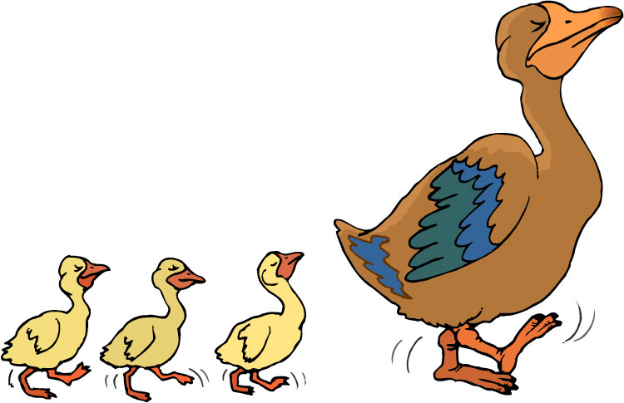
Chapter 19 Vocabulary
ἀκολουθέω
I follow

Slide 49
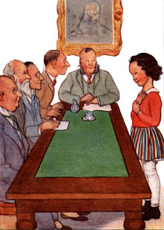
Chapter 19 Vocabulary
ἐνώπιον
before

Slide 50
Chapter 19 Vocabulary
θάλασσα, -ης, ἡ
sea, lake

Slide 51
Chapter 19 Vocabulary
κάθημαι
I sit

Slide 52
Chapter 19 Vocabulary
καιρός, -οῦ, ὁ
time

Slide 53
Chapter 19 Vocabulary
οὔτε
and not, nor, neither

Slide 54
Chapter 19 Vocabulary
πίπτω
I fall

Slide 55
Chapter 19 Vocabulary
πούς, ποδός, ὁ
foot

Slide 56
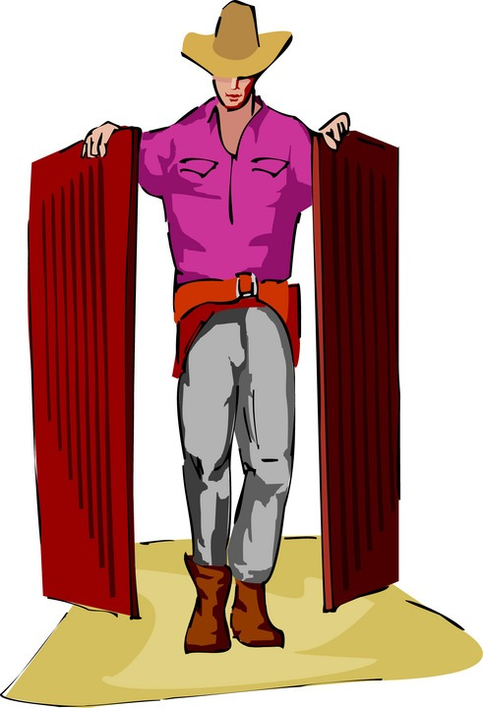
Chapter 19 Vocabulary
προσέρχομαι
I come/go to

Slide 57
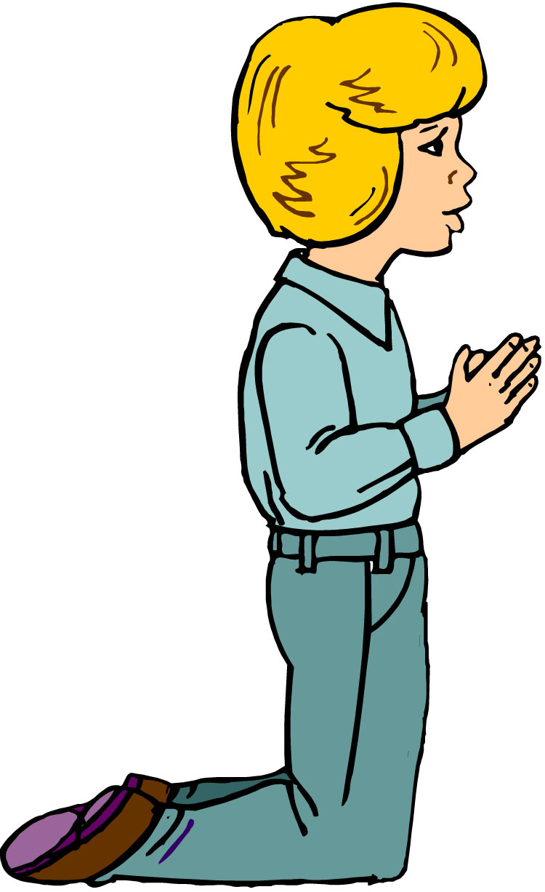
Chapter 19 Vocabulary
προσεύχομαι
I pray

Slide 58
Reverse Vocabulary Review

Slide 59
Chapter 19 Vocabulary
ἀκολουθέω
I follow
ἐνώπιον
before
θάλασσα, -ης, ἡ
sea, lake
κάθημαι
I sit
καιρός, -οῦ, ὁ
time

Slide 60
Chapter 19 Vocabulary
οὔτε
and not, nor, neither
πίπτω
I fall
πούς, ποδός, ὁ
foot
προσέρχομαι
I come/go to
προσεύχομαι
I pray

Slide 61
Chapter 18 Vocabulary
genna<w
I beget
dikaiosu<nh, -hj, h[
righteousness
e]a<n
if, when
ei]rh<nh, -hj, h[
peace
oi#da
I know

Slide 62
Chapter 18 Vocabulary
oi]ki<a, -aj, h[
house
o[ra<w
I see
peripate<w
I walk
pw?j
how?
fobe<omai
I fear

Slide 63
Chapter 17 Vocabulary
εἰ
if, that
ἐσθίω
I eat
ζάω
I live
ζητέω
I seek
ἤ
or, either

Slide 64
Chapter 17 Vocabulary
καλέω
I call
λαλέω
I speak, say
παρακαλέω
I urge, exhort
πληρόω
I fill, complete
ποιέω
I do, make

Slide 65
Chapter 16 Vocabulary
αἰων, -ῶνος, ὁ
Age, eternity
ἀλλήλων
one another
ἀριερεύς, -έως, ὁ
High priest
γυνή, -αικός, ἡ
woman
δύναμαι
I can, am able

Slide 66
Chapter 16 Vocabulary
ἔθνος, -ους, τό
nation
ὅσος, -η, -ον
as great as
πόλις, -εως, ἡ
city
τέ
And, and so
χείρ, χειρός, ἡ
hand

Slide 67
Chapter 15 Vocabulary
ἄλλος, -η, -ο
other
ἄρτος, -ου, ὁ
bread
δεῖ
it is necessary
ἐξουσία, -ας, ἡ
authority
ἕτερος, -α, -ον
different

Slide 68
Chapter 15 Vocabulary
ἔτι
yet, still
ὀφθαλμός, -οῦ, ὁ
eye
τέκνον, -ου, τό
child
τόπος, -ου, ὁ
place
φῶς, φωτός, τό
light

Slide 69
Chapter 14 Vocabulary
αἷμα, -ματος, τό
blood
αἴρω
I raise, take up
διδάσκω
I teach
ἴδιος, -α, -ον
one's own
καλός, -ή, -όν
good

Slide 70
Chapter 14 Vocabulary
μέλλω
I am about to, intend
ὁδός, -οῦ, ἡ
way
πολύς, πολλή, πολύ
much, many
σῶμα, -ματος, τό
body
ψυχή, -ῆς, ἡ
soul, life

Slide 71
Chapter 13 Vocabulary
ἀνήρ, ἀνδρός, ὁ
man, husband
βασιλεύς, -ἐως, ὁ
king
δύναμις, -εως, ἡ
power, miracle
ὄνομα, -ματος, τό
name
πᾶς, πᾶσα, πᾶν
each, every, all

Slide 72
Chapter 13 Vocabulary
πατήρ, πατρός, ὁ
father
πιστις, πίστεως, ἡ
faith, belief
πνεῦμα, -ατος, τό
spirit, wind
σάρξ, σαρκός, ἡ
flesh, body
χάρις, -ιτος, ἡ
grace, kindness

Slide 73
Chapter 12 Vocabulary
ἀποθνῄσκω
I die
ἐκεῖ
there
ἕως
until
ἰδού
behold

Slide 74
Chapter 12 Vocabulary
ἵνα
in order that, that
Ἰωάννης, -ου, ὁ
John
μέν
on the one hand, indeed
ὅλος, -η, -ον
whole, entire

Slide 75
Chapter 12 Vocabulary
ὅτε
when
σύν
with

Slide 76
Chapter 11 Vocabulary
ἀπέρχομαι
I go away, leave
ἐκεῖνος
that
Ἰουδαῖος, -α, -ον
Jewish
καθώς
as, just as

Slide 77
Chapter 11 Vocabulary
ὅς, ἥ, ὅ
who, which
ὅταν
when
πάλιν
again
οὗτος, αὗτη, τοῦτο
this

Slide 78
Chapter 11 Vocabulary
Πέτρος, -ου, ὁ
Peter
ὑπέρ
for, about (gen.)
above, beyond (acc.)

Slide 79
Chapter 11 Vocabulary
ὑπέρ
for, about (gen.)
above, beyond (acc.)

Slide 80
Vocabulary Ch. 10
life
ζωή, -ῆς, ἡ
death
θάνατος, -ου, ὁ
I judge
κρίνω
I remain
μένω
only, alone
μόνος, -η, -ον

Slide 81
Vocabulary Ch. 10
now
νῦν
and not, nor
οὐδέ
Paul
Παῦλος
I save
σῴζω
then
τότε

Slide 82
Vocabulary Ch. 9
I answer
ἀποκρίνομαι
I send
ἀποστέλλω
I throw
βάλλω
I become
γίνομαι
I come in
εἰσέρχομαι

Slide 83
Vocabulary Ch. 9
I go out
ἐξέρχομαι
I come/go
ἔρχομαι
I wish
θέλω
thus, so
οὕτως
I go
πορεύομαι

Slide 84
Vocabulary Ch. 8
he/she/it
αὐτός, -ή, -ό
land, earth, region
γῆ, -ῆς, ἡ
I, we
ἐγώ, ἡμεῖς
day
ἡμέρα, -ας, ἡ
that, so that
ὅτι

Slide 85
Vocabulary Ch. 8
so, then, therefore
οὖν
crowd
ὄχλος, -ου, ὁ
from
παρά (with Gen.)
beside, with
παρά (with Dat.)
alongside, beside
παρά (with Acc.)

Slide 86
Vocabulary Ch. 8
you / you (pl)
σύ / ὑμεῖς
by, at the hands of
ὑπό (with Gen.)
under, below
ὑπό (with Acc.)

Slide 87
Vocabulary -- Ch. 7
good
ἀγαθός, -ή, -όν
Holy
ἅγιος, -α, -ον
righteous
δίκαιοις, -α, -ον

Slide 88
Vocabulary – Ch. 7
I am
εἰμί
Jewish, a Jew
Ἰουδαῖος, -α, -ον
Great
μέγας, μεγάλη, μέγα

Slide 89
Vocabulary -- Ch. 7
dead
νεκρός, -ά, -όν
no, not
οὐ, οὐκ, οὐχ
first
πρῶτος, -η, -ον
voice
φωνή, -ῆς, ἡ

Slide 90
Chapter 6 Vocabulary
ἀπό (Gen.)
from
διά (Gen.)
through
διά (Acc.)
on account of
εἰς (Acc.)
into

Slide 91
Chapter 6 Vocabulary
ἐκ (Gen.)
out of, from
ἐν (Dat.)
in
ἐπί (Gen.)
on, over
ἐπί (Dat.)
on, at, against, on the basis of

Slide 92
Chapter 6 Vocabulary
ἐπί (Acc.)
on, to, toward, against
κατά (Gen.)
down, against
κατά (Acc.)
according to
μετά (Gen.)
with

Slide 93
Chapter 6 Vocabulary
μετά (Acc.)
after, behind
περί (Gen.)
about, concerning
περί (Acc.)
around, near
πρός (Acc.)
to

Slide 94
Ch. 5 -- Vocabulary
love
ἀγάπη, -ης, ἡ
truth
ἀλήθεια, -ας, ἡ
sin
ἁμαρτία, -ας, ἡ
kingdom
βασιλεία, -ας, ἡ
writing, Scripture
γραφή, -ῆς, ἡ

Slide 95
Ch. 5 -- Vocabulary
I raise up
ἐγείρω
assembly, church
ἐκκλησία, -ας, ἡ
work
ἔργον, -ου, τό
disciple
μαθητής, -οῦ, ὁ
Hour
ὥρα, -ας, ἡ

Slide 96
Ch. 4 -- Vocabulary
I love
ἀγαπάω
I write
γράφω
but, and
δέ
servant, slave
δοῦλος, -ου, ὁ
I find
εὑρίσκω

Slide 97
Ch. 4 -- Vocabulary
temple
ἱερόν, -οῦ, τό
People
λαός, -οῦ, ὁ
law
νόμος, -ου, ὁ
house
οἶκος, -ου, ὁ
as, about, how
ὡς

Slide 98
Ch. 3 -- Vocabulary
but, yet
ἀλλἀ
apostle, sent one
ἀπόστολος, -ου, ὁ
I see
βλέπω
for, then
γάρ
I know
γινώσκω

Slide 99
Ch. 3 -- Vocabulary
Jesus
Ἰησοῦς, -οῦ, ὁ
I take, receive
λαμβάνω
I loose
λύω
heaven
οὐρανός, -οῦ, ὁ
I believe
πιστεύω

Slide 100
Ch. 2 -- Vocabulary
brother
ἀδελφός, -οῦ, ὁ
I hear, obey
ἀκούω
glory, fame
δόξα, -ης, ἡ
I have
ἔχω
world
κόσμος, -ου, ὁ

Slide 101
Ch. 2 -- Vocabulary
Lord, sir
κύριος, -ου, ὁ
word
λόγος, -ου, ὁ
Peter
Πἑτρος, -ου, ὁ
son
υἱός, -οῦ, ὁ
Pharisee
Φαρισαῖος, -ου, ὁ

Slide 102
Ch. 1 -- Vocabulary
angel, messenger
ἄγγελος, -ου, ὁ
verily, truly
ἀμήν
man, humankind
ἄνθρωπος, -ου, ὁ
I
ἐγώ
God
θεός, -οῦ, ὁ

Slide 103
Ch. 1 -- Vocabulary
and, also, even
καί
heart
καρδία, -ας, ἡ
I say
λέγω
prophet
προφήτης, -ου, ὁ
Christ, Messiah
Χριστός, -οῦ, ὁ

Slide 104
In Order Vocabulary Review

Slide 105
Ch. 1 -- Vocabulary
angel, messenger
ἄγγελος, -ου, ὁ
verily, truly
ἀμήν
man, humankind
ἄνθρωπος, -ου, ὁ
I
ἐγώ
God
θεός, -οῦ, ὁ

Slide 106
Ch. 1 -- Vocabulary
and, also, even
καί
heart
καρδία, -ας, ἡ
I say
λέγω
prophet
προφήτης, -ου, ὁ
Christ, Messiah
Χριστός, -οῦ, ὁ

Slide 107
Ch. 2 -- Vocabulary
brother
ἀδελφός, -οῦ, ὁ
I hear, obey
ἀκούω
glory, fame
δόξα, -ης, ἡ
I have
ἔχω
world
κόσμος, -ου, ὁ

Slide 108
Ch. 2 -- Vocabulary
Lord, sir
κύριος, -ου, ὁ
word
λόγος, -ου, ὁ
Peter
Πἑτρος, -ου, ὁ
son
υἱός, -οῦ, ὁ
Pharisee
Φαρισαῖος, -ου, ὁ

Slide 109
Ch. 3 -- Vocabulary
but, yet
ἀλλἀ
apostle, sent one
ἀπόστολος, -ου, ὁ
I see
βλέπω
for, then
γάρ
I know
γινώσκω

Slide 110
Ch. 3 -- Vocabulary
Jesus
Ἰησοῦς, -οῦ, ὁ
I take, receive
λαμβάνω
I loose
λύω
heaven
οὐρανός, -οῦ, ὁ
I believe
πιστεύω

Slide 111
Ch. 4 -- Vocabulary
I love
ἀγαπάω
I write
γράφω
but, and
δέ
servant, slave
δοῦλος, -ου, ὁ
I find
εὑρίσκω

Slide 112
Ch. 4 -- Vocabulary
temple
ἱερόν, -οῦ, τό
People
λαός, -οῦ, ὁ
law
νόμος, -ου, ὁ
house
οἶκος, -ου, ὁ
as, about, how
ὡς

Slide 113
Ch. 5 -- Vocabulary
love
ἀγάπη, -ης, ἡ
truth
ἀλήθεια, -ας, ἡ
sin
ἁμαρτία, -ας, ἡ
kingdom
βασιλεία, -ας, ἡ
writing, Scripture
γραφή, -ῆς, ἡ

Slide 114
Ch. 5 -- Vocabulary
I raise up
ἐγείρω
assembly, church
ἐκκλησία, -ας, ἡ
work
ἔργον, -ου, τό
disciple
μαθητής, -οῦ, ὁ
Hour
ὥρα, -ας, ἡ

Slide 115
Chapter 6 Vocabulary
ἀπό (Gen.)
from
διά (Gen.)
through
διά (Acc.)
on account of
εἰς (Acc.)
into

Slide 116
Chapter 6 Vocabulary
ἐκ (Gen.)
out of, from
ἐν (Dat.)
in
ἐπί (Gen.)
on, over
ἐπί (Dat.)
on, at, against, on the basis of

Slide 117
Chapter 6 Vocabulary
ἐπί (Acc.)
on, to, toward, against
κατά (Gen.)
down, against
κατά (Acc.)
according to
μετά (Gen.)
with

Slide 118
Chapter 6 Vocabulary
μετά (Acc.)
after, behind
περί (Gen.)
about, concerning
περί (Acc.)
around, near
πρός (Acc.)
to

Slide 119
Vocabulary -- Ch. 7
good
ἀγαθός, -ή, -όν
Holy
ἅγιος, -α, -ον
righteous
δίκαιοις, -α, -ον

Slide 120
Vocabulary – Ch. 7
I am
εἰμί
Jewish, a Jew
Ἰουδαῖος, -α, -ον
Great
μέγας, μεγάλη, μέγα

Slide 121
Vocabulary -- Ch. 7
dead
νεκρός, -ά, -όν
no, not
οὐ, οὐκ, οὐχ
first
πρῶτος, -η, -ον
voice
φωνή, -ῆς, ἡ

Slide 122
Vocabulary Ch. 8
he/she/it
αὐτός, -ή, -ό
land, earth, region
γῆ, -ῆς, ἡ
I, we
ἐγώ, ἡμεῖς
day
ἡμέρα, -ας, ἡ
that, so that
ὅτι

Slide 123
Vocabulary Ch. 8
so, then, therefore
οὖν
crowd
ὄχλος, -ου, ὁ
from
παρά (with Gen.)
beside, with
παρά (with Dat.)
alongside, beside
παρά (with Acc.)

Slide 124
Vocabulary Ch. 8
you / you (pl)
σύ / ὑμεῖς
by, at the hands of
ὑπό (with Gen.)
under, below
ὑπό (with Acc.)

Slide 125
Vocabulary Ch. 9
I answer
ἀποκρίνομαι
I send
ἀποστέλλω
I throw
βάλλω
I become
γίνομαι
I come in
εἰσέρχομαι

Slide 126
Vocabulary Ch. 9
I go out
ἐξέρχομαι
I come/go
ἔρχομαι
I wish
θέλω
thus, so
οὕτως
I go
πορεύομαι

Slide 127
Vocabulary Ch. 10
life
ζωή, -ῆς, ἡ
death
θάνατος, -ου, ὁ
I judge
κρίνω
I remain
μένω
only, alone
μόνος, -η, -ον

Slide 128
Vocabulary Ch. 10
now
νῦν
and not, nor
οὐδέ
Paul
Παῦλος
I save
σῴζω
then
τότε

Slide 129
Chapter 11 Vocabulary
ἀπέρχομαι
I go away, leave
ἐκεῖνος
that
Ἰουδαῖος, -α, -ον
Jewish
καθώς
as, just as

Slide 130
Chapter 11 Vocabulary
ὅς, ἥ, ὅ
who, which
ὅταν
when
πάλιν
again
οὗτος, αὗτη, τοῦτο
this

Slide 131
Chapter 11 Vocabulary
Πέτρος, -ου, ὁ
Peter
ὑπέρ
for, about (gen.)
above, beyond (acc.)

Slide 132
Chapter 11 Vocabulary
ὑπέρ
for, about (gen.)
above, beyond (acc.)

Slide 133
Chapter 12 Vocabulary
ἀποθνῄσκω
I die
ἐκεῖ
there
ἕως
until
ἰδού
behold

Slide 134
Chapter 12 Vocabulary
ἵνα
in order that, that
Ἰωάννης, -ου, ὁ
John
μέν
on the one hand, indeed
ὅλος, -η, -ον
whole, entire

Slide 135
Chapter 12 Vocabulary
ὅτε
when
σύν
with

Slide 136
Chapter 13 Vocabulary
ἀνήρ, ἀνδρός, ὁ
man, husband
βασιλεύς, -ἐως, ὁ
king
δύναμις, -εως, ἡ
power, miracle
ὄνομα, -ματος, τό
name
πᾶς, πᾶσα, πᾶν
each, every, all

Slide 137
Chapter 13 Vocabulary
πατήρ, πατρός, ὁ
father
πιστις, πίστεως, ἡ
faith, belief
πνεῦμα, -ατος, τό
spirit, wind
σάρξ, σαρκός, ἡ
flesh, body
χάρις, -ιτος, ἡ
grace, kindness

Slide 138
Chapter 14 Vocabulary
αἷμα, -ματος, τό
blood
αἴρω
I raise, take up
διδάσκω
I teach
ἴδιος, -α, -ον
one's own
καλός, -ή, -όν
good

Slide 139
Chapter 14 Vocabulary
μέλλω
I am about to, intend
ὁδός, -οῦ, ἡ
way
πολύς, πολλή, πολύ
much, many
σῶμα, -ματος, τό
body
ψυχή, -ῆς, ἡ
soul, life

Slide 140
Chapter 15 Vocabulary
ἄλλος, -η, -ο
other
ἄρτος, -ου, ὁ
bread
δεῖ
it is necessary
ἐξουσία, -ας, ἡ
authority
ἕτερος, -α, -ον
different

Slide 141
Chapter 15 Vocabulary
ἔτι
yet, still
ὀφθαλμός, -οῦ, ὁ
eye
τέκνον, -ου, τό
child
τόπος, -ου, ὁ
place
φῶς, φωτός, τό
light

Slide 142
Chapter 16 Vocabulary
αἰων, -ῶνος, ὁ
Age, eternity
ἀλλήλων
one another
ἀρχιερεύς, -έως, ὁ
High priest
γυνή, -αικός, ἡ
woman
δύναμαι
I can, am able

Slide 143
Chapter 16 Vocabulary
ἔθνος, -ους, τό
nation
ὅσος, -η, -ον
as great as
πόλις, -εως, ἡ
city
τέ
And, and so
χείρ, χειρός, ἡ
hand

Slide 144
Chapter 17 Vocabulary
εἰ
if, that
ἐσθίω
I eat
ζάω
I live
ζητέω
I seek
ἤ
or, either

Slide 145
Chapter 17 Vocabulary
καλέω
I call
λαλέω
I speak, say
παρακαλέω
I urge, exhort
πληρόω
I fill, complete
ποιέω
I do, make

Slide 146
Chapter 18 Vocabulary
genna<w
I beget
dikaiosu<nh, -hj, h[
righteousness
e]a<n
if, when
ei]rh<nh, -hj, h[
peace
oi#da
I know

Slide 147
Chapter 18 Vocabulary
oi]ki<a, -aj, h[
house
o[ra<w
I see
peripate<w
I walk
pw?j
how?
fobe<omai
I fear

Slide 148
Chapter 19 Vocabulary
ἀκολουθέω
I follow
ἐνώπιον
before
θάλασσα, -ης, ἡ
sea, lake
κάθημαι
I sit
καιρός, -οῦ, ὁ
time

Slide 149
Chapter 19 Vocabulary
οὔτε
and not, nor, neither
πίπτω
I fall
πούς, ποδός, ὁ
foot
προσέρχομαι
I come/go to
προσεύχομαι
I pray

