Slide 1
Mastering NT Greek
10. Shocking the Future
By Ted Hildebrandt © 2003
Baker Academic

Slide 2
PAI Verb Paradigm Rap
λύω λύομεν
λύεις λύετε
λύει λύουσι(ν)

Slide 3
2-1-2 Paradigms - Chant this
2 1 2
λόγος γραφή ἱερόν
λόγου γραφῆς ἱεροῦ
λόγῳ γραφῇ ἱερῷ
λόγον γραφήν ἱερόν
λόγοι γραφαί ἱερά
λόγων γραφῶν ἱερῶν
λόγοις γραφαῖς ἱεροῖς
λόγους γραφάς ἱερά

Slide 4
The "is" verb PAI -- εἰμί
εἰμί ἐσμέν εἶ ἐστέ ἐστί(ν) εἰσί(ν)

Slide 5
Person Personal Pronoun Chant
Singular Plural
Nom. ἐγώ σύ ἡμεῖς
Gen. μου σου ἡμῶν Dat. μοι σοι ἡμῖν Acc. με σε ἡμάς
αὐτός, αὐτη, αὐτό (he, she, it)

Slide 6
Present Middle/Passive Indicative
λύομαι, -ομεθα -ῃ, -εσθε -εται, -ονται
I am loosed/am being loosed
I loose myself/am loosing [for myself]

Slide 7
Rapping the Lord’s Prayer
Πάτερ ἡμῶν ὁ ἐν τοῖς οὐρανοῖς father our the one in heaven
ἁγιασθήτω τὸ ὄνομά σου make holy name your
ἐλθέτω ἡ βασιλεία σου let come kingdom your
γενηθήτω τὸ θέλημά σου, let be will your

Slide 8
English Introduction
Tenses in English
Present: We go to the mountains.
Past: We went to the mountains
Future: We will go to the mountains.
Three types of future: PID
Predictive: I will go.
Imperative: You shall go!
Deliberative rhetorical: Shall we go?

Slide 9
Shape of the Future in Greek
λύσω λύσομεν I will loose We will loose
λύσεις λύσετε You will loose You all will loose
λύσει λύσουσι(ν) S/he/it will loose They will loose
Chant this one

Slide 10
Future Active Indicative Chant
λύσω λύσομεν λύσεις λύσετε λύσει λύσουσι(ν)

Slide 11
Future Middle Paradigm
λύσομαι λυσόμεθα I will loose (for myself) We will loose (for ourselves)
λύσῃ λύσεσθε You will loose (for yourself) You all will loose (for yourselves)
λύσεται λύσονται S/he/it will loose (for himself) They will loose (for themselves)
Chant this: λύσομαι, -ῃ, -εται, -ομεθα, -εσθε, -ονται

Slide 12
Future Middle Chant
λύσομαι, -ομεθα, -ῃ, -εσθε, -εται, -ονται

Slide 13
Sigma Addition - 5 Variations
Palatals: κ, γ, or χ + σ = ξ
ἔχω --- ἕξω I will have
ἄγω --- ἄξω I will lead, bring
Labials: π, β, or φ + σ = ψ
βλέπω --- βλέψω I will see
γράφω --- γράψω I will write
Dentals: τ, δ, or θ + σ = σ
πείθω --- πείσω I will persuade
Sibilants: σ or ζ + σ = σ
σῴζω --- σώσω I will save

Slide 14
Sigma Addition--Lemoners
Liquids (Lemoner): λ, μ, ν, or ρ + σ = ˜
The liquid and sigma collapse into a circumflex. Beware of these as they often can be mistaken as a present tense verb.
μένω ---> μενῶ I will remain
ἀποστέλλω ---> ἀποστελῶ I will send

Slide 15
Sigma Shifting Chart
Palatals Dentals
κ, γ, or χ + σ = ξ τ, δ, or θ + σ = σ
Labials Sibilants
π, β, or φ + σ = ψ σ or ζ + σ = σ
Liquids (lemoner)
λ, μ, ν, or ρ + σ = ˜
˜
?

Slide 16
Future of Being: εἰμί
ἔσομαι ἐσόμεθα I will be We will be
ἔσῃ ἔσεσθε You will be You all will be
ἔσται ἔσονται S/he/it will be They will be

Slide 17
Deponent Future
Sometimes verbs are regular in the present but deponent in the future
λαμβάνω λήμψομαι I will take
γινώσκω γνώσομαι I will know

Slide 18
4 Future Bad Boys
ἔρχομαι ἐλεύσομαι I will go/come
λέγω ἐρῶ I will say
γινώσκω γνώσομαι I will know
λαμβάνω λήμψομαι I will take

Slide 19
Chapter 10 Vocabulary
ζωή, -ῆς, ἡ
life

Slide 20
Chapter 10 Vocabulary
θάνατος, -ου, ὁ
death

Slide 21
Chapter 10 Vocabulary
κρίνω
I judge

Slide 22
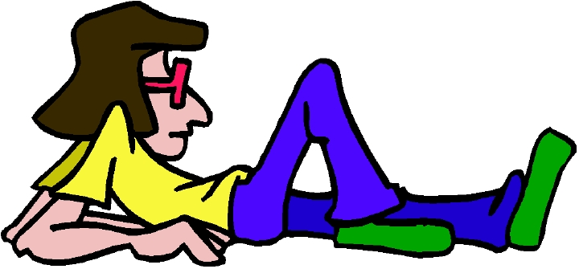
Chapter 10 Vocabulary
μένω
I remain

Slide 23
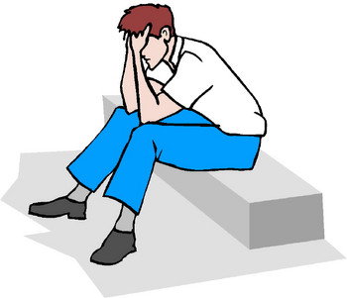
Chapter 10 Vocabulary
μόνος, -η, -ον
only, alone

Slide 24
Chapter 10 Vocabulary
νῦν
now

Slide 25
Chapter 10 Vocabulary
οὐδέ
and not, nor

Slide 26
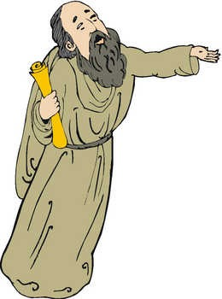
Chapter 10 Vocabulary
Παῦλος
Paul

Slide 27
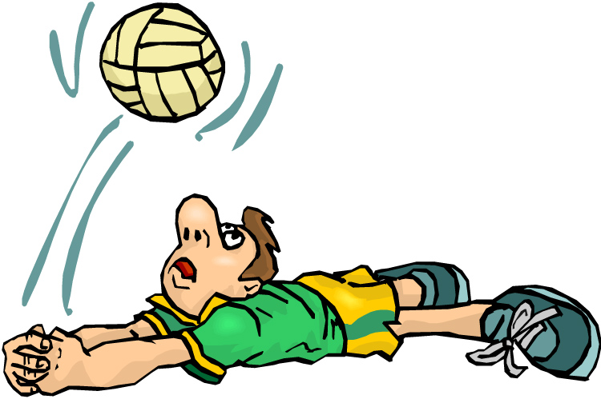
Chapter 10 Vocabulary
σῴζω
I save

Slide 28
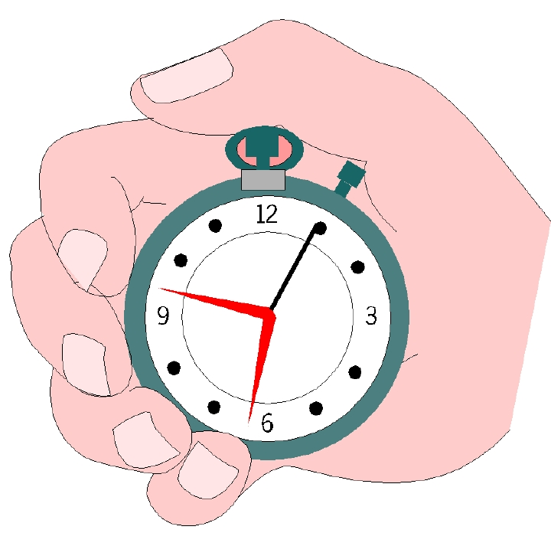
Chapter 10 Vocabulary
τότε
then

Slide 29
Ch. 1 -- Vocabulary
angel, messenger
ἄγγελος, -ου, ὁ
verily, truly
ἀμήν
man, humankind
ἄνθρωπος, -ου, ὁ
I
ἐγώ
God
θεός, -οῦ, ὁ

Slide 30
Ch. 1 -- Vocabulary
and, also, even
καί
heart
καρδία, -ας, ἡ
I say
λέγω
prophet
προφήτης, -ου, ὁ
Christ, Messiah
Χριστός, -οῦ, ὁ

Slide 31
Ch. 2 -- Vocabulary
brother
ἀδελφός, -οῦ, ὁ
I hear, obey
ἀκούω
glory, fame
δόξα, -ης, ἡ
I have
ἔχω
world
κόσμος, -ου, ὁ

Slide 32
Ch. 2 -- Vocabulary
Lord, sir
κύριος, -ου, ὁ
word
λόγος, -ου, ὁ
Peter
Πἑτρος, -ου, ὁ
son
υἱός, -οῦ, ὁ
Pharisee
Φαρισαῖος, -ου, ὁ

Slide 33
Ch. 3 -- Vocabulary
but, yet
ἀλλἀ
apostle, sent one
ἀπόστολος, -ου, ὁ
I see
βλέπω
for, then
γάρ
I know
γινώσκω

Slide 34
Ch. 3 -- Vocabulary
Jesus
Ἰησοῦς, -οῦ, ὁ
I take, receive
λαμβάνω
I loose
λύω
heaven
οὐρανός, -οῦ, ὁ
I believe
πιστεύω

Slide 35
Ch. 4 -- Vocabulary
I love
ἀγαπάω
I write
γράφω
but, and
δέ
servant, slave
δοῦλος, -ου, ὁ
I find
εὑρίσκω

Slide 36
Ch. 4 -- Vocabulary
temple
ἱερόν, -οῦ, τό
People
λαός, -οῦ, ὁ
law
νόμος, -ου, ὁ
house
οἶκος, -ου, ὁ
as, about, how
ὡς

Slide 37
Ch. 5 -- Vocabulary
love
ἀγάπη, -ης, ἡ
truth
ἀλήθεια, -ας, ἡ
sin
ἁμαρτία, -ας, ἡ
kingdom
βασιλεία, -ας, ἡ
writing, Scripture
γραφή, -ῆς, ἡ

Slide 38
Ch. 5 -- Vocabulary
I raise up
ἐγείρω
assembly, church
ἐκκλησία, -ας, ἡ
work
ἔργον, -ου, τό
disciple
μαθητής, -οῦ, ὁ
Hour
ὥρα, -ας, ἡ

Slide 39
Chapter 6 Vocabulary
ἀπό (Gen.)
from
διά (Gen.)
through
διά (Acc.)
on account of
εἰς (Acc.)
into

Slide 40
Chapter 6 Vocabulary
ἐκ (Gen.)
out of, from
ἐν (Dat.)
in
ἐπί (Gen.)
on, over
ἐπί (Dat.)
on, at, against, on the basis of

Slide 41
Chapter 6 Vocabulary
ἐπί (Acc.)
on, to, toward, against
κατά (Gen.)
down, against
κατά (Acc.)
according to
μετά (Gen.)
with

Slide 42
Chapter 6 Vocabulary
μετά (Acc.)
after, behind
περί (Gen.)
about, concerning
περί (Acc.)
around, near
πρός (Acc.)
to

Slide 43
Vocabulary -- Ch. 7
good
ἀγαθός, -ή, -όν
Holy
ἅγιος, -α, -ον
righteous
δίκαιοις, -α, -ον

Slide 44
Vocabulary – Ch. 7
I am
εἰμί
Jewish, a Jew
Ἰουδαῖος, -α, -ον
Great
μέγας, μεγάλη, μέγα

Slide 45
Vocabulary -- Ch. 7
dead
νεκρός, -ά, -όν
no, not
οὐ, οὐκ, οὐχ
first
πρῶτος, -η, -ον
voice
φωνή, -ῆς, ἡ

Slide 46
Vocabulary Ch. 8
he/she/it
αὐτός, -ή, -ό
land, earth, region
γῆ, -ῆς, ἡ
I, we
ἐγώ, ἡμεῖς
day
ἡμέρα, -ας, ἡ
that, so that
ὅτι

Slide 47
Vocabulary Ch. 8
so, then, therefore
οὖν
crowd
ὄχλος, -ου, ὁ
from
παρά (with Gen.)
beside, with
παρά (with Dat.)
alongside, beside
παρά (with Acc.)

Slide 48
Vocabulary Ch. 8
you / you (pl)
σύ / ὑμεῖς
by, at the hands of
ὑπό (with Gen.)
under, below
ὑπό (with Acc.)

Slide 49
Vocabulary Ch. 9
I answer
ἀποκρίνομαι
I send
ἀποστέλλω
I throw
βάλλω
I become
γίνομαι
I come in
εἰσέρχομαι

Slide 50
Vocabulary Ch. 9
I go out
ἐξέρχομαι
I come/go
ἔρχομαι
I wish
θέλω
thus, so
οὕτως
I go
πορεύομαι

Slide 51
Vocabulary Ch. 10
life
ζωή, -ῆς, ἡ
death
θάνατος, -ου, ὁ
I judge
κρίνω
I remain
μένω
only, alone
μόνος, -η, -ον

Slide 52
Vocabulary Ch. 10
now
νῦν
and not, nor
οὐδέ
Paul
Παῦλος
I save
σῴζω
then
τότε

