Slide 1
Mastering NT Greek
9. Present Middle/Passives
By Ted Hildebrandt © 2003
Baker Academic

Slide 2
Warm-ups

Slide 3
Rapping the Lord’s Prayer
Πάτερ ἡμῶν ὁ ἐν τοῖς οὐρανοῖς father our the one in heaven
ἁγιασθήτω τὸ ὄνομά σου make holy name your
ἐλθέτω ἡ βασιλεία σου let come kingdom your
γενηθήτω τὸ θέλημά σου, let be will your

Slide 4
PAI Verb Paradigm Rap
λύω λύομεν
λύεις λύετε
λύει λύουσι(ν)

Slide 5
2-1-2 Paradigms - Chant this
2 1 2
λόγος γραφή ἱερόν
λόγου γραφῆς ἱεροῦ
λόγῳ γραφῇ ἱερῷ
λόγον γραφήν ἱερόν
λόγοι γραφαί ἱερά
λόγων γραφῶν ἱερῶν
λόγοις γραφαῖς ἱεροῖς
λόγους γραφάς ἱερά

Slide 6
The "is" verb PAI -- εἰμί
εἰμί ἐσμέν εἶ ἐστέ ἐστί(ν) εἰσί(ν)

Slide 7
Person Personal Pronoun Chant
Singular Plural
Nom. ἐγώ σύ ἡμεῖς
Gen. μου σου ἡμῶν Dat. μοι σοι ἡμῖν Acc. με σε ἡμάς
αὐτός, αὐτη, αὐτό (he, she, it)

Slide 8
English Voices
Active – subject does the action
Terry hit the rock
Passive – subject receives the action
Terry was hit by the rock
Put “by what” after the verb
Was hit by what?

Slide 9
Translation – Aktionsart
He is hit by the rock -- undefined
He is being hit by the ball – continuous

Slide 10
Middle
Voice of emphasizing the subject’s participation in the action of the verb;
Self-interest or rarely reflexive: (Tanya splashed herself, Tanya listened carefully…).
The Present passive and middle forms are the same (only different in Aorist/Future)

Slide 11
Deponent Verbs
Deponent verbs: lack active form
Middle in form and active in meaning.
How do you tell a deponent verb?
In the lexicon they will have an – omai ending (note the lexicon at at the end of your textbook and the complete lexicon on the CD)

Slide 12
Middle—another way
Some today are eliminating the term deponent (to lay aside—missing an active voice form)—many “deponents” are just true middles
Middle emphasizes the subject’s involvement or participation
They state that the middle was dying out and today only active and passive are used; with reflexive pronouns being used to trigger the reflexive idea

Slide 13
Present Middle Indicative
λύομαι λυόμεθα I am loosing (for myself) We are loosing (for ourselves)
λύῃ λύεσθε You are loosing (for yourself) You are loosing (for yourselves)
λύεται λύονται He/she/it is loosing (for They are loosing (for him/her/itself) themselves)

Slide 14
Present Passive Indicative
λύομαι λυόμεθα I am being loosed We are being loosed
λύῃ λύεσθε You are being loosed You are being loosed
λύεται λύονατι He/she/it is being loosed They are being loosed

Slide 15
Present Middle/Passive Endings:
1. -ομαι -ομεθα 2. -ῃ (-σαι) - εσθε 3. -εται -ονται
These are the middle/passive primary endings.

Slide 16
The Chanter – P M/P I
λύομαι, -όμεθα,
-ῃ, -εσθε
-εται, -ονται

Slide 17
Deponent Verbs
Frequently used “Deponents”
ἀποκρίνομαι I answer (231)
ἔρχομαι I come, go (634)
εἰσέρχομαι I come in (194)
ἐξέρχομαι I go out (218)
γίνομαι I become (669)
πορεύομαι I go (132)

Slide 18
Compound Verbs
Many verbs neatly add prepositions to the front making compound verbs.
ἔρχομαι I come, go
εἰσέρχομαι I go in, enter (εἰς)
ἐξέρχομαι I go out, leave (ἐκ)
διέρχομαι I go through (διά)

Slide 19
Parsing
λύεται P M/P I 3 sg. from λύω "s/he/it is loosed
The deponent verb is parsed with a "D"
ἔρχονται PDI 3 pl. from ἔρχομαι "they come“
It should be noted that 75% of the middle forms are deponent (3 to 1). So usually translate the middle form as active.

Slide 20
Ch. 9 Vocabulary
ἀποκρίνομαι
I answer

Slide 21
Ch. 9 Vocabulary
ἀποστέλλω
I send

Slide 22
Ch. 9 Vocabulary
βάλλω
I throw

Slide 23
Ch. 9 Vocabulary
γίνομαι
I become

Slide 24
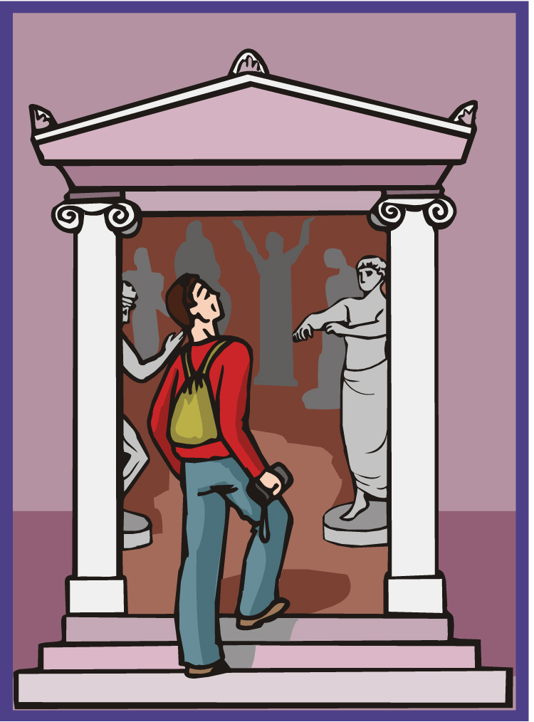
Ch. 9 Vocabulary
εἰσέρχομαι
I come in

Slide 25
Ch. 9 Vocabulary
ἐξέρχομαι
I go out

Slide 26
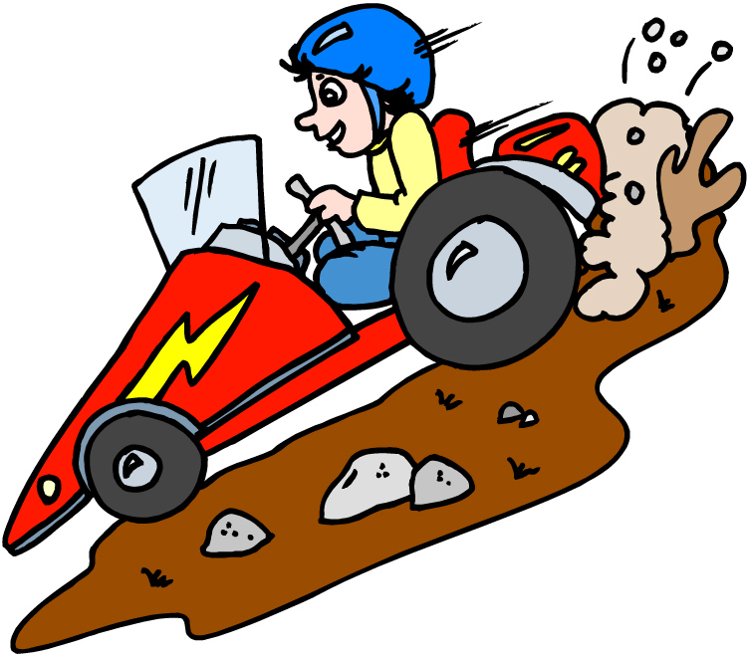
Ch. 9 Vocabulary
ἔρχομαι
I come/go

Slide 27
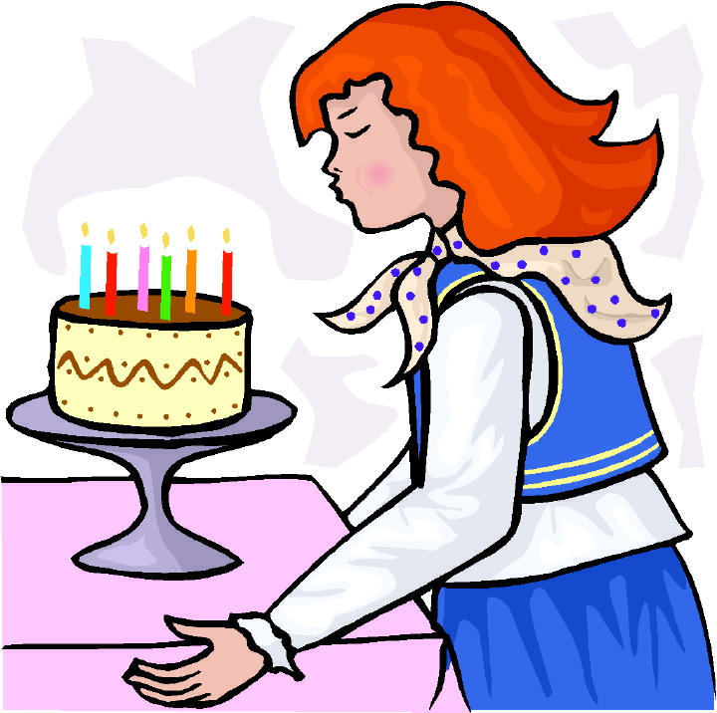
Ch. 9 Vocabulary
θέλω
I wish

Slide 28
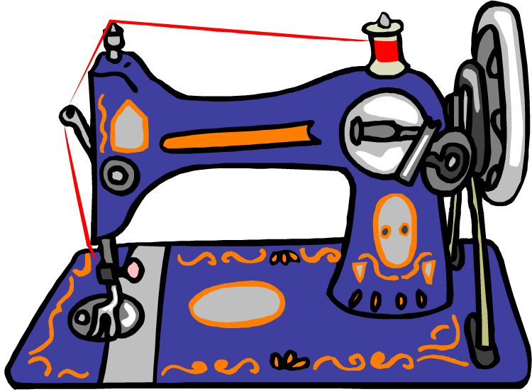
Ch. 9 Vocabulary
οὕτως
thus, so

Slide 29
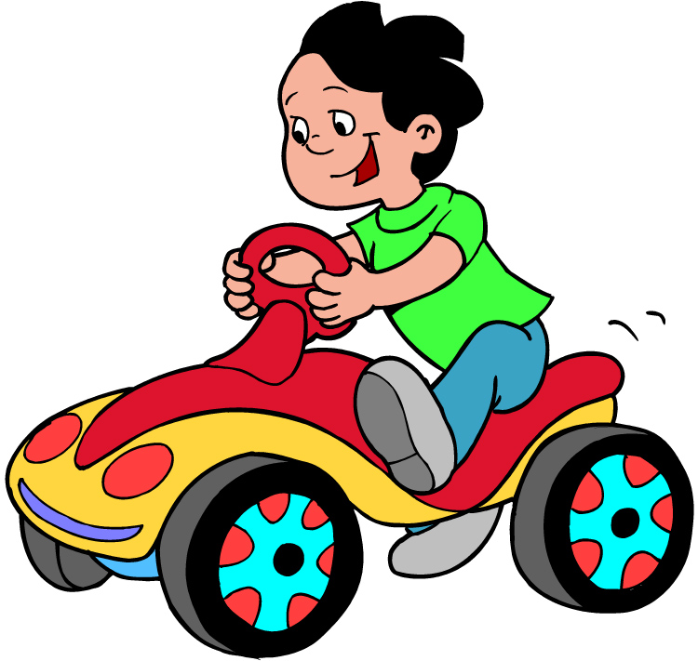
Ch. 9 Vocabulary
πορεύομαι
I go

Slide 30
Vocabulary Review

Slide 31
Ch. 1 -- Vocabulary
angel, messenger
a@ggeloj, -ou, o[
verily, truly
a]mh<n
man, humankind
a@nqrwpoj, -ou, o[
I
e]gw<
God
qeo<j, -ou?, o[

Slide 32
Ch. 1 -- Vocabulary
and, also, even
kai<
heart
kardi<a, -aj, h[
I say
le<gw
prophet
profh<thj, -ou, o[
Christ, Messiah
Xristo<j, -ou?, o[

Slide 33
Ch. 2 -- Vocabulary
brother
a]delfo<j, -ou?, o[
I hear, obey
a]kou<w
glory, fame
do<ca, -hj, h[
I have
e@xw
world
ko<smoj, -ou, o[

Slide 34
Ch. 2 -- Vocabulary
Lord, sir
ku<rioj, -ou, o[
word
lo<goj, -ou, o[
Peter
Pe<troj, -ou, o[
son
ui[o<j, -ou?, o[
Pharisee
Farisai?oj, -ou, o[

Slide 35
Ch. 3 -- Vocabulary
but, yet
a]lla<
apostle, sent one
a]po<stoloj, -ou, o[
I see
ble<pw
for, then
ga<r
I know
ginw<skw

Slide 36
Ch. 3 -- Vocabulary
Jesus
]Ihsou?j, -ou?, o[
I take, receive
lamba<nw
I loose
lu<w
heaven
ou]rano<j, -ou?, o[
I believe
pisteu<w

Slide 37
Ch. 4 -- Vocabulary
a]gapa<w
I love
gra<fw
I write
de<
but, and
dou?loj, -ou, o[
servant, slave
eu[ri<skw
I find

Slide 38
Ch. 4 -- Vocabulary
i[ero<n, -ou?, to<
temple
lao<j, -ou?, o[
people
no<moj, -ou, o[
law
oi#koj, -ou, o[
house
w[j
as, about, how

Slide 39
Ch. 5 -- Vocabulary
a]ga<ph, -hj, h[
love
a]lh<qeia, -aj, h[
truth
a[marti<a, -aj, h[
sin
basilei<a, -aj, h[
kingdom
grafh<, -h?j, h[
writing, Scripture

Slide 40
Ch. 5 -- Vocabulary
e]gei<rw
I raise up
e]kklhsi<a, -aj, h[
assembly, church
e@rgon, -ou, to<
work
maqhth<j, -ou, o[
disciple
w!ra, -aj, h[
Hour

Slide 41
Chapter 6 Vocabulary
a]po< (Gen.)
from
dia< (Gen.)
through
dia< (Acc.)
on account of
ei]j (Acc.)
into

Slide 42
Chapter 6 Vocabulary
e]k (Gen.)
out of, from
e]n (Dat.)
in
e]pi< (Gen.)
on, over
epi< (Dat.)
on, at, against, on the basis of

Slide 43
Chapter 6 Vocabulary
e]pi< (Acc.)
on, to, toward, against
kata< (Gen.)
down, against
kata< (Acc.)
according to
meta< (Gen.)
with

Slide 44
Chapter 6 Vocabulary
meta< (Acc.)
after, behind
peri< (Gen.)
about, concerning
peri< (Acc.)
around, near
pro<j (Acc.)
to

Slide 45
Vocabulary -- Ch. 7
a]gaqo<j, -h<, -o<n
good
a!gioj, -a, -on
holy
di<kaioj, -a, -on
righteous

Slide 46
Vocabulary – Ch. 7
ei]mi<
I am
]Ioudai?oj, -a, -on
Jewish, a Jew
me<gaj, mega<lh, me<ga
great

Slide 47
Vocabulary -- Ch. 7
nekro<j, -a<, -o<n
dead
ou], ou]k, ou]x
no, not
prw?toj, -h, -on
first
fwnh<, -h?j, h[
voice

Slide 48
Vocabulary Review

Slide 49
Ch. 1 -- Vocabulary
angel, messenger
ἄγγελος, -ου, ὁ
verily, truly
ἀμήν
man, humankind
ἄνθρωπος, -ου, ὁ
I
ἐγώ
God
θεός, -οῦ, ὁ

Slide 50
Ch. 1 -- Vocabulary
and, also, even
καί
heart
καρδία, -ας, ἡ
I say
λέγω
prophet
προφήτης, -ου, ὁ
Christ, Messiah
Χριστός, -οῦ, ὁ

Slide 51
Ch. 2 -- Vocabulary
brother
ἀδελφός, -οῦ, ὁ
I hear, obey
ἀκούω
glory, fame
δόξα, -ης, ἡ
I have
ἔχω
world
κόσμος, -ου, ὁ

Slide 52
Ch. 2 -- Vocabulary
Lord, sir
κύριος, -ου, ὁ
word
λόγος, -ου, ὁ
Peter
Πἑτρος, -ου, ὁ
son
υἱός, -οῦ, ὁ
Pharisee
Φαρισαῖος, -ου, ὁ

Slide 53
Ch. 3 -- Vocabulary
but, yet
ἀλλἀ
apostle, sent one
ἀπόστολος, -ου, ὁ
I see
βλέπω
for, then
γάρ
I know
γινώσκω

Slide 54
Ch. 3 -- Vocabulary
Jesus
Ἰησοῦς, -οῦ, ὁ
I take, receive
λαμβάνω
I loose
λύω
heaven
οὐρανός, -οῦ, ὁ
I believe
πιστεύω

Slide 55
Ch. 4 -- Vocabulary
I love
ἀγαπάω
I write
γράφω
but, and
δέ
servant, slave
δοῦλος, -ου, ὁ
I find
εὑρίσκω

Slide 56
Ch. 4 -- Vocabulary
temple
ἱερόν, -οῦ, τό
People
λαός, -οῦ, ὁ
law
νόμος, -ου, ὁ
house
οἶκος, -ου, ὁ
as, about, how
ὡς

Slide 57
Ch. 5 -- Vocabulary
love
ἀγάπη, -ης, ἡ
truth
ἀλήθεια, -ας, ἡ
sin
ἁμαρτία, -ας, ἡ
kingdom
βασιλεία, -ας, ἡ
writing, Scripture
γραφή, -ῆς, ἡ

Slide 58
Ch. 5 -- Vocabulary
I raise up
ἐγείρω
assembly, church
ἐκκλησία, -ας, ἡ
work
ἔργον, -ου, τό
disciple
μαθητής, -οῦ, ὁ
Hour
ὥρα, -ας, ἡ

Slide 59
Chapter 6 Vocabulary
ἀπό (Gen.)
from
διά (Gen.)
through
διά (Acc.)
on account of
εἰς (Acc.)
into

Slide 60
Chapter 6 Vocabulary
ἐκ (Gen.)
out of, from
ἐν (Dat.)
in
ἐπί (Gen.)
on, over
ἐπί (Dat.)
on, at, against, on the basis of

Slide 61
Chapter 6 Vocabulary
ἐπί (Acc.)
on, to, toward, against
κατά (Gen.)
down, against
κατά (Acc.)
according to
μετά (Gen.)
with

Slide 62
Chapter 6 Vocabulary
μετά (Acc.)
after, behind
περί (Gen.)
about, concerning
περί (Acc.)
around, near
πρός (Acc.)
to

Slide 63
Vocabulary -- Ch. 7
good
ἀγαθός, -ή, -όν
Holy
ἅγιος, -α, -ον
righteous
δίκαιοις, -α, -ον

Slide 64
Vocabulary – Ch. 7
I am
εἰμί
Jewish, a Jew
Ἰουδαῖος, -α, -ον
Great
μέγας, μεγάλη, μέγα

Slide 65
Vocabulary -- Ch. 7
dead
νεκρός, -ά, -όν
no, not
οὐ, οὐκ, οὐχ
first
πρῶτος, -η, -ον
voice
φωνή, -ῆς, ἡ

Slide 66
Vocabulary Ch. 8
he/she/it
αὐτός, -ή, -ό
land, earth, region
γῆ, -ῆς, ἡ
I, we
ἐγώ, ἡμεῖς
day
ἡμέρα, -ας, ἡ
that, so that
ὅτι

Slide 67
Vocabulary Ch. 8
so, then, therefore
οὖν
crowd
ὄχλος, -ου, ὁ
from
παρά (with Gen.)
beside, with
παρά (with Dat.)
alongside, beside
παρά (with Acc.)

Slide 68
Vocabulary Ch. 8
you / you (pl)
σύ / ὑμεῖς
by, at the hands of
ὑπό (with Gen.)
under, below
ὑπό (with Acc.)

Slide 69
Wallace’s Analysis
“Is” verbs take predicate nominatives—”It is I” not “It is me.”
The subject is marked by greater definiteness or is a proper noun
The Jehovah Witnesses New World Translation (JW) “and the Word was a God.”
John 1-18 8x θεος –DA = 6x translated “God” in NWT (1:6 παρὰ θεοῦ =from a god??? cf. 1:18 (Wallace—p. 269)

Slide 70
3 Options
καὶ ὁ λόγος ἦν ὁ θεός “and the Word was the God” (i.e. the Father; Sabellianism)
καὶ ὁ λόγος ἦν θεός “and the Word was a God” (Arianism, Jehovah Witnesses)
καὶ θεὸς ἦν ὁ λόγος “an the Word was God (orthodoxy)—Mounce, p. 29 – preverbal anarthrous Pred. Nom. are qualitative – Jesus had the quality of God

