Slide 1
Mastering NT Greek
8. Getting Personal Pronouns
By Ted Hildebrandt © 2003
Baker Academic

Slide 2
Warm-ups

Slide 3
Review: What we’ve done so far
Alphabet, accents, syllables
Verb: Present Active Indicative (PAI)
Nouns: 2-1-2 (Masc/Fem)
Prepositions
Adjectives (Attributive (+Article), Predicate (-Article), Substantive (-Noun))

Slide 4
PAI Verb Paradigm Rap
λύω λύομεν
λύεις λύετε
λύει λύουσι(ν)

Slide 5
2-1-2 Paradigms - Chant this
2 1 2
λόγος γραφή ἱερόν
λόγου γραφῆς ἱεροῦ
λόγῳ γραφῇ ἱερῷ
λόγον γραφήν ἱερόν
λόγοι γραφαί ἱερά
λόγων γραφῶν ἱερῶν
λόγοις γραφαῖς ἱεροῖς
λόγους γραφάς ἱερά

Slide 6
The "is" verb PAI -- εἰμί
εἰμί ἐσμέν εἶ ἐστέ ἐστί(ν) εἰσί(ν)

Slide 7
Preping Prepositions
ἐπί (on)
Accusative (towards)
Genitive (separation, from)
πρός (to)
ἀπό (from)
εἰς (into)
ἐκ (out of, from)
Dative (in)
ἐν (in)
περί (about, around)
σύν (with)
διά (through; on account of)
μετά (with; after)
κατά (down, against)

Slide 8
Memory Verse -- Jn 1:1
Ἐν ἀρχῇ ἦν ὁ λόγος,
in the beginning was the word
καὶ ὁ λόγος ἦν πρὸς τὸν θεόν,
and the word was with God
καὶ θεὸς ἦν ὁ λόγος.
and the word was God

Slide 9
Personal Pronouns: an Introduction

Slide 10
Pronouns in English
Def: Pronoun is a word that stands in place of a noun.
Zach threw the ball to Elliott.
It (the ball) hit him (Elliott).

Slide 11
6 Types of Pronouns
Personal Pronouns: I, me, you, he, she, it, they. She rode the train.
Demonstrative Pronouns: this, that
This bike belongs to that student.
Relative Pronouns: who, which
It is a great person who attempts to master Greek.
Reciprocal Pronouns: one another
They loved one another.

Slide 12
6 Types of Pronouns
Reflexive Pronouns: herself, himself
She hid herself in the closet.
Interrogative Pronouns: ask a question Who? What?
Who took my keys?

Slide 13
English Pronoun Case
Subject: I, you, he, she, they
Possessive: my, yours, his, hers, their
The bike was hers.
Objective: me, you, him, her, them
He took them to the store.
It is I or me?
It is he or him?
It is she or her?

Slide 14
First Person Personal Pronoun
First Person = I (ἐγώ)
Singular Plural
Nom. ἐγώ I ἡμεῖς we Gen. μου my/of me ἡμῶν our Dat. μοι to/for me ἡμῖν to us Acc. με me ἡμᾶς us
Learn the call chant for ἐγώ

Slide 15
Second Person Personal Pronoun
Second Person = you (σύ)
Singular Plural
Nom. σύ you ὑμεῖς you (pl.) Gen. σου your/of you ὑμῶν your Dat. σοι to/for you ὑμῖν to/for you Acc. σε you ὑμᾶς you (pl.)
Learn the call chant for ἐγώ and σύ (see below)

Slide 16
Examples
Ἐγώ εἰμι τὸ φῶς τοὺ κόσμου
I am the light of the world

Slide 17
1st and 2nd Person Chant
ἐγώ σύ ἡμεῖς [ὑμεῖς]
μου σου ἡμῶν [ὑμῶν]
μοι σοι ἡμῖν [ὑμῖν]
με σε ἡμᾶς [ὑμᾶς]
To get the 2nd person ] plural just shift the ἡ (ἡμεῖς) to a ὑ (ὑμεῖς) etc.

Slide 18
Declension Format
Person + Case + Number
μου = 1st Gen Sg from ἐγώ “my”
σε = 2nd Acc Sg from σύ “you”

Slide 19
Third Person Personal Pronoun
Follows the 2-1-2 pattern: αὐτός (he)
Masculine
Nom. αὐτός he αὐτοί they Gen. αὐτοῦ his αὐτῶν their Dat. αὐτῷ to/for him αὐτοῖς to them Acc. αὐτόν him αὐτούς them

Slide 20
Third Person Personal Pronoun
Follows the 2-1-2 pattern: αὐτή (she)
Feminine
Nom. αὐτή she αὐταί they Gen. αὐτῆς hers αὐτῶν their Dat. αὐτῇ to/for her αὐταῖς to them Acc. αὐτήν her αὐτάς them

Slide 21
Third Person Personal Pronoun
Follows the 2-1-2 pattern: αὐτό (it)
Neuter
Nom. αὐτό it αὐτά they Gen. αὐτοῦ its αὐτῶν their Dat. αὐτῷ to/for it αὐτοῖς to them Acc. αὐτό it αὐτά them

Slide 22
Three uses of αὐτός
1) As a pronoun
λέγει αὐτῷ ὁ Ἰησοῦς
Jesus said to him
2) Reflexive Intensifier -- she herself
Usually nominative – predicate use (no Art.)
Ἰησοῦς αὐτὸς οὺκ ἐβάπτιζεν.
Jesus himself did not baptize.

Slide 23
Three uses of αὐτός
3. Adjective meaning "same"
In the attributive position, adjectival relation to the noun (+ art.)
ἡ αὐτὴ σάρξ
The same flesh

Slide 24
Totally Personal Chant
ἐγώ σύ ἡμεῖς [ὑμεῖς]
μου σου ἡμῶν [ὑμῶν]
μοι σοι ἡμῖν [ὑμῖν]
με σε ἡμᾶς [ὑμᾶς]
αὐτός, αὐτή, αὐτό

Slide 25
Pronoun Enclitics
Many personal pronouns are enclitics.
μου, μοι, με, σου, σοι, σε
Sometimes these are accented for emphasis or when they are the first word in the sentence. An e may also be added as well to the 1st person singular forms: ἐμοῦ, ἐμοί, ἐμέ.

Slide 26
Chapter 8 Vocabulary
αὐτός, -ή, -ό
he/she/it

Slide 27
Chapter 8 Vocabulary
γῆ, -ῆς, ἡ
land, earth, region

Slide 28
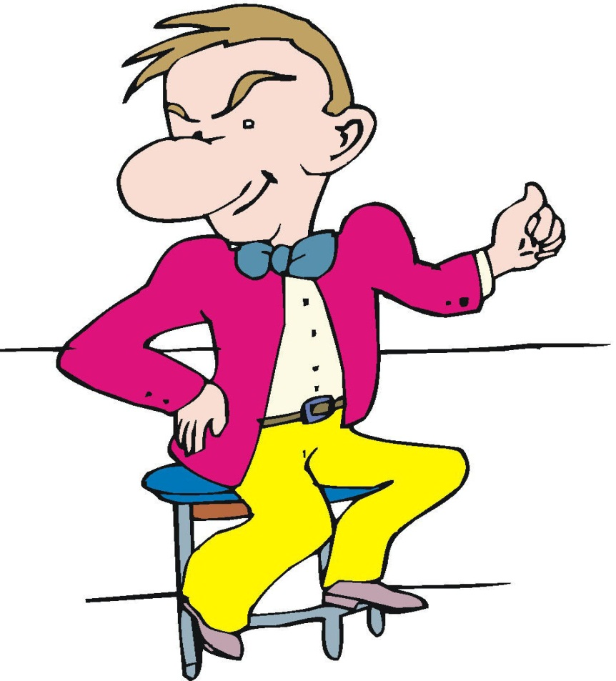
Chapter 8 Vocabulary
ἐγώ, ἡμεῖς
I, we

Slide 29
Chapter 8 Vocabulary
ἡμέρα, -ας, ἡ
day

Slide 30
Chapter 8 Vocabulary
ὅτι
that, so that

Slide 31
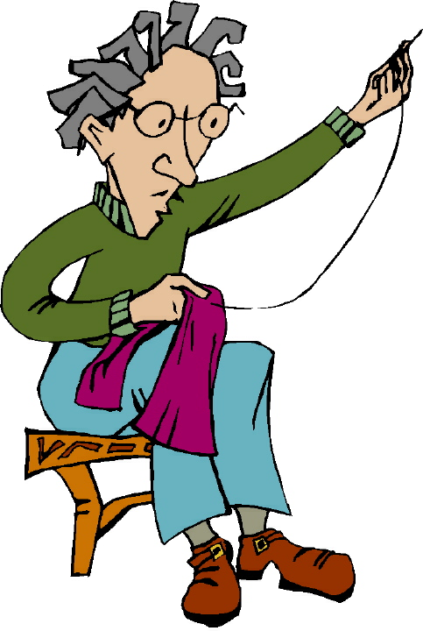
Chapter 8 Vocabulary
οὖν
so, then, therefore

Slide 32
Chapter 8 Vocabulary
ὄχλος, -ου, ὁ
crowd

Slide 33
Chapter 8 Vocabulary
παρά
from (with Gen.)

Slide 34
Chapter 8 Vocabulary
παρά
beside, with (with Dat.)
alongside, beside (with Acc.)

Slide 35
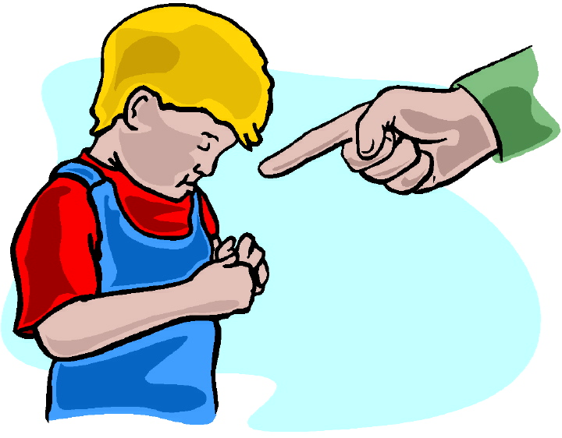
Chapter 8 Vocabulary
σύ, ὑμεῖς
you, you (pl.)

Slide 36
Chapter 8 Vocabulary
ὑπό
by, at the hands of (with Gen.)

Slide 37
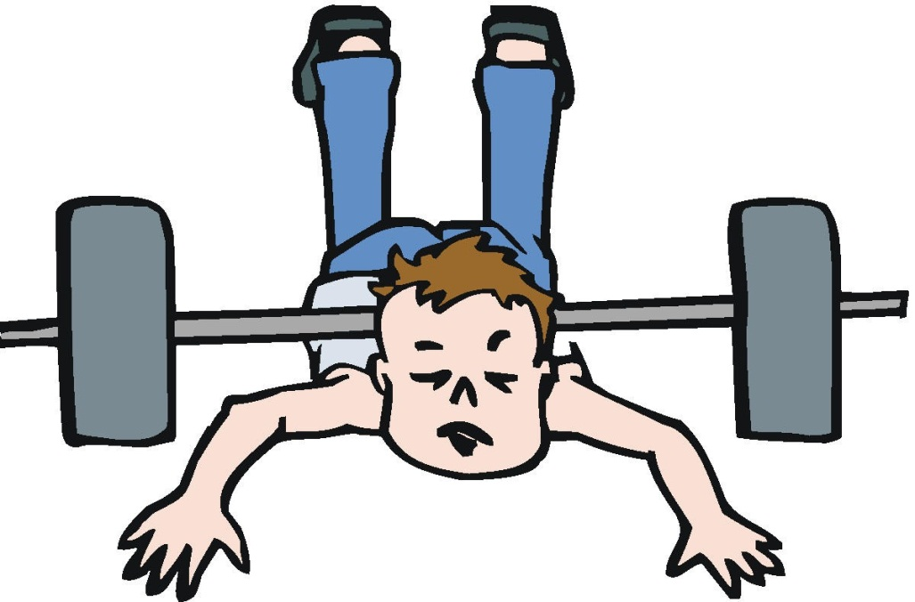
Chapter 8 Vocabulary
ὑπό
under, below (with Acc.)

Slide 38
4 Chants

Slide 39
PAI Verb Paradigm Rap
λύω λύομεν
λύεις λύετε
λύει λύουσι(ν)

Slide 40
Second Declension Chant
Nom. Sg.
Gen. Sg.
Dat. Sg.
Acc. Sg.
Nom. Pl.
Gen. Pl.
Dat. Pl.
Acc. Pl.
λόγος
λόγου
λόγῳ
λόγον
λόγοι
λόγων
λόγοις
λόγους
ἱερόν
ἱεροῦ
ἱερῷ
ἱερόν
ἱερά
ἱερῶν
ἱεροῖς
ἱερά

Slide 41
The "is" verb PAI -- εἰμί
εἰμί ἐσμέν εἶ ἐστέ ἐστί(ν) εἰσί(ν)

Slide 42
Totally Personal Chant
e]gw< su h[mei?j [u[mei?j]
mou sou h[mw?n [u[mw?n]
moi soi h[mi?n [u[mi?n]
me se h[ma?j [u[ma?j]
Au]to<j, au]th<, au]to<

Slide 43
Totally Personal Chant
ἐγώ σύ ἡμεῖς [ὑμεῖς]
μου σου ἡμῶν [ὑμῶν]
μοι σοι ἡμῖν [ὑμῖν]
με σε ἡμᾶς [ὑμᾶς]
αὐτός, αὐτή, αὐτό

Slide 44
Vocabulary Review

Slide 45
Ch. 1 -- Vocabulary
angel, messenger
ἄγγελος, -ου, ὁ
verily, truly
ἀμήν
man, humankind
ἄνθρωπος, -ου, ὁ
I
ἐγώ
God
θεός, -οῦ, ὁ

Slide 46
Ch. 1 -- Vocabulary
and, also, even
καί
heart
καρδία, -ας, ἡ
I say
λέγω
prophet
προφήτης, -ου, ὁ
Christ, Messiah
Χριστός, -οῦ, ὁ

Slide 47
Ch. 2 -- Vocabulary
brother
ἀδελφός, -οῦ, ὁ
I hear, obey
ἀκούω
glory, fame
δόξα, -ης, ἡ
I have
ἔχω
world
κόσμος, -ου, ὁ

Slide 48
Ch. 2 -- Vocabulary
Lord, sir
κύριος, -ου, ὁ
word
λόγος, -ου, ὁ
Peter
Πἑτρος, -ου, ὁ
son
υἱός, -οῦ, ὁ
Pharisee
Φαρισαῖος, -ου, ὁ

Slide 49
Ch. 3 -- Vocabulary
but, yet
ἀλλἀ
apostle, sent one
ἀπόστολος, -ου, ὁ
I see
βλέπω
for, then
γάρ
I know
γινώσκω

Slide 50
Ch. 3 -- Vocabulary
Jesus
Ἰησοῦς, -οῦ, ὁ
I take, receive
λαμβάνω
I loose
λύω
heaven
οὐρανός, -οῦ, ὁ
I believe
πιστεύω

Slide 51
Ch. 4 -- Vocabulary
I love
ἀγαπάω
I write
γράφω
but, and
δέ
servant, slave
δοῦλος, -ου, ὁ
I find
εὑρίσκω

Slide 52
Ch. 4 -- Vocabulary
temple
ἱερόν, -οῦ, τό
People
λαός, -οῦ, ὁ
law
νόμος, -ου, ὁ
house
οἶκος, -ου, ὁ
as, about, how
ὡς

Slide 53
Ch. 5 -- Vocabulary
love
ἀγάπη, -ης, ἡ
truth
ἀλήθεια, -ας, ἡ
sin
ἁμαρτία, -ας, ἡ
kingdom
βασιλεία, -ας, ἡ
writing, Scripture
γραφή, -ῆς, ἡ

Slide 54
Ch. 5 -- Vocabulary
I raise up
ἐγείρω
assembly, church
ἐκκλησία, -ας, ἡ
work
ἔργον, -ου, τό
disciple
μαθητής, -οῦ, ὁ
Hour
ὥρα, -ας, ἡ

Slide 55
Chapter 6 Vocabulary
ἀπό (Gen.)
from
διά (Gen.)
through
διά (Acc.)
on account of
εἰς (Acc.)
into

Slide 56
Chapter 6 Vocabulary
ἐκ (Gen.)
out of, from
ἐν (Dat.)
in
ἐπί (Gen.)
on, over
ἐπί (Dat.)
on, at, against, on the basis of

Slide 57
Chapter 6 Vocabulary
ἐπί (Acc.)
on, to, toward, against
κατά (Gen.)
down, against
κατά (Acc.)
according to
μετά (Gen.)
with

Slide 58
Chapter 6 Vocabulary
μετά (Acc.)
after, behind
περί (Gen.)
about, concerning
περί (Acc.)
around, near
πρός (Acc.)
to

Slide 59
Vocabulary -- Ch. 7
good
ἀγαθός, -ή, -όν
Holy
ἅγιος, -α, -ον
righteous
δίκαιοις, -α, -ον

Slide 60
Vocabulary – Ch. 7
I am
εἰμί
Jewish, a Jew
Ἰουδαῖος, -α, -ον
Great
μέγας, μεγάλη, μέγα

Slide 61
Vocabulary -- Ch. 7
dead
νεκρός, -ά, -όν
no, not
οὐ, οὐκ, οὐχ
first
πρῶτος, -η, -ον
voice
φωνή, -ῆς, ἡ

