Slide 1
Mastering NT Greek
7. Agitating the Adjectives
By Ted Hildebrandt © 2003
Baker Academic

Slide 2
Warm-ups

Slide 3
PAI Verb Paradigm Rap
λύω λύομεν
λύεις λύετε
λύει λύουσι(ν)

Slide 4
2-1-2 Paradigms - Chant this
2 1 2
λόγος γραφή ἱερόν
λόγου γραφῆς ἱεροῦ
λόγῳ γραφῇ ἱερῷ
λόγον γραφήν ἱερόν
λόγοι γραφαί ἱερά
λόγων γραφῶν ἱερῶν
λόγοις γραφαῖς ἱεροῖς
λόγους γραφάς ἱερά

Slide 5
Memory Verse -- Jn 1:1
Ἐν ἀρχῇ ἦν ὁ λόγος,
in the beginning was the word
καὶ ὁ λόγος ἦν πρὸς τὸν θεόν,
and the word was with God
καὶ θεὸς ἦν ὁ λόγος.
and the word was God

Slide 6
Preping Prepositions
ἐπί (on)
Accusative (towards)
Genitive (separation, from)
πρός (to)
ἀπό (from)
εἰς (into)
ἐκ (out of, from)
Dative (in)
ἐν (in)
περί (about, around)
σύν (with)
διά (through; on account of)
μετά (with; after)
κατά (down, against)

Slide 7
Vocabulary – Ch 6
ἀπό (+ Gen.)
from
διά (+ Gen.)
through
διά (+ Acc.)
on account of
εἰς (+ Acc.)
into
ἐκ (+ Gen.)
out of

Slide 8
Vocabulary – Ch 6
ἐν (+ Dat.)
in
ἐπί (+ Gen.)
on, over
ἐπί (+ Dat)
on, against, at, on the basis of

Slide 9
Vocabulary – Ch. 6 (cont.)
ἐπί (+ Acc.)
on, toward, to, against
κατά (+ Gen.)
down, against
κατά (+ Acc.)
according to
μετά (+ Gen.)
with

Slide 10
Vocabulary – Ch. 6 (cont.)
μετά (+ Acc.)
after, behind
περί (+ Gen.)
about, concerning
περί (+ Acc.)
around, near
πρός
to (+ Acc.)

Slide 11
Introducing the Adjectives

Slide 12
Adjectives
Definition: word used to modify a noun or pronoun.
Often answers the question "What kind of ________ is it?"
The red truck sped by us.
What kind of truck? -- red
The good mechanic passed our car.

Slide 13
3 Types of Adjectives Usage
Attributive: attributes a characteristic to the noun -- The good book
Predicate: Assigns a characteristic to the subject of the sentence -- The book is good.
Substantive: the adjective acts as a stand alone noun -- The good die young.
These three usages are the tricky part of adjectives. Note the differences well.

Slide 14
A "Good" Adjective Paradigm - 2-1-2
2 1 2 Masc Fem Neut
Nom Sg ἀγαθός ἀγαθή ἀγαθόν Gen Sg ἀγαθοῦ ἀγαθῆς ἀγαθοῦ Dat Sg ἀγαθῷ ἀγαθῇ ἀγαθῷ Acc Sg ἀγαθόν ἀγαθήν ἀγαθόν Nom Pl ἀγαθοί ἀγαθαί ἀγαθά Gen Pl ἀγαθῶν ἀγαθῶν ἀγαθῶν Dat Pl ἀγαθοῖς ἀγαθαῖς ἀγαθοῖς Acc Pl ἀγαθούς ἀγαθάς ἀγαθά

Slide 15
Attributive Position (+ Art.)
Attributive: the Adj. has the Article
ὁ ἀγαθὸς λόγος -- the good word
ὁ λόγος ὁ ἀγαθός -- the good word
ἐγώ εἰμὶ ὁ ποιμὴν ὁ καλός
I am the good shepherd (Jn. 10:11).

Slide 16
Predicate Position (No Art.)
Predicate position the Adj. has no Article but the noun has a Art.
ἀγαθὸς ὁ λόγος -- the word is good.
ὁ λόγος ἀγαθὸς -- the word is good.
καὶ ὁ ἄνθρωπος οὗτος δίκαιος
and this man was righteous (Lk. 2:25).

Slide 17
Predicate or Attributive?
Sometimes both the noun and the adjective do not have the article in which case context must determine whether it is predicate or attributive
καὶ ἀνὴρ ἀγαθὸς καὶ δίκαιος
and a good and righteous man (Lk 23:50)

Slide 18
Substantive Use -- No noun
The substantive often has the Article but no accompanying noun
οἱ δἐ δίκοιοι εἰς ζωὴν αἰώνιον
and the righteous unto eternal life

Slide 19
The "is" verb PAI -- εἰμί
Singular Plural
εἰμί I am ἐσμέν we are εἶ you are ἐστέ you are ἐστί(ν) he/she/it is εἰσί(ν) they are
This verb is very important. Chant these forms.

Slide 20
Example of εἰμί
ὅτι θεὸς ἀληθής ἐστιν.
that God is true (Jn 3:33)

Slide 21
Negation of the Indicative – οὐ
οὐ -- before a consonant
καὶ οὐ λαμβάνετέ με
and you do not accept me
οὺκ -- before a smooth breath vowel
καὶ λέγει, Οὐκ εἰμί
and he said "I am not“
οὐχ -- before a rough breathing vowel
οὐχ ὑμεῖς λέγετε ὅτι
do you not say that

Slide 22
Vocabulary -- Ch. 7
ἀγαθός, -ή, -όν
good

Slide 23
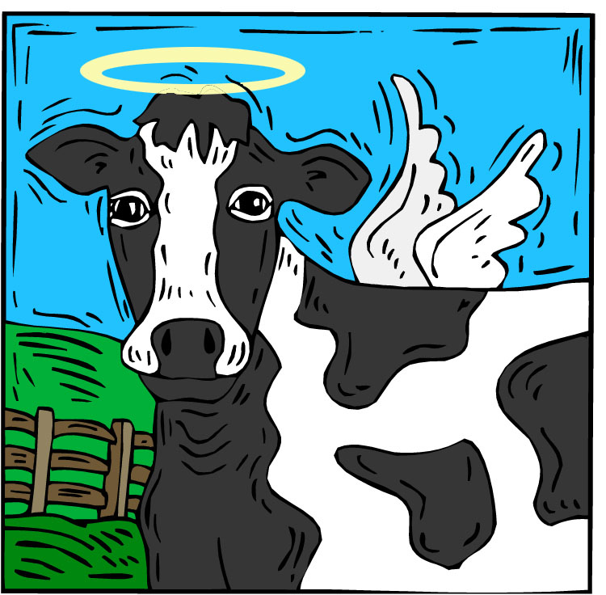
Vocabulary -- Ch. 7
ἅγιος, -α, -ον
holy

Slide 24
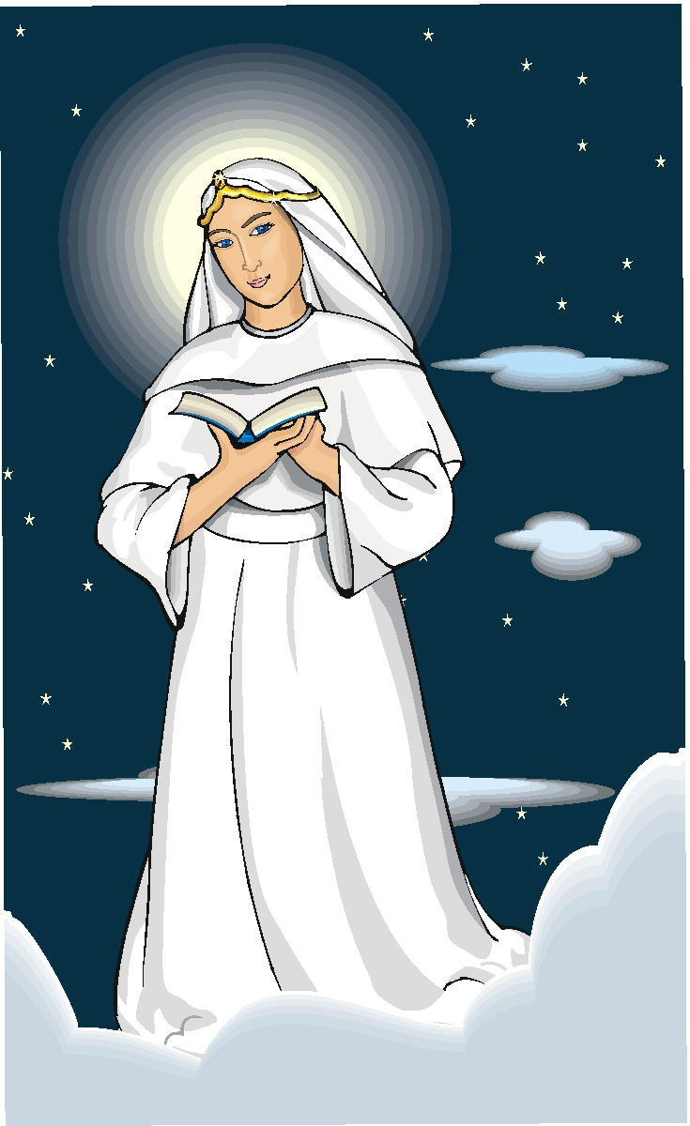
Vocabulary -- Ch. 7
δίκαιος, -α, -ον
righteous

Slide 25
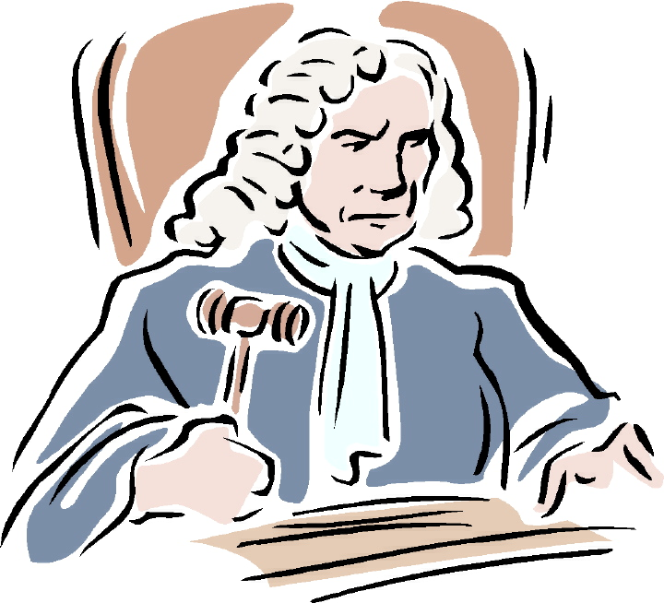
Vocabulary -- Ch. 7
εἰμί
I am

Slide 26
Vocabulary -- Ch. 7
Ἰουδαῖος, -α, -ον
Jewish, a Jew

Slide 27
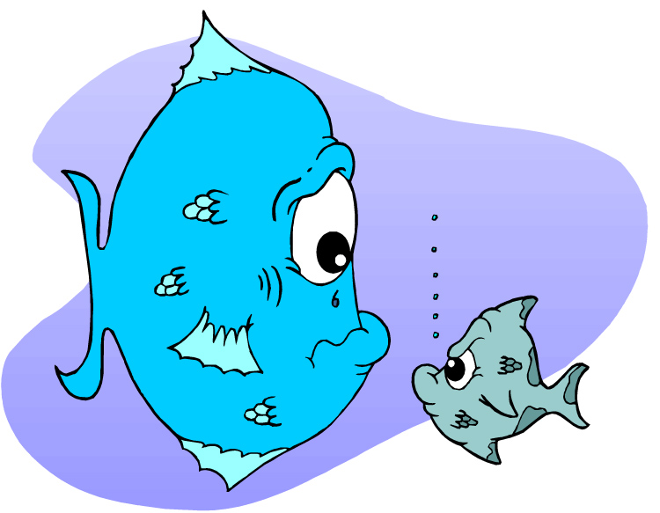
Vocabulary -- Ch. 7
μέγας, μεγάλη, μέγα
great

Slide 28
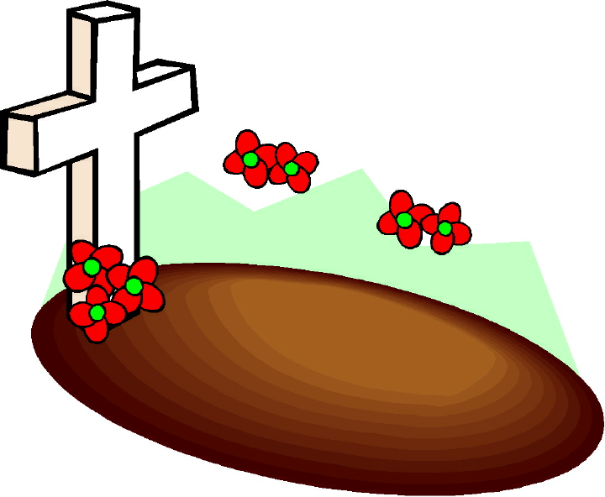
Vocabulary -- Ch. 7
νεκρός, -ά, -όν
dead

Slide 29
Vocabulary -- Ch. 7
οὐ, οὐκ, οὐχ
no, not

Slide 30
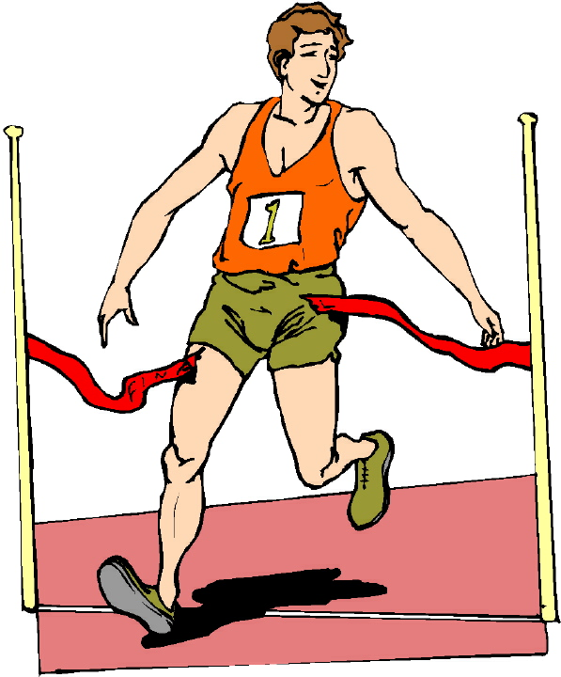
Vocabulary -- Ch. 7
πρῶτος, -η, -ον
first

Slide 31
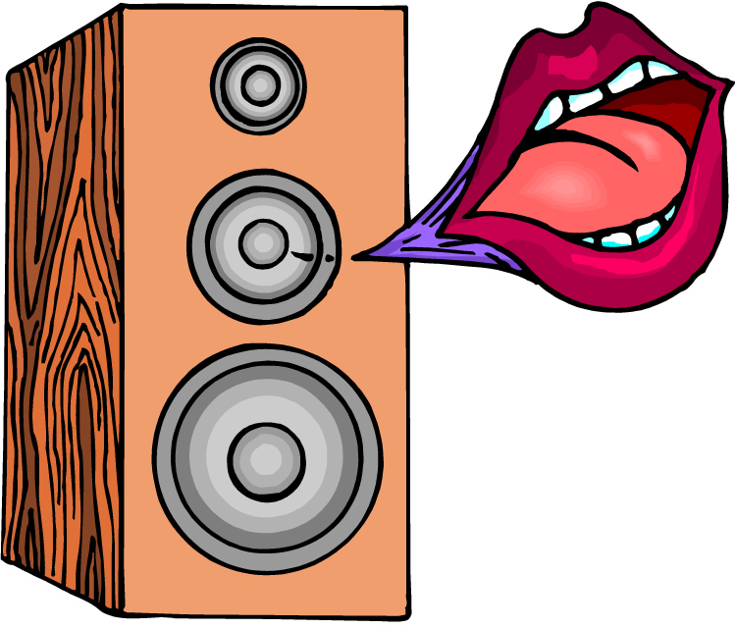
Vocabulary -- Ch. 7
φωνή, -ῆς, ἡ
voice

Slide 32
Vocabulary Review

Slide 33
Ch. 1 -- Vocabulary
angel, messenger
ἄγγελος, -ου, ὁ
verily, truly
ἀμήν
man, humankind
ἄνθρωπος, -ου, ὁ
I
ἐγώ
God
θεός, -οῦ, ὁ

Slide 34
Ch. 1 -- Vocabulary
and, also, even
καί
heart
καρδία, -ας, ἡ
I say
λέγω
prophet
προφήτης, -ου, ὁ
Christ, Messiah
Χριστός, -οῦ, ὁ

Slide 35
Ch. 2 -- Vocabulary
brother
ἀδελφός, -οῦ, ὁ
I hear, obey
ἀκούω
glory, fame
δόξα, -ης, ἡ
I have
ἔχω
world
κόσμος, -ου, ὁ

Slide 36
Ch. 2 -- Vocabulary
Lord, sir
κύριος, -ου, ὁ
word
λόγος, -ου, ὁ
Peter
Πἑτρος, -ου, ὁ
son
υἱός, -οῦ, ὁ
Pharisee
Φαρισαῖος, -ου, ὁ

Slide 37
Ch. 3 -- Vocabulary
but, yet
ἀλλἀ
apostle, sent one
ἀπόστολος, -ου, ὁ
I see
βλέπω
for, then
γάρ
I know
γινώσκω

Slide 38
Ch. 3 -- Vocabulary
Jesus
Ἰησοῦς, -οῦ, ὁ
I take, receive
λαμβάνω
I loose
λύω
heaven
οὐρανός, -οῦ, ὁ
I believe
πιστεύω

Slide 39
Ch. 4 -- Vocabulary
I love
ἀγαπάω
I write
γράφω
but, and
δέ
servant, slave
δοῦλος, -ου, ὁ
I find
εὑρίσκω

Slide 40
Ch. 4 -- Vocabulary
temple
ἱερόν, -οῦ, τό
People
λαός, -οῦ, ὁ
law
νόμος, -ου, ὁ
house
οἶκος, -ου, ὁ
as, about, how
ὡς

Slide 41
Ch. 5 -- Vocabulary
love
ἀγάπη, -ης, ἡ
truth
ἀλήθεια, -ας, ἡ
sin
ἁμαρτία, -ας, ἡ
kingdom
βασιλεία, -ας, ἡ
writing, Scripture
γραφή, -ῆς, ἡ

Slide 42
Ch. 5 -- Vocabulary
I raise up
ἐγείρω
assembly, church
ἐκκλησία, -ας, ἡ
work
ἔργον, -ου, τό
disciple
μαθητής, -οῦ, ὁ
Hour
ὥρα, -ας, ἡ

Slide 43
Chapter 6 Vocabulary
ἀπό (Gen.)
from
διά (Gen.)
through
διά (Acc.)
on account of
εἰς (Acc.)
into

Slide 44
Chapter 6 Vocabulary
ἐκ (Gen.)
out of, from
ἐν (Dat.)
in
ἐπί (Gen.)
on, over
ἐπί (Dat.)
on, at, against, on the basis of

Slide 45
Chapter 6 Vocabulary
ἐπί (Acc.)
on, to, toward, against
κατά (Gen.)
down, against
κατά (Acc.)
according to
μετά (Gen.)
with

Slide 46
Chapter 6 Vocabulary
μετά (Acc.)
after, behind
περί (Gen.)
about, concerning
περί (Acc.)
around, near
πρός (Acc.)
to

Slide 47
Vocabulary -- Ch. 7
good
ἀγαθός, -ή, -όν
Holy
ἅγιος, -α, -ον
righteous
δίκαιοις, -α, -ον

Slide 48
Vocabulary – Ch. 7
I am
εἰμί
Jewish, a Jew
Ἰουδαῖος, -α, -ον
Great
μέγας, μεγάλη, μέγα

Slide 49
Vocabulary -- Ch. 7
dead
νεκρός, -ά, -όν
no, not
οὐ, οὐκ, οὐχ
first
πρῶτος, -η, -ον
voice
φωνή, -ῆς, ἡ

