Slide 1
Mastering NT Greek
4. Nouns: Second Declension
By Ted Hildebrandt © 2003
Baker Academic

Slide 2
λύω PAI (Present Active Indicative)
1st sg λύω I loose/am loosing.
2nd sg λύεις You loose/are loosing.
3rd sg λύει He/she/it looses.
1st pl λύομεν We loose/are loosing.
2nd pl λύετε You (all) loose/are loosing.
3nd pl λύουσι(ν) They loose/are loosing.

Slide 3
Intro to English Nouns
Gender:
Masculine = he (prince=he)
Feminine = she (ship, princess = she),
Neuter = it (computer = it)
ἁμαρτία = feminine "sin"
ἁμαρτωλός = masculine "sinner"

Slide 4
Intro to English Nouns
Number:
Singular: skate, child, woman, deer
Plural: skates, children, women, deer
οὐρανός heaven
οὐρανοί heavens

Slide 5
Intro to Nouns
Case:
Nominative: subject of sentence (naming designating)—31% (Walllace, 138) (S/he received the award.)
Accusative: object of the sentence (The car hit him.)– 29%

Slide 6
Intro to Nouns
Genitive: possessive, (origin, separation, descriptive)—25%; Keyword: of + x
The car of the boy didn’t pass inspection.—poss.
He went to the house of prayer (descriptive)
The writing of the prophet (origin)
The son of Mary (relation)

Slide 7
Intro to Nouns
Dative: Indirect object (location, means)—15% (not in modern Greek)
Give the car to her. –indirect obj.
He was hit by the goalie. --agent
She went to the store. –location
2x4 ate (at) with
Keywords: 2x4, at, with (to, by, for, at…)
Vocative: Direct Address –1% (Walllace, 138)
O car, roll on. –direct address

Slide 8
The Article
Indefinite article: "a" boat not marked in Greek
Definite article: "the" boat
ὁ = the (masculine)
ἡ = the (feminine)
τό = the (neuter)
When you learn the noun learn it with the definite article that will tell you what gender it is.

Slide 9
First, Second and Third Declensions
Shared sets of endings
First = "α" or "η" ending nouns (usually fem.) γραφή or ὥρα
Second = "o" ending nouns (usually masc./neut.) λόγος
Third = consonant ending nouns χάρις (stem ends in “ρ")

Slide 10
Greek Second Declension Nouns
Omicron ending nouns
ἀpόστολος
ἄγγελος
λόγος
To get the root take off the ς ending
λόγο + ς

Slide 11
Second Declension Translations: Masculine
Singular Plural
Nom. λόγος word λόγοι words
Gen. λόγου of a word λόγων of words
Dat. λόγῳ to/for a word λόγοις to/for words
Acc. λόγον word λόγους words
Voc. λόγε O word λόγοι O words

Slide 12
Second Declension Chant: Masculine Paradigm
Know the following paradigm cold.
Singular Plural
Nom. λόγος λόγοι
Gen. λόγου λόγων
Dat. λόγῳ λόγοις
Acc. λόγον λόγους

Slide 13
Second Declension Chant: Neuter (ἱερόν = temple)
Be able to chant through this paradigm.
Singular Plural
Nom./Voc. ἱερόν ἱερά
Gen. ἱεροῦ ἱερῶν
Dat. ἱερῷ ἱεροἰς
Acc. ἱερόν ἱερά

Slide 14
Declining Nouns
Case, number, gender, root, translation
λόγῳ
Dat. Sg. Masc. λόγος, "to/for a word"
λόγων
Gen. Pl. Masc. λόγος, "of words"
λόγοις
Dat. Pl. Masc. λόγος, "to/for/by/at words"
ἱερόν
Nom/Acc/Voc. Sg. Neut. ἱερόν, "temple"

Slide 15
Cases another look
Another way to look at the cases is:
Accusative Dative Genitive
Motion to/into in Motion away from
in

Slide 16
Second Declension Chant
Nom. Sg.
Gen. Sg.
Dat. Sg.
Acc. Sg.
Nom. Pl.
Gen. Pl.
Dat. Pl.
Acc. Pl.
λόγος
λόγου
λόγῳ
λόγον
λόγοι
λόγων
λόγοις
λόγους
ἱερόν
ἱεροῦ
ἱερῷ
ἱερόν
ἱερά
ἱερῶν
ἱεροῖς
ἱερά

Slide 17
Appositional Use of Acc.
Appositional use is when 2 adjacent substantives (nouns) refer to the same person, place or thing…piggy-backs, can happen with other cases as well, when you have a string of the same cases in a row (Wallace’s Grammar, 199).
Mk 1:16 Ἀνδέαν τὸν ἀδελφὸν Σίμωνος Andrew, the brother of Simon

Slide 18
Chapter 4 Vocabulary
ἀγαπάω
I love

Slide 19
Chapter 4 Vocabulary
γράφω
I write

Slide 20
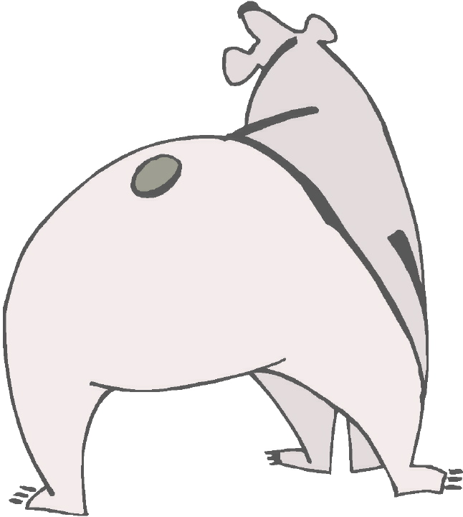
Chapter 4 Vocabulary
δέ
but, and

Slide 21
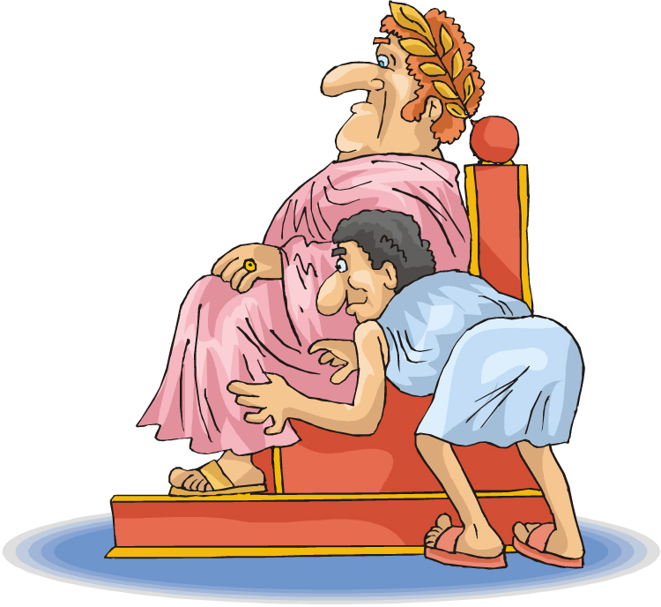
Chapter 4 Vocabulary
δοῦλος, -ου, ὁ
servant, slave

Slide 22
Chapter 4 Vocabulary
εὑρίσκω
I find

Slide 23
Chapter 4 Vocabulary
ἱερόν, -οῦ, τό
temple

Slide 24
Chapter 4 Vocabulary
λαός, -οῦ, ὁ
people

Slide 25
Chapter 4 Vocabulary
νόμος, -ου, ὁ
law

Slide 26
Chapter 4 Vocabulary
οἶκος, -ου, ὁ
house

Slide 27
Chapter 4 Vocabulary
ὡς
as, about, how

Slide 28
Memory Verse -- Jn 1:1
Ἐν ἀρχῇ ἦν ὁ λόγος,
in the beginning was the word
καὶ ὁ λόγος ἦν πρὸς τὸν θεόν,
and the word was with God
καὶ θεὸς ἦν ὁ λόγος.
and the word was God

Slide 29
Review

Slide 30
Vocabulary Review Chapter 1
ἄγγελος, -ου, ὁ
ἀμήν
Humankind
ἐγώ
θεός, -ου, ὁ

Slide 31
Vocabulary Review Chapter 1
καί
heart
λέγω
προφήτης, -ου, ὁ
Χριστός, -οῦ, ὁ

Slide 32
Vocabulary Review Chapter 2
ἀδελφός, -οῦ, ὁ
I hear
δόξα, -ης, ἡ
ἔχω
world

Slide 33
Vocabulary Review Chapter 2
κύριος, -ου, ὁ
λόγος, -ου, ὁ
Πέτρος, -ου, ὁ
son
Φαρισαῖος, -ου, ὁ

Slide 34
Vocabulary Chapter 3
ἀλλά
ἀπόστολος, -ου, ὁ
I see
γάρ
I know

Slide 35
Vocabulary Chapter 3
Ἰησοῦς, -οῦ, ὁ
λαμβάνω
λύω
heaven
πιστεύω

Slide 36
λύω Chant
1st sg λύω I loose/am loosing
2nd sg λύεις you loose/are loosing
3rd sg λύει he/she/it looses
1st pl λύομεν we loose/are loosing
2nd pl λύετε you (all) loose/are loosing
3nd pl λύουσι(ν) they loose/are loosing

Slide 37
Second Declension Chant
Nom. Sg.
Gen. Sg.
Dat. Sg.
Acc. Sg.
Nom. Pl.
Gen. Pl.
Dat. Pl.
Acc. Pl.
λόγος
λόγου
λόγῳ
λόγον
λόγοι
λόγων
λόγοις
λόγους
ἱερόν
ἱεροῦ
ἱερῷ
ἱερόν
ἱερά
ἱερῶν
ἱεροῖς
ἱερά

