Slide 1
Mastering NT Greek
3. Present Active Indicative Verb
By Ted Hildebrandt © 2003
Baker Academic

Slide 2
English Grammar Review: parts of speech
Noun: book, table, car
Adjective: red book, big table
Definite Article -- the [indefinite art.=a]
Pronoun: I, you, he, she, it, this/that, who
Preposition: in, by, because
Verb: swam, ran, studied
Adverb: read quickly, skipped happily

Slide 3
Sentence Parts (syntax)
1. Subject: about which something is said: Terry went to the store
2. Predicate: that which is said about the subject: Terry went to the store.
Predicate Nominative: It is I.
3. Phrase: group of words with no verb but used as a single part of speech: The book on the table is mine

Slide 4
Sentence Parts (syntax)
4. Clause: group of words that has a verb: The student who studied Greek by the ocean is relaxed.
5. SVOM -- Subject, Verb, Object, Modifier
Terry brought the book to the class.
S V O M
S:agent V: O:Item M:location

Slide 5
Vanquishing Verbs: Tense=Time?
Present: Zach plays basketball.
Past: Zach played basketball.
Future: Zach will play basketball.
Perfect: Zach had played basketball.
In Greek the present tense can be translated past, present or even future
For now we will simply translate it present tense--relax

Slide 6
Vanquishing Verbs: Aktionsart: How action happens
Continuous action: I was studying Greek.
Undefined: I studied for the test.
Perfect: I have studied for the test.

Slide 7
Aspect:author’s portrayal of act
Present/Imperfect: immediacy, details, in progress, descriptive, foreground material: watching parade right in front of you
Aorist: wholistic, complete, undifferentiated, background material; watching the parade from the 10th story
Perfect/Pluperfect: state of affairs, special frontground, emphasis, material

Slide 8
Vanquishing Verbs: Voice
Active: subject does the action
Elliott hit the ball.
Middle: subject does action on or for itself; participates in the action of the verb, emphasis on the subject doing the action
Elliott hit himself. He took the book.
Passive: the subject receives the action
Elliott was hit by the ball.

Slide 9
Vanquishing Verbs: Mood
Indicative: statement of fact He stood.
Subjunctive: desire or possibility He may stand.
Imperative: command Stand!
Optative: wish Oh that he would stand.

Slide 10
Present Active Indicative Verb
Present tense: action represented as immediacy, foregrounding, details
"I feel the wind blowing." –present time
Aktionsart:
Continuous: "I am feeling the wind."
Undefined: "I feel the wind.“

Slide 11
Verbs getting personal: English
1st person sg: I -- I saw.
1st person pl: we -- We saw.
2nd person sg: you (thou) -- You saw.
2nd person pl: you (all) ye -- You (all) saw.
3rd person sg: he/she/it -- She saw him.
3rd person pl: they -- They saw them.

Slide 12
Present Active Indicative Verb Formation
Present Stem + Pronominal Ending
λύ + ομεν, λύ + ετε
Primary Endings: the PAI [Present Active Indicative] pronominal endings are called primary endings (cf. future)

Slide 13
λύω PAI (Present Active Indicative)
1st sg λύω I loose/am loosing.
2nd sg λύεις You loose/are loosing.
3rd sg λύει He/she/it looses.
1st pl λύομεν We loose/are loosing.
2nd pl λύετε You (all) loose/are loosing.
3nd pl λύουσι(ν) They loose/are loosing.

Slide 14
PAI Verb Paradigm: First Chant
Learn to chant/rap this paradigm so well until you can say it in your sleep.
λύω λύομεν
λύεις λύετε
λύει λύουσι(ν)

Slide 15
Personal Endings: Primary Pronominal endings
1 sg ω 1 pl ομεν
2 sg εις 2 pl ετε
3 sg ει 3 pl ουσι(ν)

Slide 16
Present Active Indicative Meaning
The Present Active Indicative can be translated in the following ways.
Undefined Aktionsart: I loose
Continuous Aktionsart: I am loosing
The present tense may be used to describe something that actually happened in the past. This is called the "historical present.“ (Time =/= tense)
λέγω "I said" instead of "I say".

Slide 17
Movable Nu (n)
Sometimes a nu (ν) is added to the end of words ending in σι or ε. Smooths pronunciation before a word beginning with a vowel or ending a clause/sentence.
λύουσι becomes λύουσιν αὐτῷ
Makes no difference to the translation.

Slide 18
Second Person Plural
The King James version nicely distinguishes “thou” (2nd singular) from “ye” (2nd plural).
In class we will adopt a "you” or southern “you all" to make the plural explicit. In normal translation use "you" for both.

Slide 19
Parsing Party Format
Use the following format for parsing verbs:
PAI = Present Active Indicative
1 sg = First Person Singular
λύω
PAI 1 sg from lu<w meaning "I loose.“
λύετε
PAI 2 pl from lu<w meaning “you (all) loose.”

Slide 20
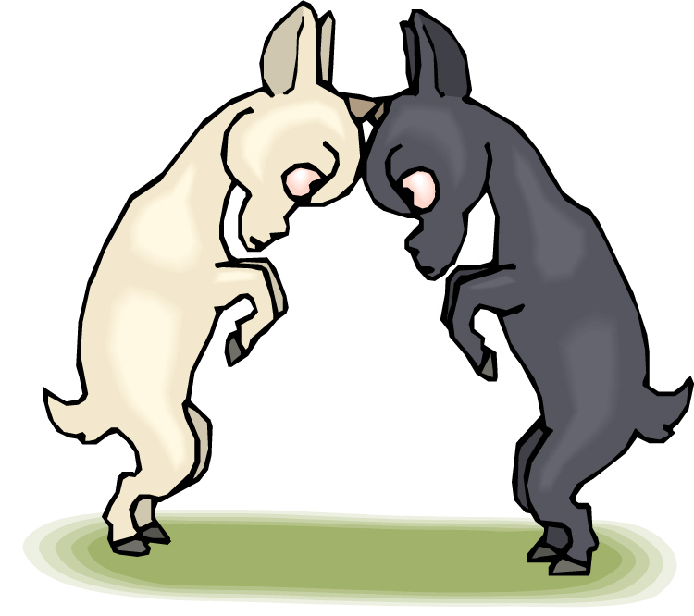
Chapter 3 Vocabulary
ἀλλά
but, yet

Slide 21
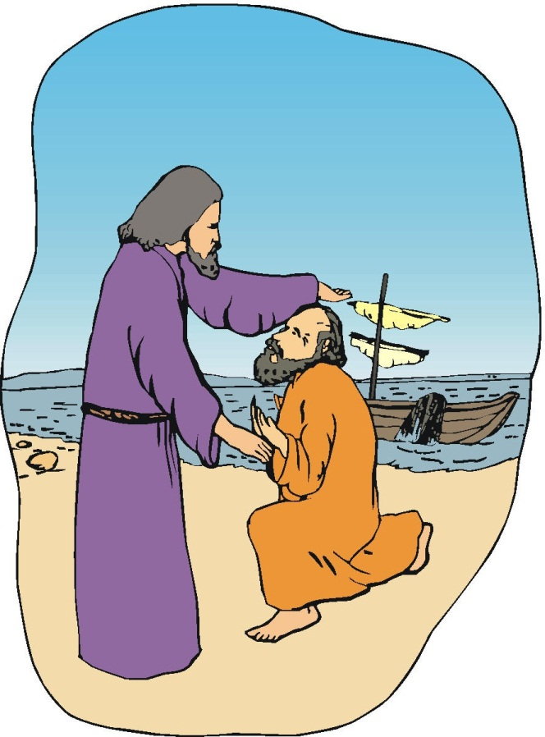
Chapter 3 Vocabulary
ἀπόστολος
apostle, sent one

Slide 22
Chapter 3 Vocabulary
βλέπω
I see

Slide 23
Chapter 3 Vocabulary
γάρ
for, then

Slide 24
Chapter 3 Vocabulary
γινώσκω
I know

Slide 25
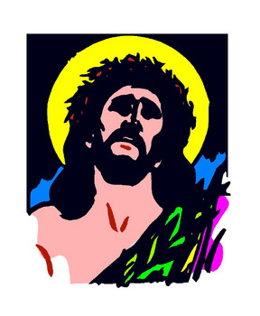
Chapter 3 Vocabulary
Ἰησοῦς
Jesus

Slide 26
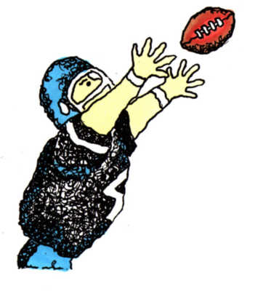
Chapter 3 Vocabulary
λαμβάνω
I take, receive

Slide 27
Chapter 3 Vocabulary
λύω
I loose

Slide 28
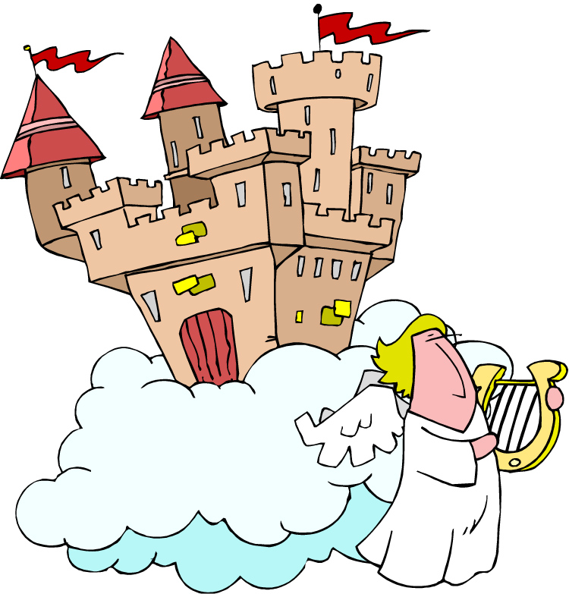
Chapter 3 Vocabulary
οὐρανός
heaven

Slide 29
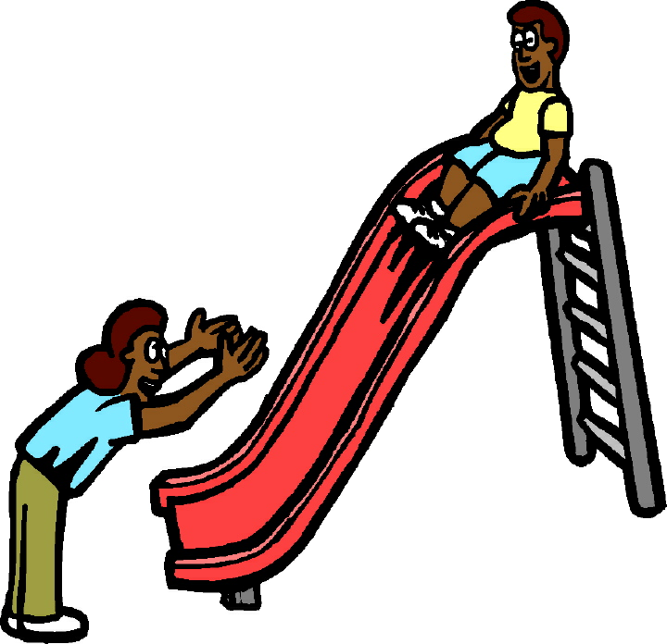
Chapter 3 Vocabulary
πιστεύω
I believe

Slide 30
Review Chapter 1 Vocabulary
Angel
ἄγγελος
Truly, verily
ἀμήν
Man, human
ἄνθρωπος

Slide 31
Review Chapter 1 Vocab
I
ἐγώ
God
θεός
And
καί

Slide 32
Review Chapter 1 Vocabulary
καρδία
heart
λέγω
I say
προφήτης
prophet

Slide 33
Review Chapter 1 Vocabulary
Χριστός
Christ

Slide 34
Review Chapter 2 Vocabulary
brother
ἀδελφός
I hear
ἀκούω
glory
δόξα

Slide 35
Review Chapter 2 Vocabulary
I have
ἔχω
world
κόσμος
Lord
κύριος
υἱός
Φαρισαῖος

Slide 36
Review Chapter 2 Vocabulary
word
λόγος
Peter
Πέτρος

Slide 37
Review Chapter 3 Vocabulary
but
ἀλλά
Apostle
ἀπόστολος
I see
βλέπω

Slide 38
Review Chapter 3 Vocabulary
For
γάρ
I know
γινώσκω
Jesus
Ἰησοῦς

Slide 39
Review Chapter 3 Vocabulary
I take, receive
λαμβάνω
I loose
λύω
Heaven
οὐρανός

Slide 40
Review Chapter 3 Vocabulary
I believe
πιστεύω

Slide 41
Review Chapter 1 Vocab
I
ἐγώ
God
θεός
And
καί

Slide 42
Review Chapter 1 Vocabulary
heart
καρδία
I say
λέγω
prophet
προφήτης

Slide 43
Review Chapter 1 Vocabulary
Christ
Χριστός

Slide 44
Review Chapter 2 Vocabulary
brother
ἀδελφός
I hear
ἀκούω
glory
δόξα

Slide 45
Review Chapter 2 Vocabulary
I have
ἔχω
world
κόσμος
Lord
κύριος
son
υἱός

Slide 46
Review Chapter 2 Vocabulary
Pharisee
Φαρισαῖος
word
λόγος
Peter
Πέτρος

Slide 47
Review Chapter 3 Vocabulary
but
ἀλλά
Apostle
ἀπόστολος
I see
βλέπω

Slide 48
Review Chapter 3 Vocabulary
For
γάρ
I know
γινώσκω
Jesus
Ἰησοῦς

Slide 49
Review Chapter 3 Vocabulary
I take, receive
λαμβάνω
I loose
λύω
Heaven
οὐρανός

Slide 50
Review Chapter 3 Vocabulary
I believe
πιστεύω

