Slide 1
Mastering NT Greek
2. Accents, Syllables, and English Grammar
By Ted Hildebrandt © 2003
Baker Academic

Slide 2
Chapter 2: Greek Fun with Words:
Homemade = made at home
Butter + Fly = butterfly
Pine + apple = pineapple
John 3:16 God gave his only begotten son
Μονογενής = μονο + γενης (γεννάω) only begotten only begotten
Actually = one of a kind γενης = kind/genus
Unique, only –Hebrews 11:17 of Isaac

Slide 3
Syllable Slicing -- 4 Rules
1. Consonants goes with what follows it 2. Split two consonants unless they are a consonant cluster (e.g. st, ch, br…) [Consonant cluster are two constants that can start a word]

Slide 4
Syllable Slicing -- 4 Rules
3. Split two vowels (except for diphthongs), allowing only one vowel or diphthong per syllable.
4. Split compound words into their original parts before applying the rules of syllable division.

Slide 5
Rules 1: Consonant goes with what follows
ἐγώ
ἐ / γώ
λέγω
λέ / γω
προφήτης
προ / φή / της

Slide 6
Rule 2. Split consonants but keep consonant clusters together
καρδία
καρ / δί / α
Χριστός
Χρι / στός

Slide 7
Rule 3. Split vowels but keep diphthongs together
θεός
θε / ός
φαρισαῖος
φα / ρι / σαῖ / ος
Why not καί

Slide 8
4. Split between words
συνάγω
συν + άγω (2 words)
συν ά γω
ἀπέρχομαι
ἀπ / έρ / χο / μαι

Slide 9
3 Syllable Names
ἄνθρωπος -- ἄν / θρω / πος (3 syllables)
Antepenult Penult Ultima
ἄν θρω πος
[Penult = almost last in Latin]
[Ante-Penult = before the almost last]

Slide 10
3 Accents
Acute ( ά ) λέγω I say
Grave ( ὰ ) ἀδελφὸς brother
Circumflex ( ᾶ ) αὐτοῦ his

Slide 11
Potential Accent Placement
Acute– can be placed on any of the last three syllables
ἄνθρωπος (ἄν θρω πος ) - antepenult
λέγω ( λέ γω) - penult
θεός (θε ός) - ultima

Slide 12
Potential Accent Placement
Circumflex – can be placed only on last 2 syllables
φαρισαῖος (φα ρι σαῖ ος) - penult
αὐτοῦ (αὐ τοῦ ) - ultima

Slide 13
Grave only last syllable
Χριστὸς (Χρι στὸς ) - ultima

Slide 14
6 Accent Rules
1. Nouns are retentive.
ἄγγελος, ἀγγέλῳ, ἄγγελον
2. Verbs are recessive.
λέγω (penult), λύομεν (antepenult)
3. If the ultima is long, then antepenult cannot be accented.
ἄγγελοω, ἀγγέλῳ

Slide 15
6 Accent Rules (cont.)
4. If the ultima is long and the penult is accented, then that accent must be an acute.
ἄγγελος, ἀγγέλῳ
5. If the ultima is short and the penult long and accented, that accent must be a circumflex.
ἐκεῖνος

Slide 16
6 Accent Rules (cont.)
6. If an acute is on the ultima, it becomes a grave when followed by another word without intervening punctuation.
καὶ θεὸς ἦν

Slide 17
Possible Accent Placement Chart
ά ά ά Acute
ᾶ ᾶ Circumflex
ὰ Grave

Slide 18
Words with No Accents
Clitics are words that "lean on" the words preceding or following.
Proclitic: comes before the word that carries the accent
ὁ Χριστός
Ἐν ἀρχῇ
οὐ κατέλαβεν (John 1:5) -KJV, NIV, NRSV, NLT

Slide 19
Words with no accents
Enclitic: comes after the word that carries the accent
Ἐγώ εἰμι

Slide 20
Breathing Marks
Smooth Breathing: ( ’ )
ἀδελφός ἐγώ
Rough Breathing: ( ‘ )
υἱός ῥημα
ἑξαγωνον –hexagon
Initial υ and ρ always take a rough breathing although it is not pronounced on a ρ

Slide 21
Punctuation Marks
Period ( . ) λόγος.
Comma ( , ) λόγος,
Colon ( · ) λόγος·
Question Mark ( ; ) λόγος;

Slide 22
Apostrophe
διά + αὐτοῦ == δι’ αὐτοῦ

Slide 23
Coronis contraction
και + ἐγώ == κἀγώ
ἀλλα + ἵνα == ἀλλ’ ἵνα

Slide 24
Diaeresis (¨) --the diphthong buster
Placed over second of two vowels in a row to keep the sounds separate -- not letting them become a diphthong.
Ἠσαΐας Ἠ σα ΐ ας
Μωϋσῆς Μω ϋ σῆς

Slide 25
English Grammar Review: parts of speech
Noun: person, place or thing: book
Adjective: noun modifier -- big red book
Definite Article: the (indefinite=a)
Pronoun: I, we, you, he, she, it, they
Preposition: in, by, because, out
Verb: swam, ran, studied
Adverb: modifies verb – quickly, swiftly
Conjunction: and, but

Slide 26
Sentence Parts (syntax)
1) Subject: about which something is said
Terry went to the store.
2) Predicate: that which is said about the subject: He drove the car.
Predicate Nominative: It is I.
Phrases: group of words with no verb but used as a single part of speech:
The book on the table is mine.

Slide 27
Sentence Parts (syntax)
Clauses: group of words that has a verb
The student who studied Greek by the ocean is relaxed.
SVOM -- Subject, Verb, Object, Modifier
The girl climbed the tree in the yard.
S V O M
S:NP V:V O:NP M:PP

Slide 28
Vanquishing Verbs: Tense
Present: Zach plays basketball.
Past: Zach played basketball.
Future: Zach will play basketball.
Perfect: Zach has played basketball.

Slide 29
Vanquishing Verbs: Aktionsart: How
Continuous action: I was studying Greek.
Undefined: I studied for the test.
Perfect: I have studied for the test.

Slide 30
Vanquishing Verbs: Voice
Active: subject does the action
Tanya took the car.
Middle: subject involved/interested/ participating or rarely reflexive action on or for itself
Tanya took herself (reflexive).
Passive: the subject receives the action
Tanya was taken by the car.

Slide 31
Vanquishing Verbs: Verb Moods
Indicative: statement of fact He stood.
Subjunctive: desire or possibility He may stand.
Imperative: command Stand!
Optative: wish Oh that he would stand.

Slide 32
Nouns
Gender: masculine, feminine, neuter
Number: singular / plural -- skate/skates
Case: Role the noun plays in the sentence
Nominative: subject of sentence (She received the award.)
Accusative: object of the sentence (The car hit her.)
Genitive: possessive (The car was hers.)

Slide 33
Nouns
Greek Adds two more cases
Dative: Indirect object (I told the story to the teacher.)
Vocative: direct address (O Lord, save me.)
Learn these 5 cases cold as they are crucial in Greek.

Slide 34
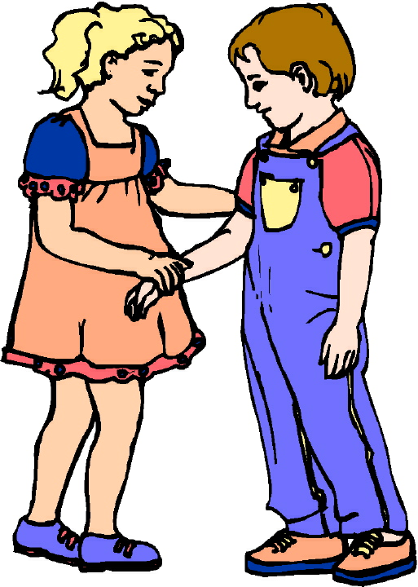
Chapter 2 Vocabulary
ἀδελφός, -οῦ, ὁ
brother

Slide 35
Chapter 2 Vocabulary
ἀκούω
I hear, obey

Slide 36
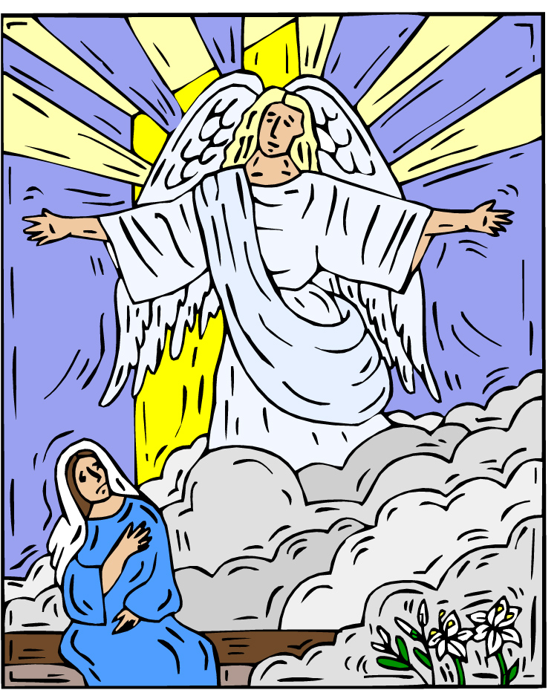
Chapter 2 Vocabulary
δόξα, -ας, ἡ
glory, fame

Slide 37
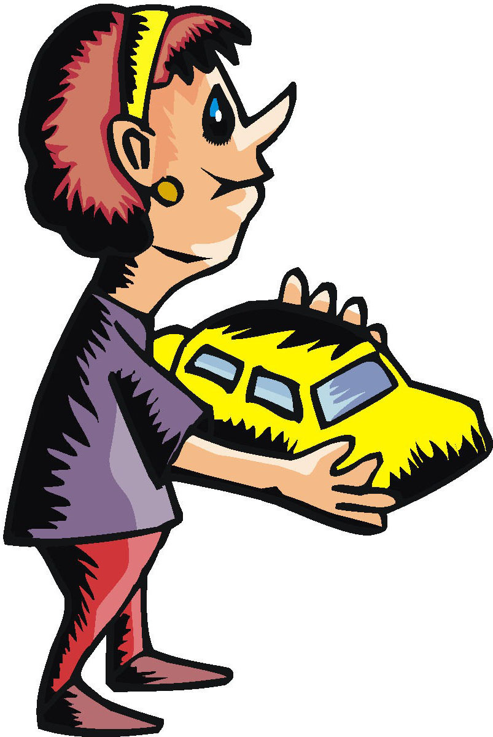
Chapter 2 Vocabulary
ἔχω
I have

Slide 38
Chapter 2 Vocabulary
κόσμος, -ου, ὁ
world

Slide 39
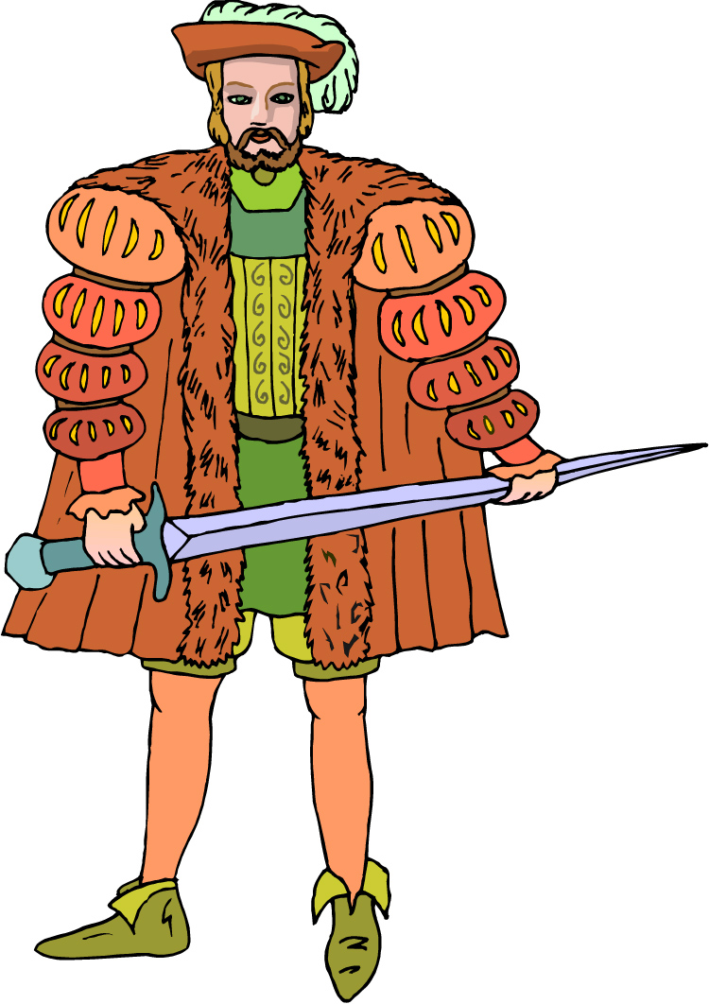
Chapter 2 Vocabulary
κύριος, -ου, ὁ
lord, Lord, sir

Slide 40
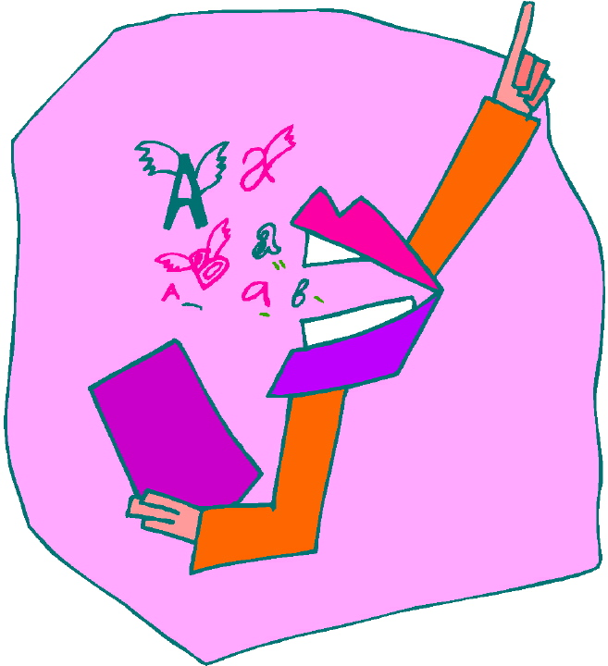
Chapter 2 Vocabulary
λόγος, -ου, ὁ
word

Slide 41
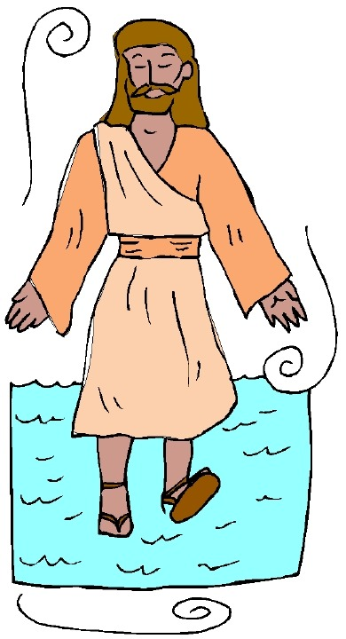
Chapter 2 Vocabulary
Πέτρος, -ου, ὁ
Peter

Slide 42
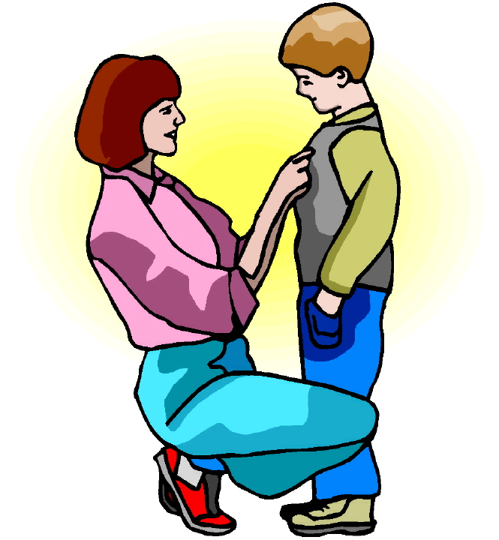
Chapter 2 Vocabulary
υἱός, -οῦ, ὁ
son

Slide 43
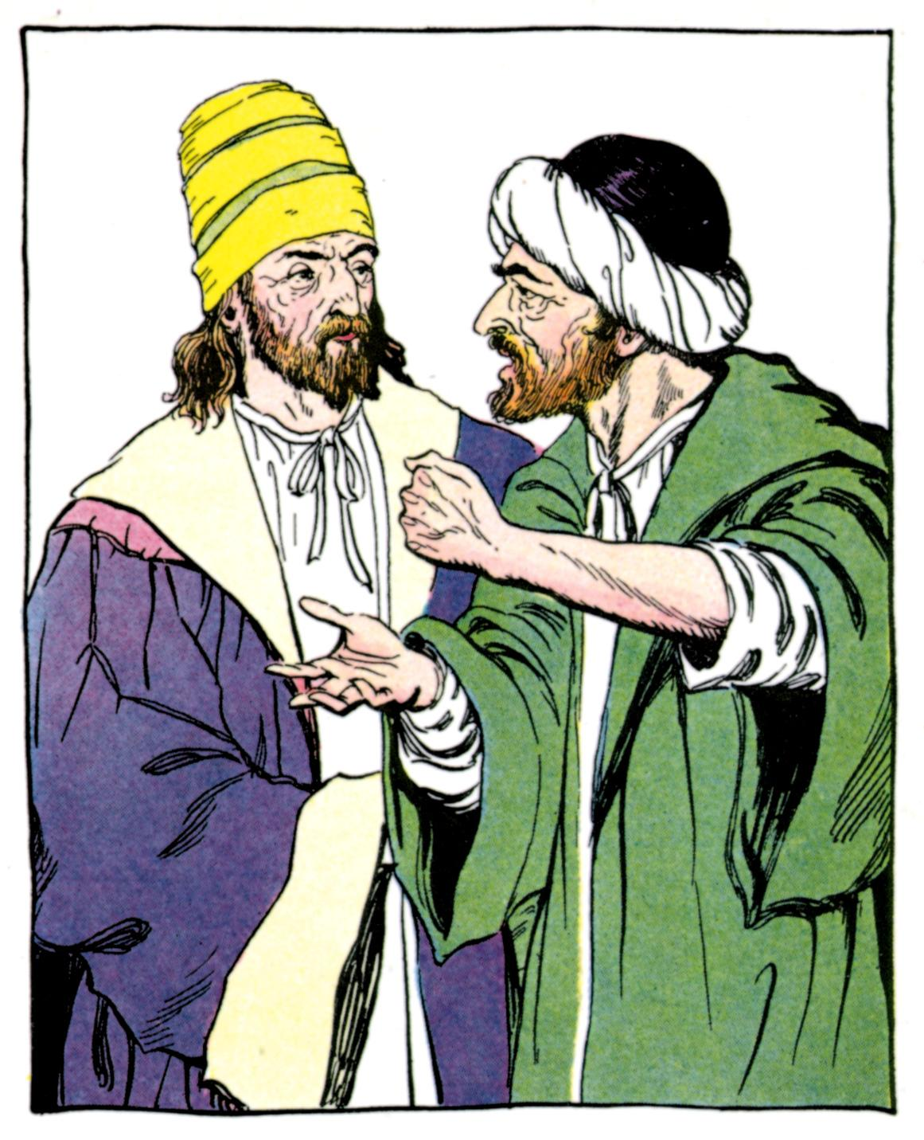
Chapter 2 Vocabulary
Φαρισαῖος, -ου, ὁ
Pharisee

Slide 44
Chapter 2 Vocabulary
ἀδελφός
brother
ἀκούω
I hear, obey
δόξα
glory, fame
ἔχω
I have

Slide 45
Chapter 2 Vocabulary
κόσμος
world
κύριος
Lord, sir
λόγος
word

Slide 46
Chapter 2 Vocabulary
Πέτρος
Peter
υἱός
son
Φαρισαῖος
Pharisee

Slide 47
Chapter 1 Vocabulary
ἄγγελος, -ου, ὁ
angel
ἀμήν
truly, verily
ἄνθρωπος, -ου, ὁ
man, human

Slide 48
Chapter 1 Vocabulary
ἐγώ
I—ego
θεός, -οῦ, ὁ
God
καί
and

Slide 49
Chapter 1 Vocabulary
καρδία, -ας, ἡ
heart
λέγω
I say
προφήτης, -ου, ὁ
prophet
Χριστός, -οῦ, ὁ
Christ, Messiah, anointed one

